Slide 2
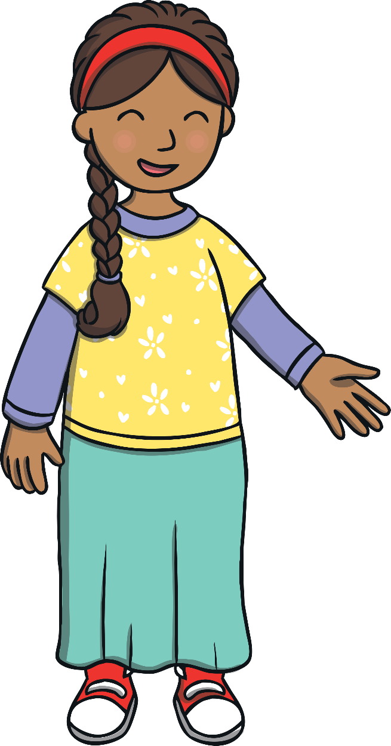
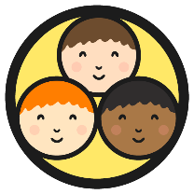
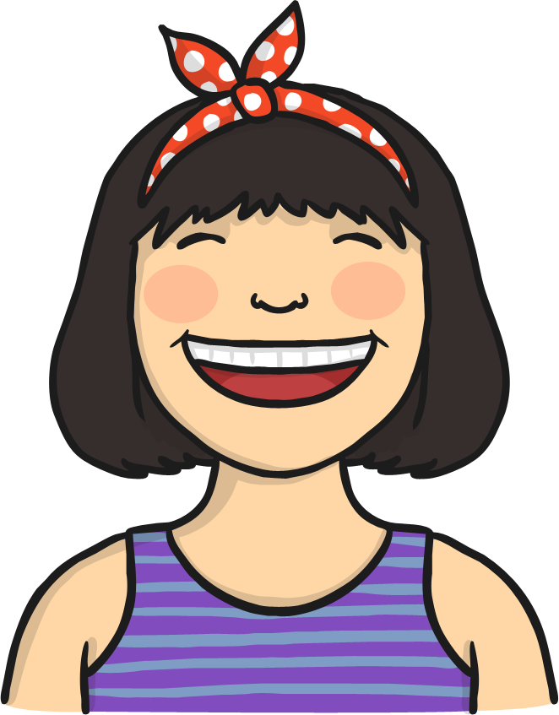
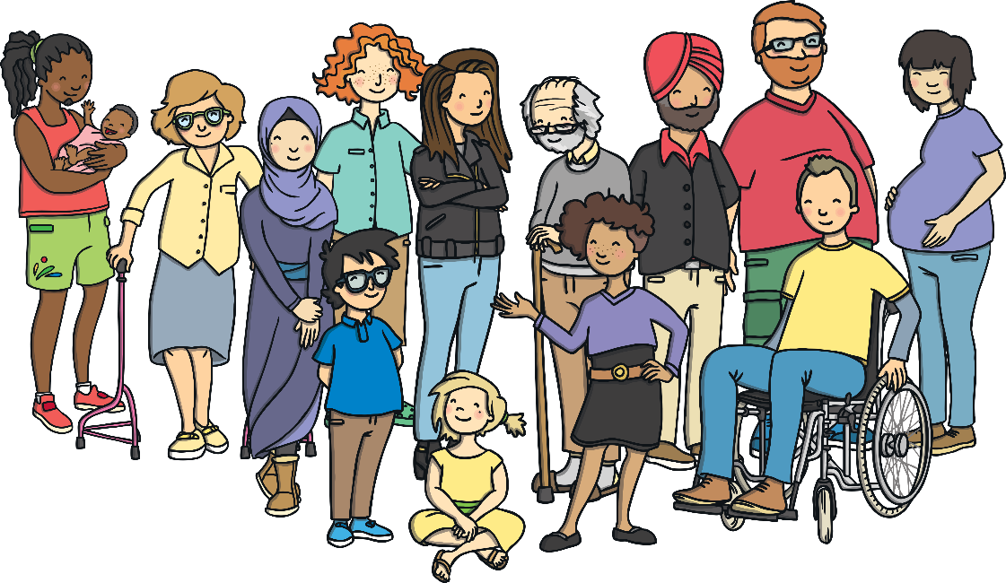
Differences between People
All people have the right to be themselves
People have different beliefs, live in different families, are different ages, come from different places, wear different clothes, have different abilities and interests, look different and do things in different ways.
People can be different from each other for lots of different reasons.

Slide 3
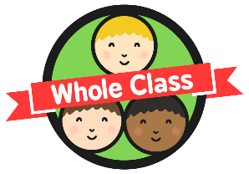

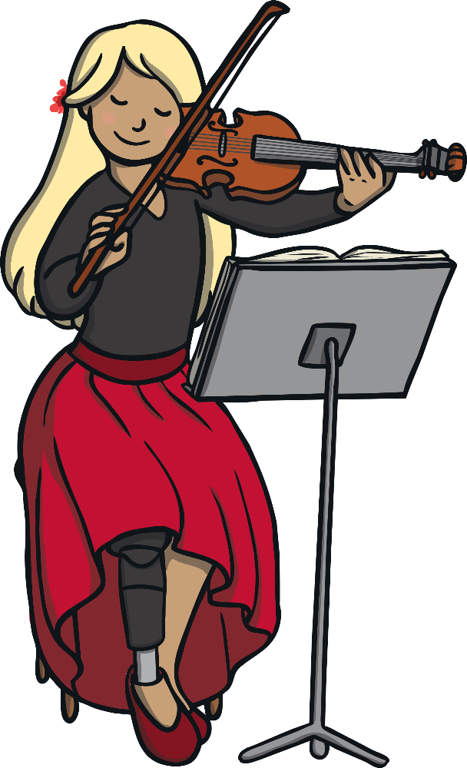
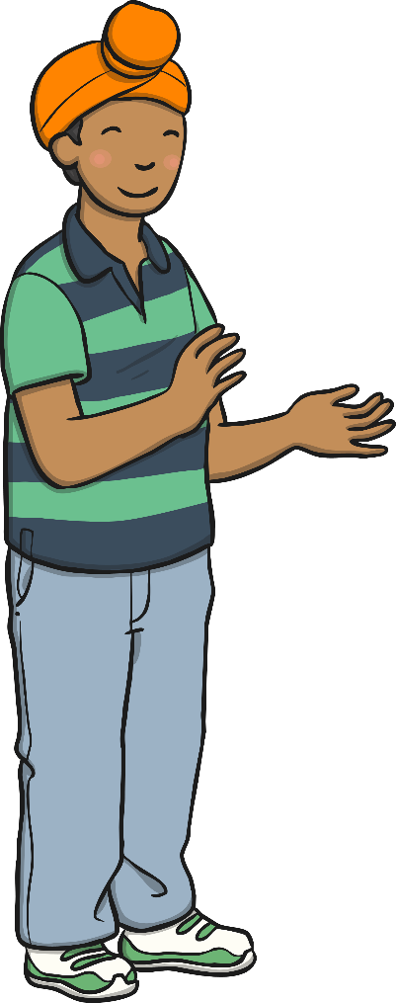
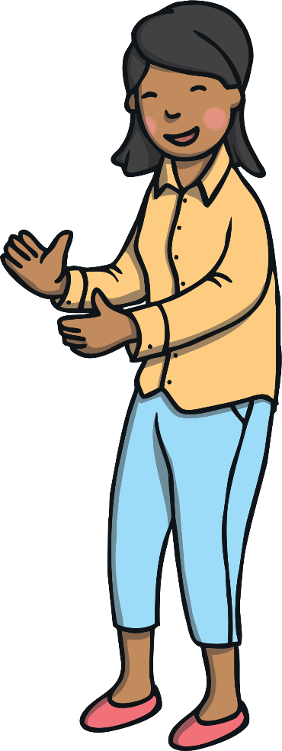
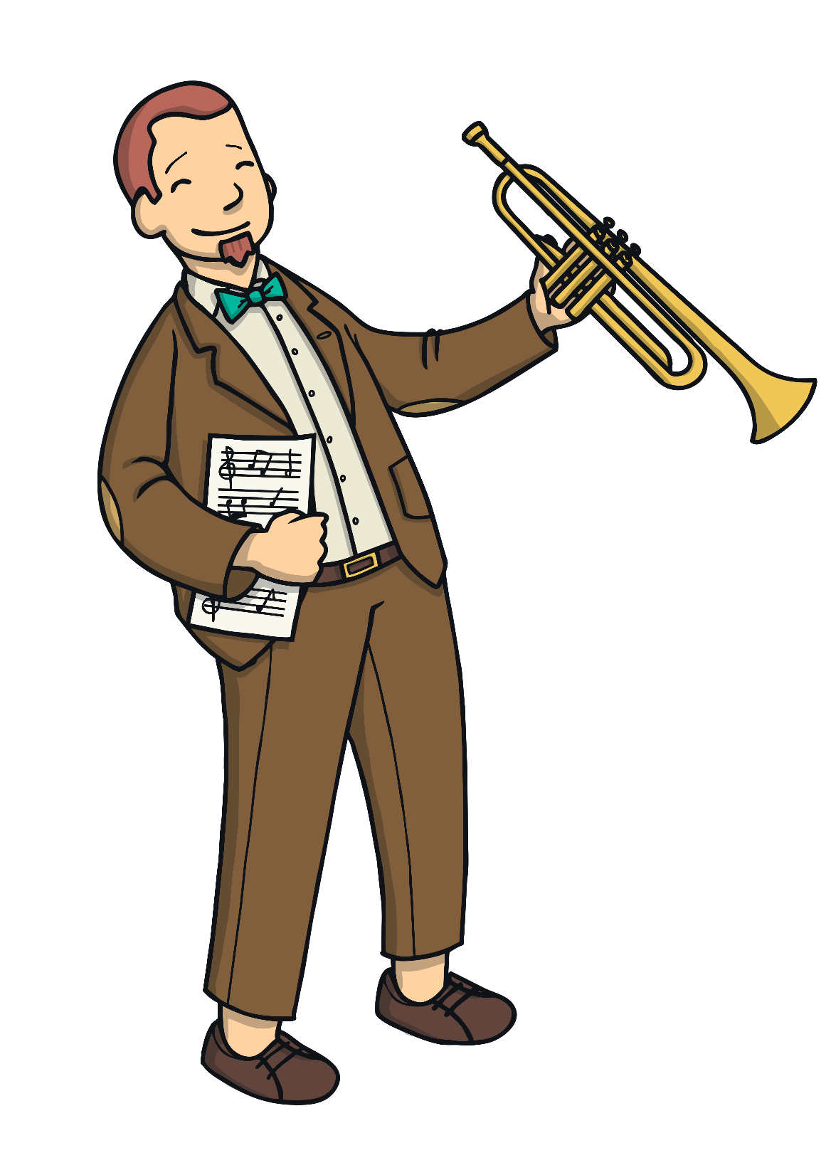
Different but Similar
It is important that we all feel able to be ourselves and it is our right to be who we want to be.
Although we are all wonderfully different, we also all have things in common.
We all have basic needs which need to be met for us to learn and grow healthily. We all need to feel safe and cared for
to live happy and
fulfilling lives – this is
everyone’s right

Slide 4

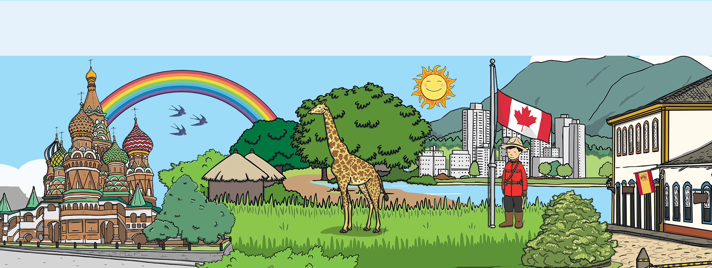
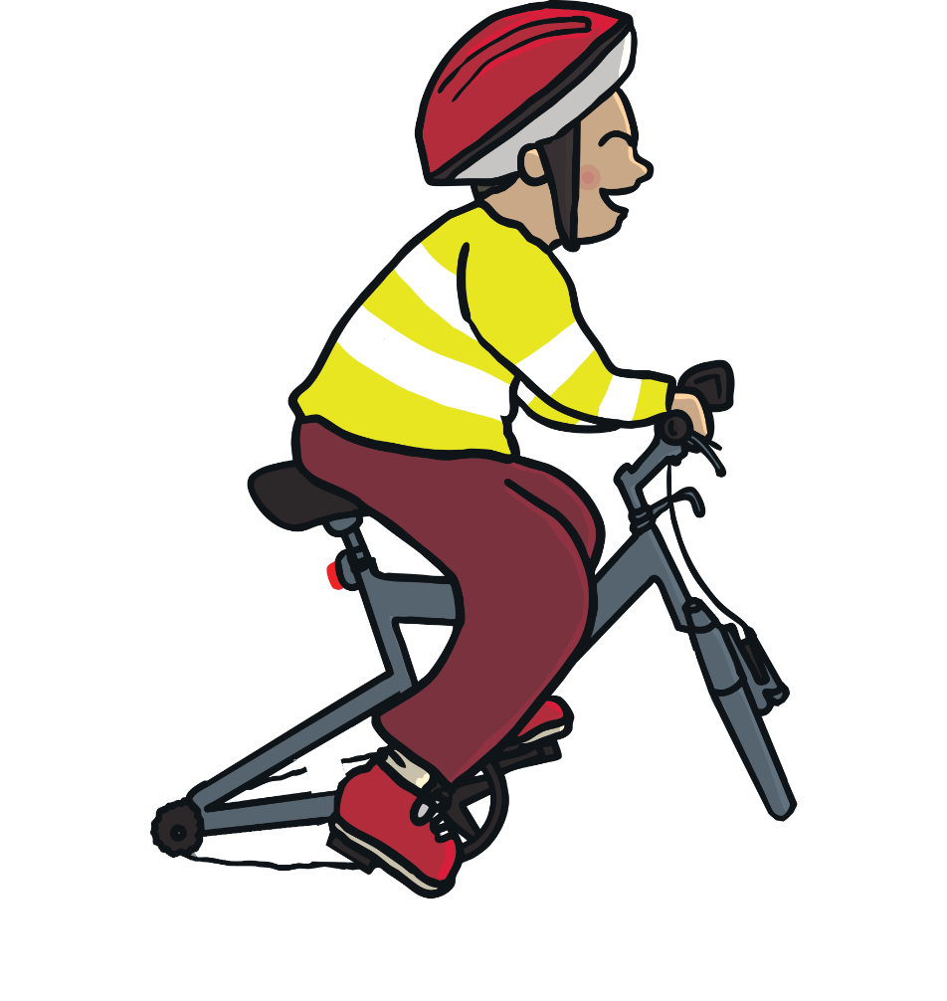

How Should We Behave Towards
People Who Are Different from Us?
All people have the right to be treated with kindness and respect – no matter who they are or where they are from; whether they are similar to us or different from us

Slide 5
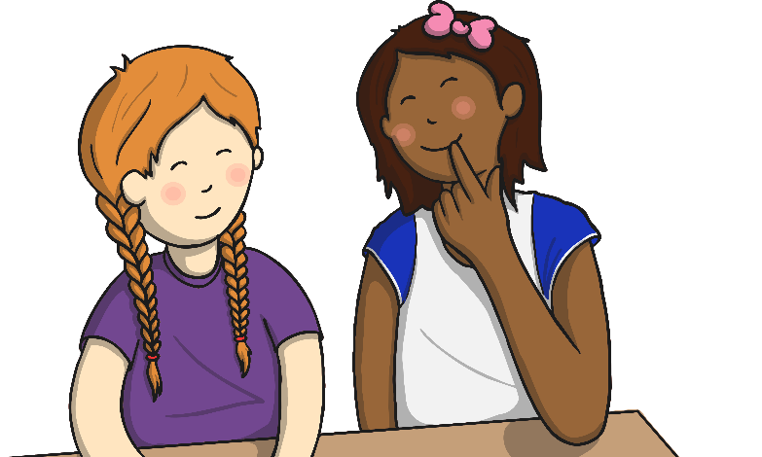
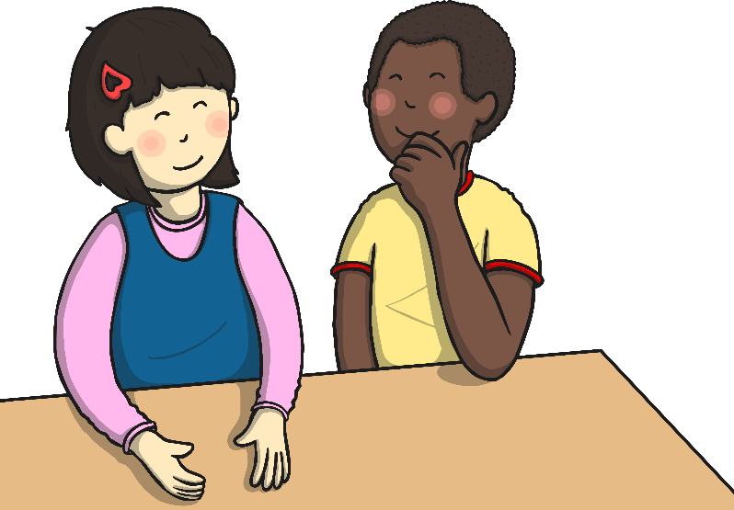
Equality and Equity
What does being fair mean to you?
How many times have you said, “But that’s not fair!”?
When we talk about fairness and giving everyone
the same chance, we often use two words:
equality and equity

Slide 6
Equality and Equity
What is equality?
Equality means that everyone has the same chances or gets the same treatment. Everyone is treated equally.
What is equity?
Equity means that everyone has the same chances - just like equality - but equity also means considering different people’s situations so that they really are treated fairly.

Slide 7
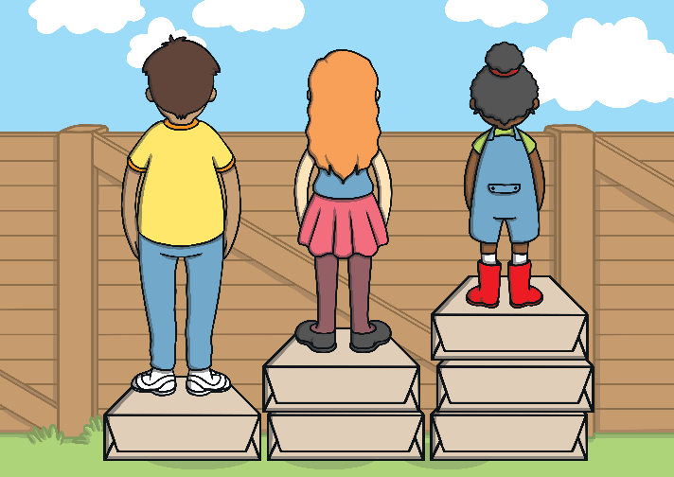
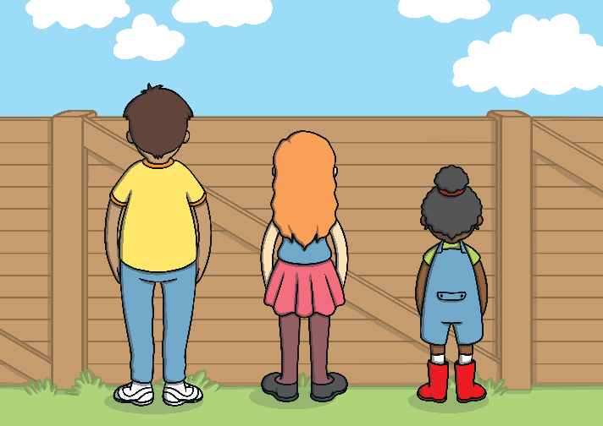
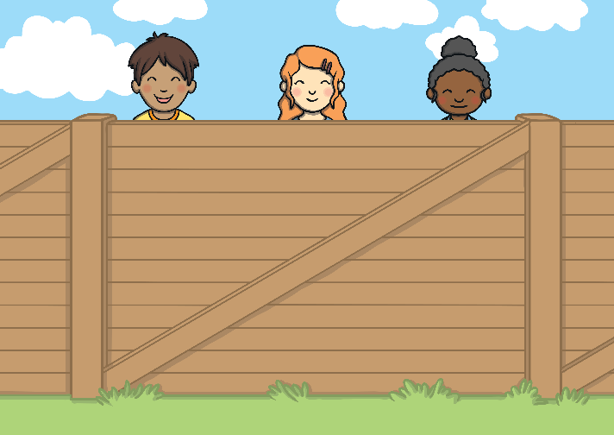
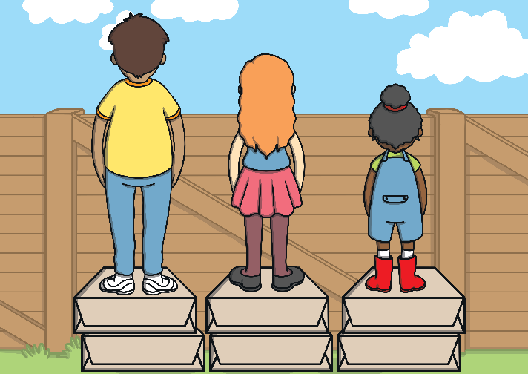
Equality and Equity
Imagine three people of different heights want to watch a game of football.
They are standing behind a fence which blocks their view. To help, they are all given the same size of box to stand on. They are being treated equally. However some of them still can’t see the game!
However, if they are given different sized boxes to stand on to help them all see, they are being treated with equity.

Slide 8
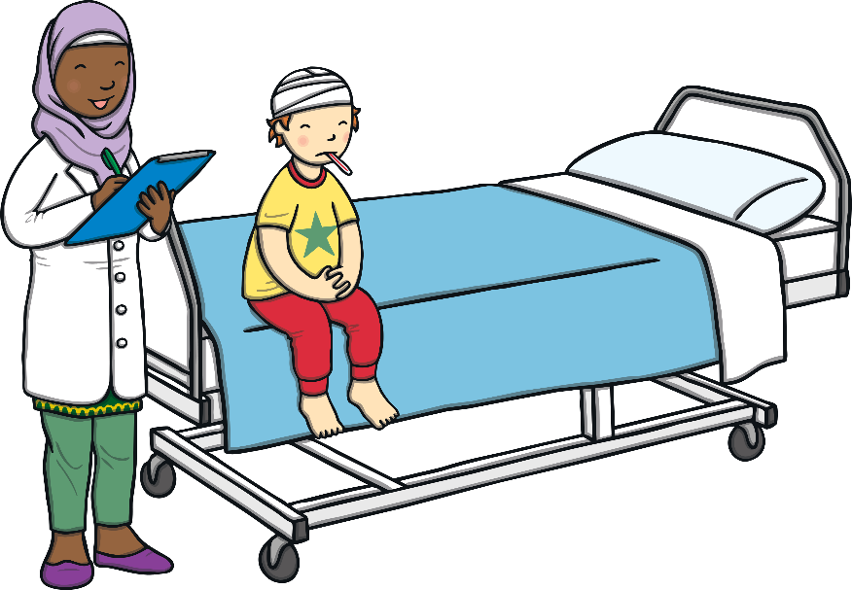
Equality and Equity
Imagine if all the patients who went to see a doctor were given a five-minute appointment then a plaster to make them better.
They would have equal treatment, but it wouldn’t consider all of their illnesses; it wouldn’t give everyone the same chance of getting better.
Even though everyone was treated
with equality they wouldn’t be
treated equitably.

Slide 9
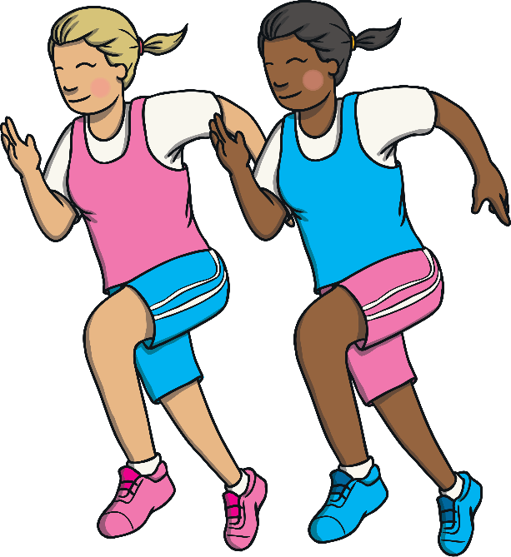
Equality and Equity
In a race on a running track, equality would mean all the runners should start from the same place. That’s fair!
However, runners on the inside lane have a shorter distance round the track than runners in the outside lane.
Being equal sometimes doesn’t give
a fair chance for all.
Equity means changing the starting
position of each runner to make sure
everyone has a fair chance.

Slide 10
Equality and Equity
Remember, equality is when we make sure
that everyone is treated equally.
Being treated equally sometimes doesn’t
make things fair for everyone.
Equity takes into account different people’s
needs so that they can be treated fairly.

Slide 11
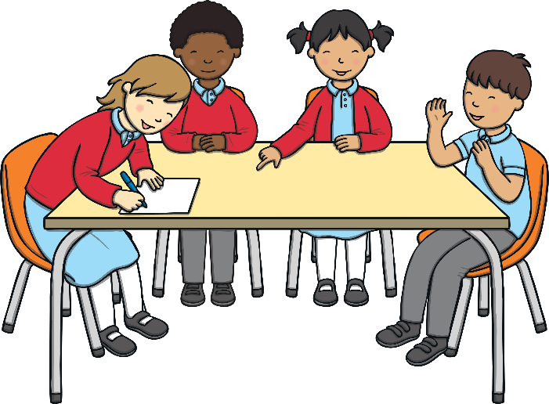
Equality and Equity
Can you think about what equality or equity look like in your school, community or at home?
It might be having an automatic door to your school so that everyone can get in and out of the building more easily.
It might be giving someone extra help in school so that they can achieve success like their class mates.
It might be having a Homework Club in
school so that children who can’t work
at home can still complete their tasks.

Slide 12
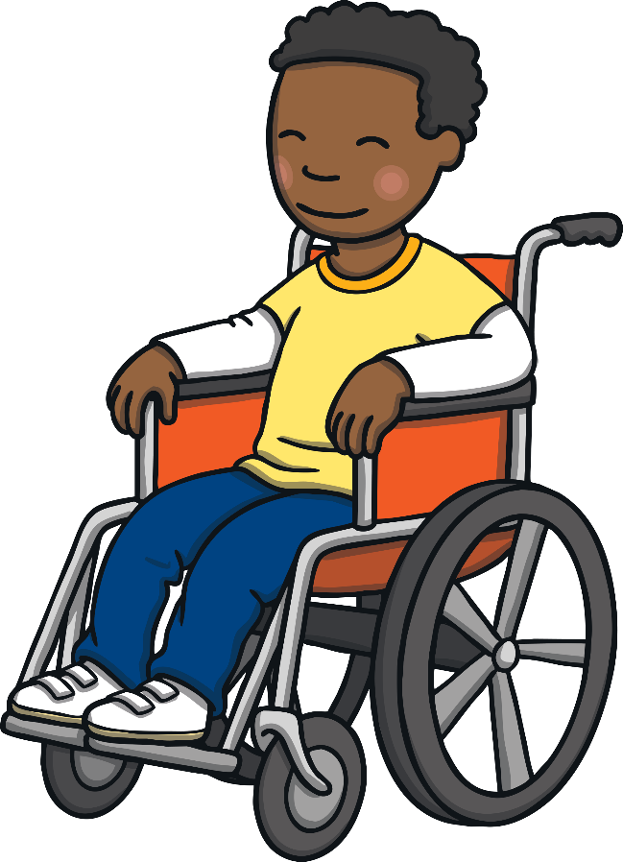
Equality and Equity
It might be adapting a sports activity for younger children
so that they can still score points on Sports Day.
It might be having marked parking spaces
for disabled people so that they can access
shops or services more easily.
Try and think of some other examples.

Slide 13
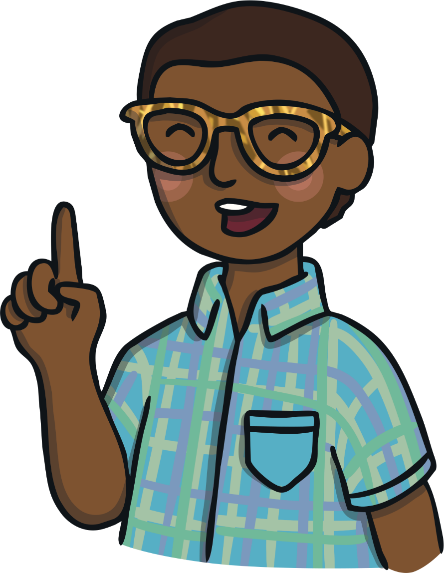
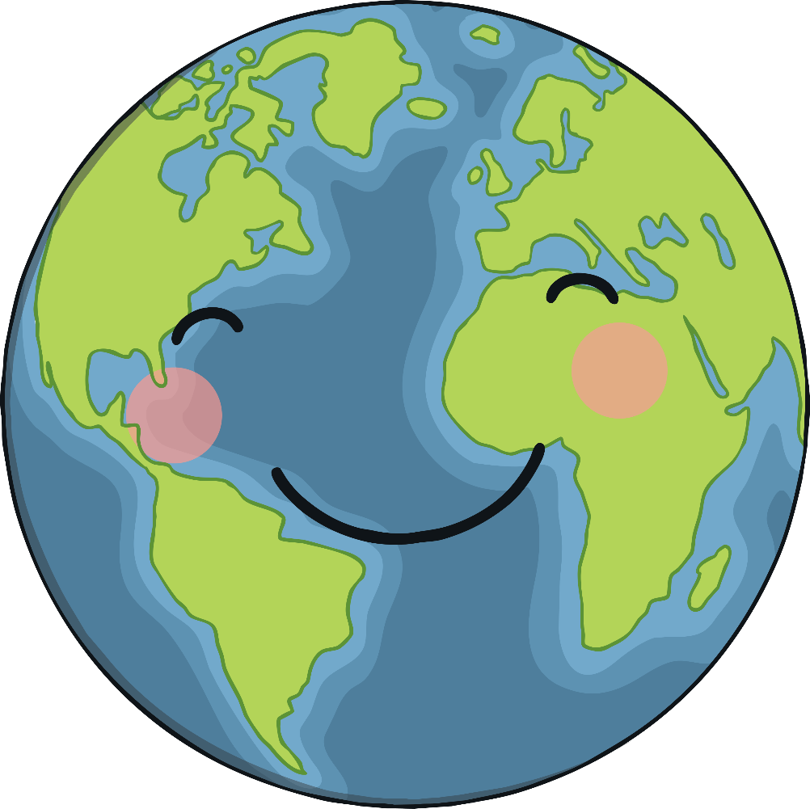
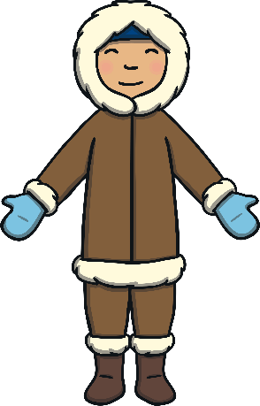
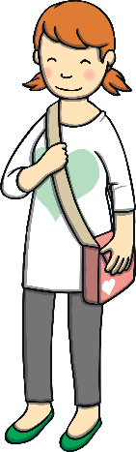
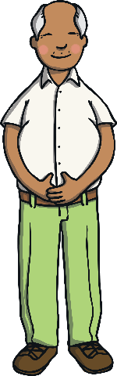
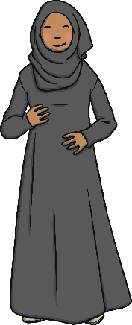
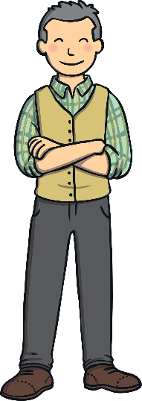
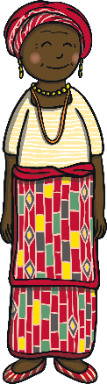
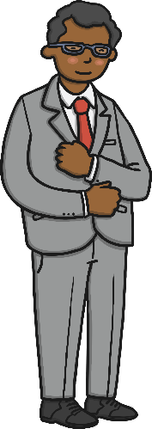
Helpful Hints
It is important to treat all people with kindness and respect and it is important that we are all treated with kindness and respect by others.
Help others to behave kindly towards all people – no matter who they are or where they are from.

Slide 14
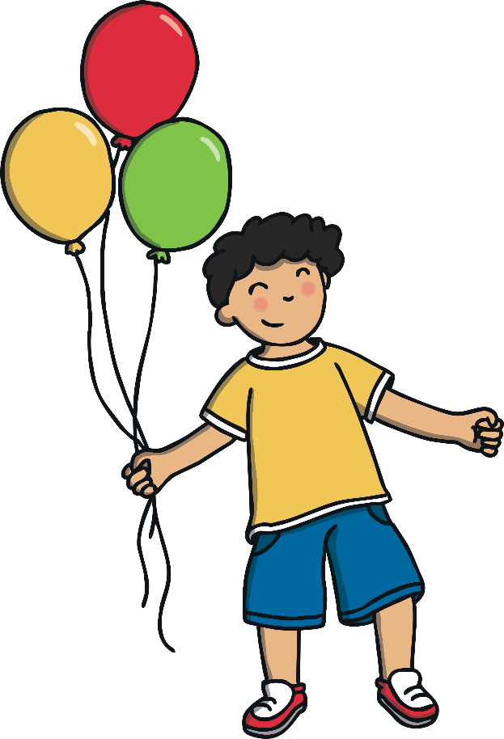

How Should We Behave Towards
People Who Are Different from Us?
No person is more or less important than another. Being kind
and respectful to all people helps us to feel happy and safe.
Reflecting

Slide 15
Dear God,
We can be very quick to make judgements about people which so often prove to be wrong.
Teach us to see the real value in people around us.
Amen.

