Slide 1

Teaching the Equality Act at Botley Primary School

Slide 2
What is the Equality Act?
The Equality Act 2010 states that it is against the law to discriminate against anyone because of:
Age
Disability
Gender reassignment
Marriage or civil partnership
Pregnancy or maternity
Race
Religion or belief
Sex/gender
Sexual orientation
(Government, 2010, p1)

Slide 3
Why are we looking at this now?
The public sector Equality Duty came into force on 5th April 2011 and requires that public bodies (including schools):
Have due regard to the need to eliminate discrimination.
Advance equality of opportunity.
Foster good relations between different people when carrying out their activities.
(Government Equalities Office 2013, p1)
This makes it clear that promoting some of the protected characteristics of the Equality Act while ignoring others is against UK law.
At Botley School we constantly reflect on what we are teaching and promoting in school, highlighting strengths and weaknesses. Recent audits of our teaching of British Values showed that we excel in teaching and building understanding in some areas of the Equality Act, some we do not cover as well as we could and some we do not cover effectively and so do not fully fulfil our duties under the Equality Act.

Slide 4
How are we aiming to improve?
At Botley School we will address this through a project called ‘No Outsiders’.
‘No Outsiders’ aims to develop the ethos of the school into one where every member of the school community, as well as every visitor through our doors, feels welcome and able to be themselves without fear of discrimination.
Through a series of lessons based around common children’s picture books, pupils will be taught the message:
that every individual is equal regardless of their age, gender, race, religion, belief, marital status, transgender identity or sexual orientation.
that each individual should be met with respect and tolerance without discrimination or hatred.

Slide 5
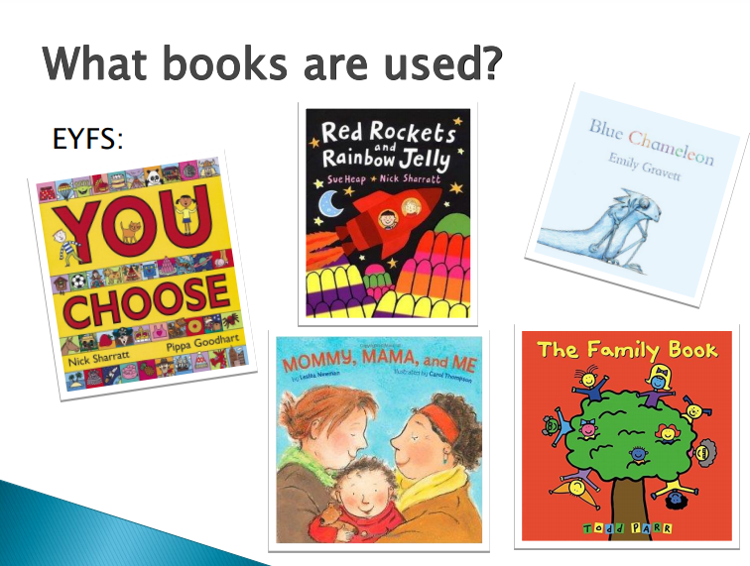

Slide 6
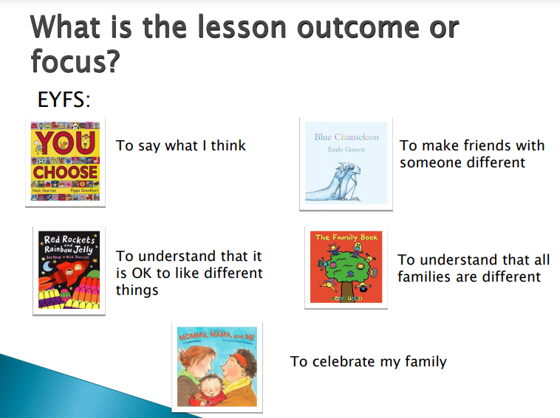

Slide 7
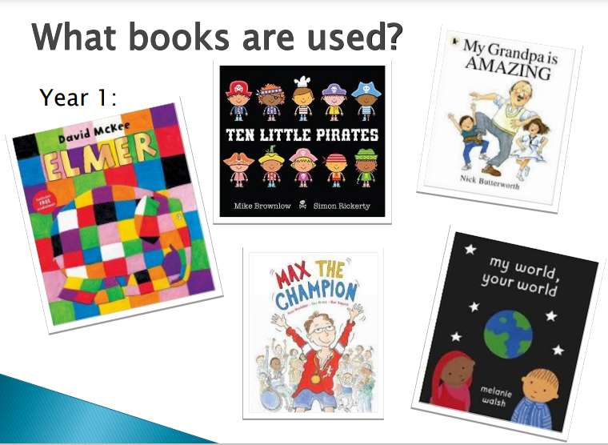

Slide 8
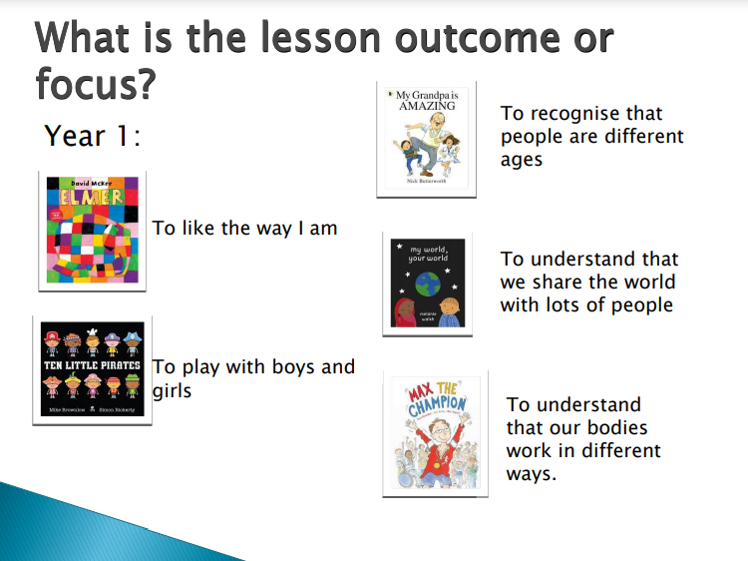

Slide 9
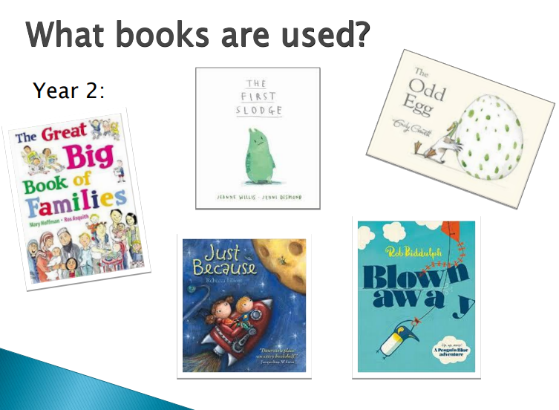

Slide 10
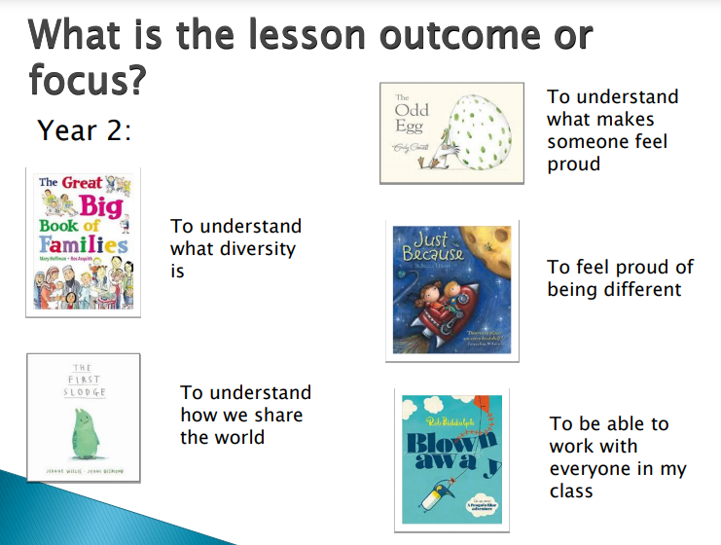

Slide 11
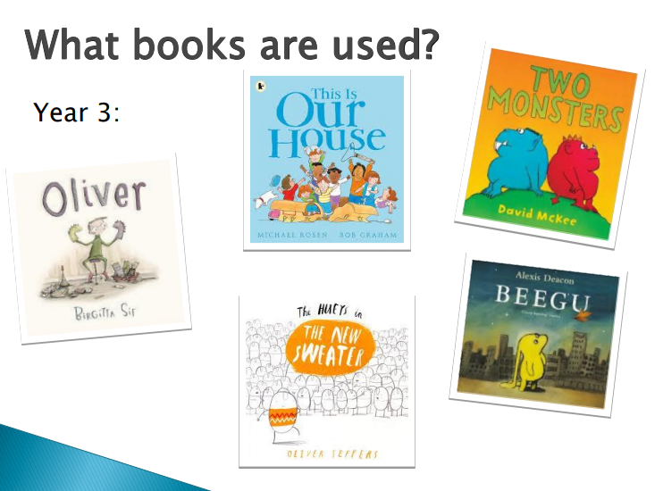

Slide 12
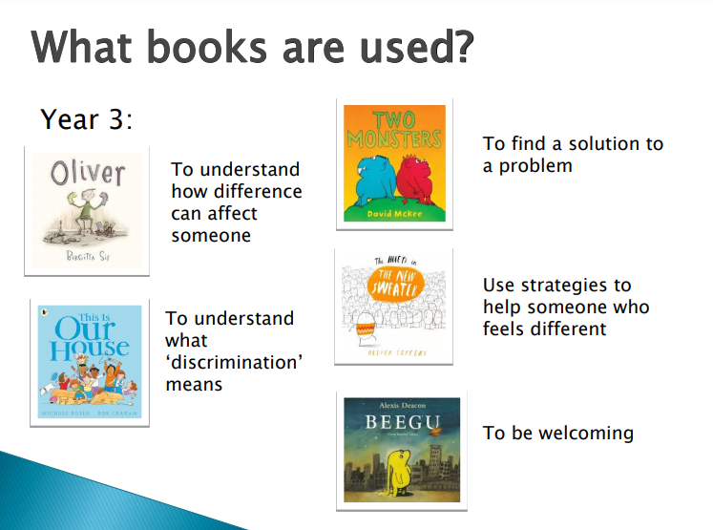

Slide 13
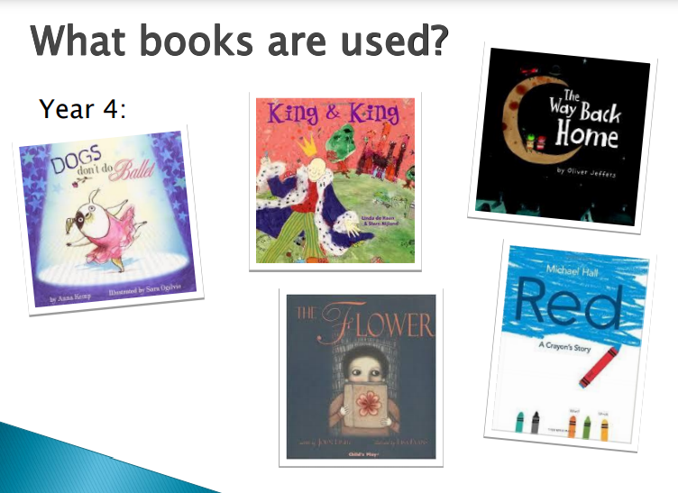

Slide 14
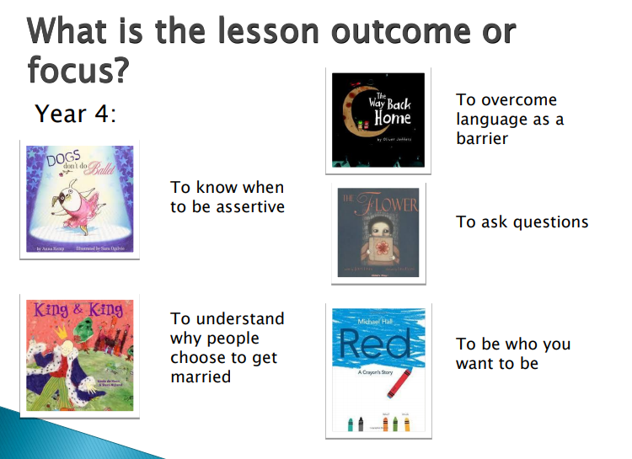

Slide 15
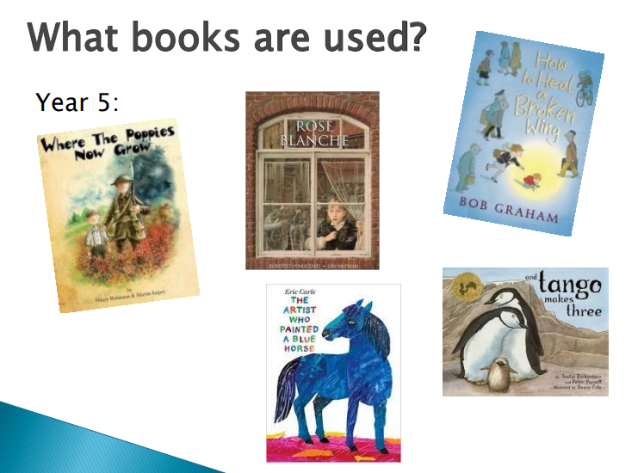

Slide 16
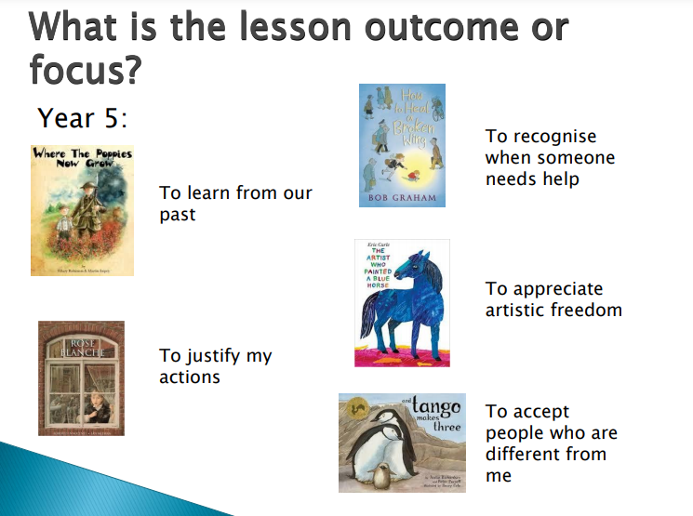

Slide 17
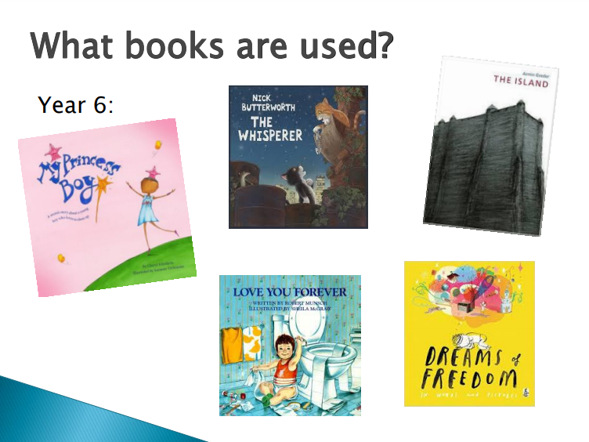

Slide 18
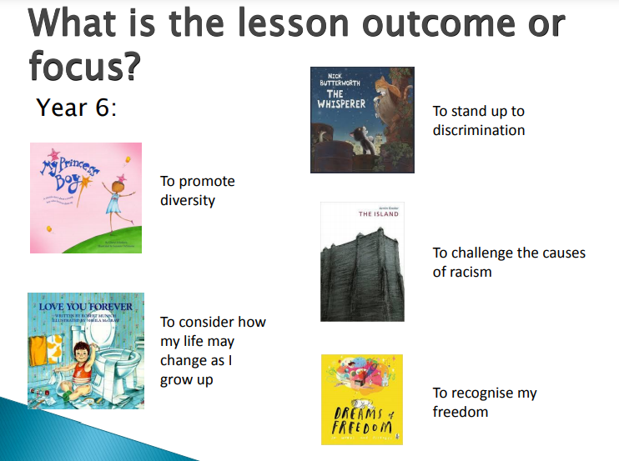

Slide 19
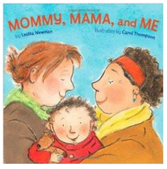
What might a lesson look like in Year R?
Read the book. Discuss what activities from the book the children like doing with their family.
Make a list of activities from the book that the family share. Act them out.
Write a sentence and draw a picture about an activity the children like doing with their family at home.
Look at the faces of the children in the book. How are they feeling?
What is your family good at? Who loves you in your family?

Slide 20

What might a lesson look like in Year 1 or 2?
Read the book. What examples of diversity (difference) are in the book?
Have categories: transport, festivals, homes, religions. Teams of children have to race to think of as many examples as possible to show the diversity within each category.
Around a map of the UK, children write ways in which we are diverse e.g. families, religions, homes, jobs
What would it be like if we were all the same? Why is diversity a good thing?

Slide 21

What might a lesson look like in Year 3 and 4?
Read the story
What does the flower represent? How does the flower change Briggs’ life?
Briggs smuggled a book out of the library . Play a game where one child is a guard and the other children have to sneak a book out of the room without them knowing?
Children complete phrases like ‘The Flower book is labelled dangerous because …….’ and ‘Brigg wants to read the book because…..’
Briggs lives in a world where people are not confident to ask questions. How can we make sure children in our school feel confident to ask questions?

Slide 22

What might a lesson look like in Year 5 and 6?
Read the first part of the story.
Why are the islanders frightened of the new person? How do they show this? How does this make the new person feel?
Read the rest of the story. Do their views change? How and why?
Write a letter to the islanders explaining why it is important to treat people with respect and not judge them on initial impressions and appearance?
What can the story teach us? How can we apply that understanding in our school?

Slide 23
Will these lessons prompt my child to ask challenging questions?
Possibly, your child or children trust you and will be likely to ask you questions to test your beliefs and opinions.
Please don’t avoid them, talk openly about diversity and equality.
Teaching about diversity and equality is teaching about:
Difference
Acceptance
Tolerance
Diversity
How to challenge discrimination
Teaching about equality helps our children to prepare for the next stages in their lives.

Slide 24
Tackling prejudicial language…
Every child and adult in our school community has the right to be protected from prejudicial views and behaviours. Prejudicial language or behaviour can be words or acts based on preconceived opinion. They are not based on reason or actual experience, for example, not liking someone based on their skin colour or sexual identity.
Within our school we will not tolerate any prejudicial language or behaviour aimed at students or adults.
We want everyone at Botley School to feel welcome. We want there to be no outsiders.

Slide 25
Addressing difficult questions…
If you are able to, it may help to rehearse how you want to handle a difficult conversation. In that way you are prepared and unflustered.
Keep the message simple, e.g. ‘We are all different and that is ok’, ‘We can all be friends’, or ‘We like different things and that is ok’.
Make simple analogies around liking some things the same and some things differently from others in your family.

Slide 26
I have some further questions…..
If you have any further questions, please talk to your child’s class teacher initially.
You can also talk to Miss Sambles (Deputy Head) to seek further clarification on how the No Outsiders lessons will be used in school.

