Slide 1
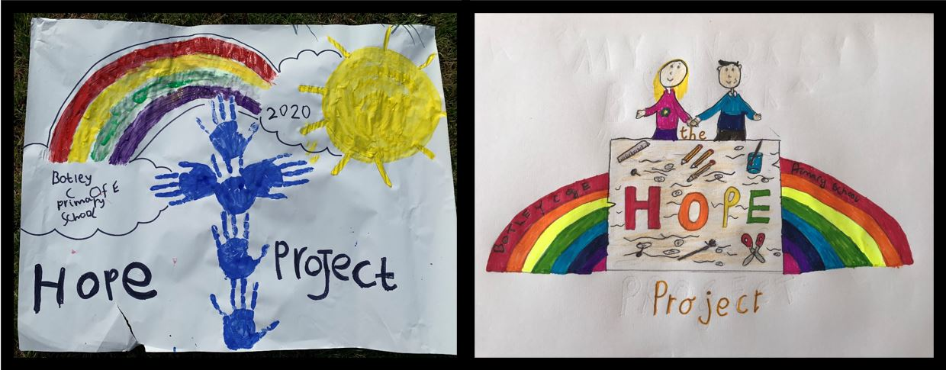
The Botley School Hope Project!

Slide 2
Could you be one of our new Botley Primary school
C H A M P S?
C OMPASSION
H OPE
A ND
M INDFULLNESS
P ROJECT
S TEWARDS

Slide 3
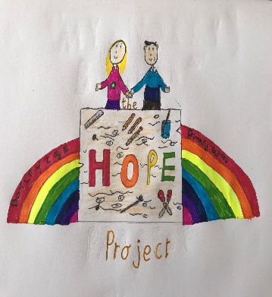
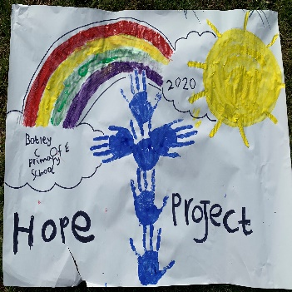
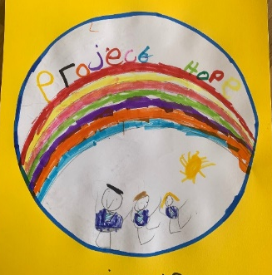
What is the role of a Champ?
COMPASSION
HOPE
AND
MINDFULLNESS
PROJECT
STEWARD
There will be 2 champs from each Bubble (1 per class)
Help to check when Hope Project challenges have been completed
Presenting the Award badges.
To earn a badge, you need to show that you have completed 2 Hope Project challenges.
There are 12 badges to collect!
Botley C of E Primary School
Hope Project Award 1
Botley C of E Primary School
Hope Project Award 2
Botley C of E Primary School
Hope Project Award 3

Slide 4
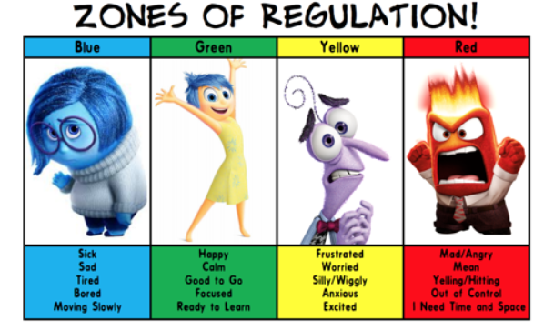
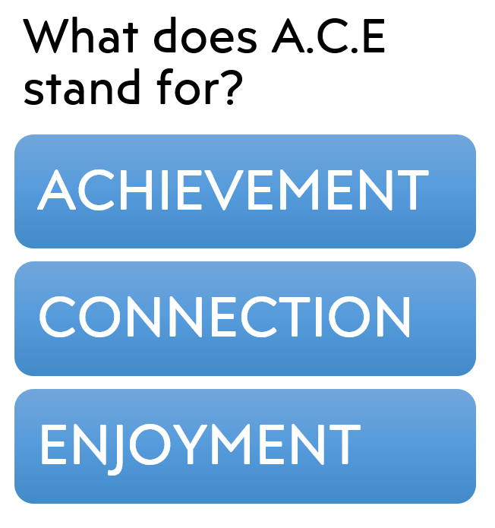
Week 1- Challenge

Slide 5
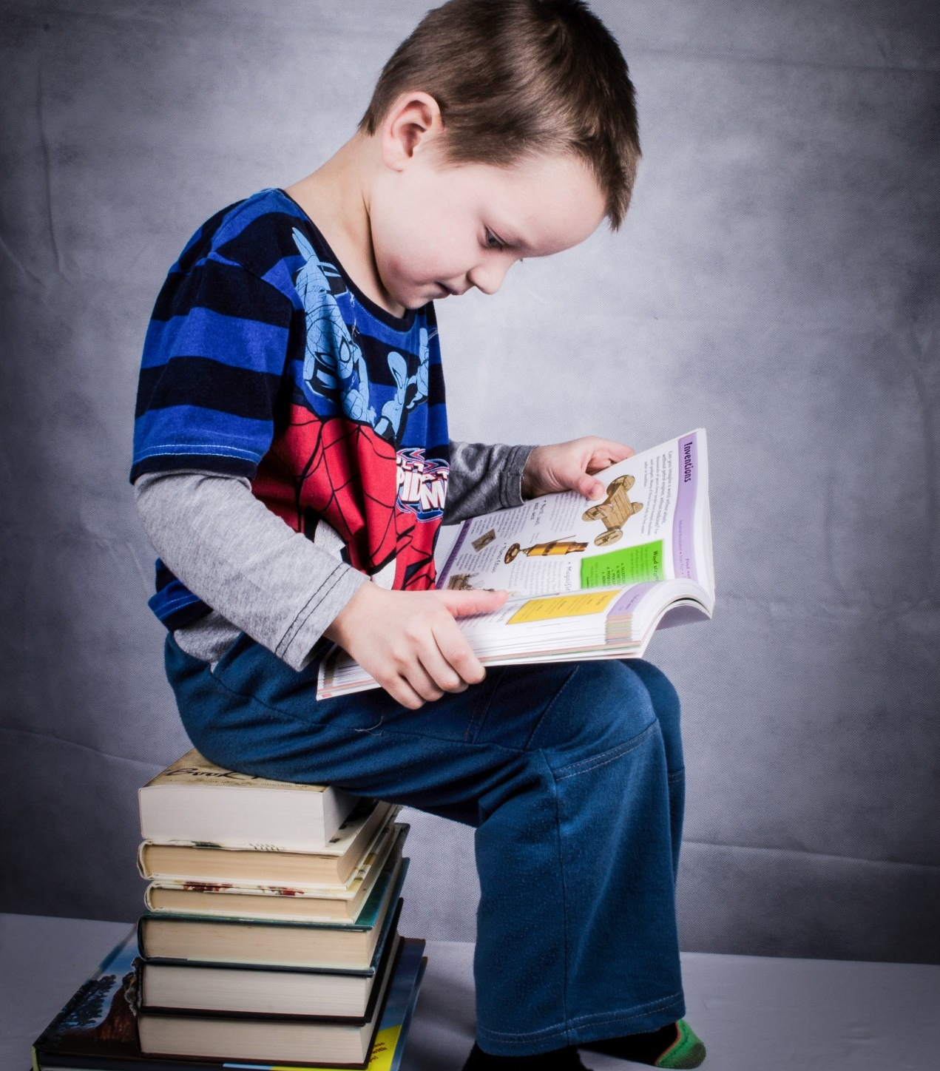
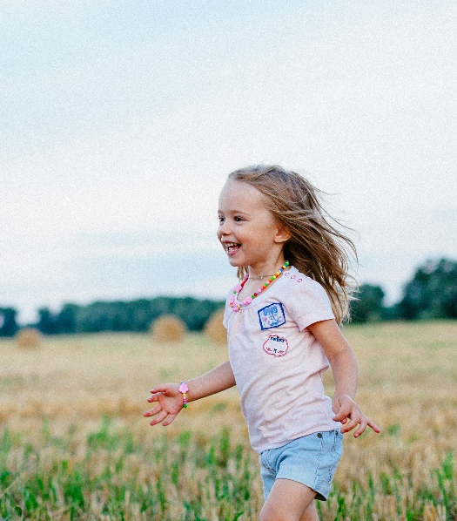
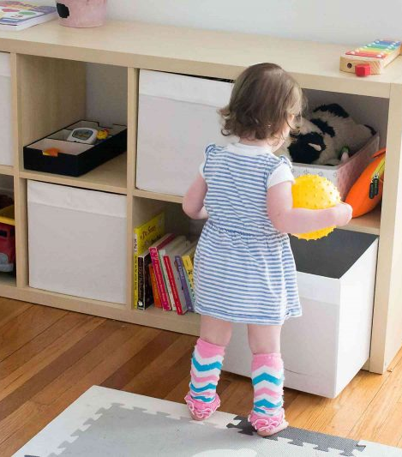
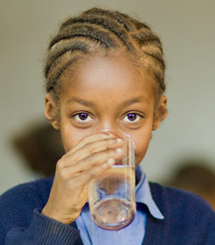
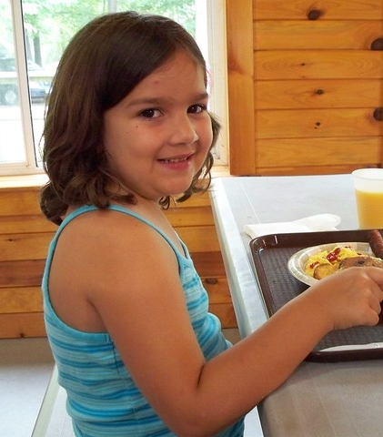
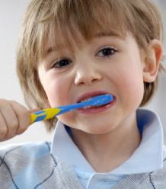

ACHIEVE
Achievement means to succeed at something.
What are the children in these pictures achieving?

Slide 6
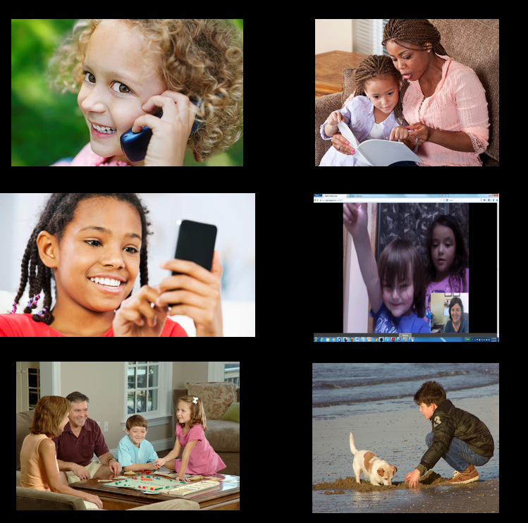
CONNECT
We are social beings.
Making connections with others is important!

Slide 7
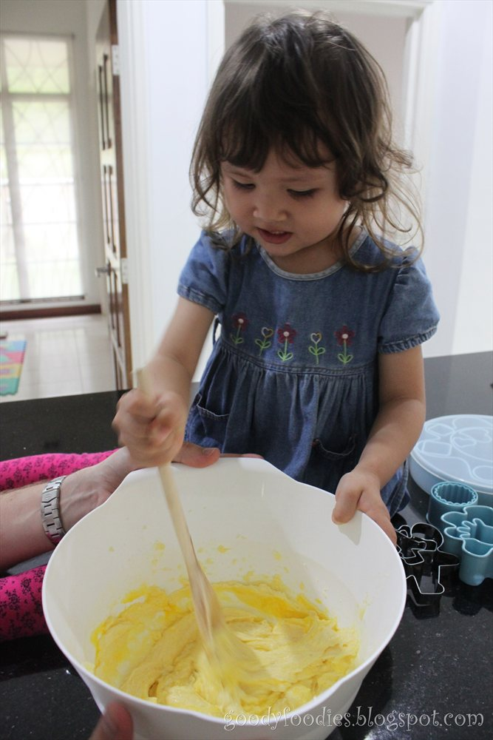
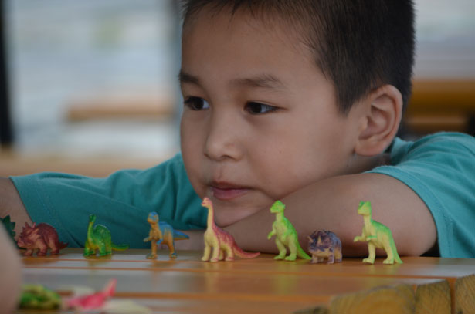
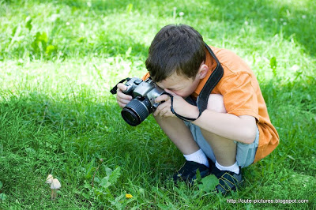

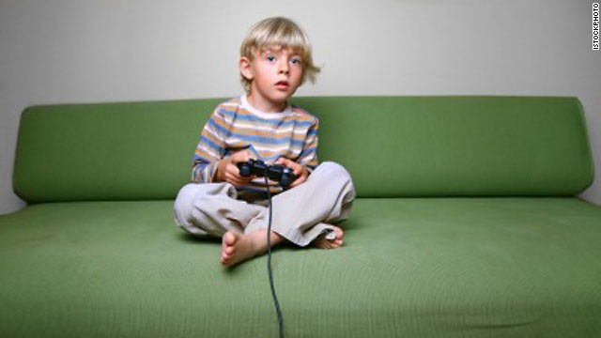
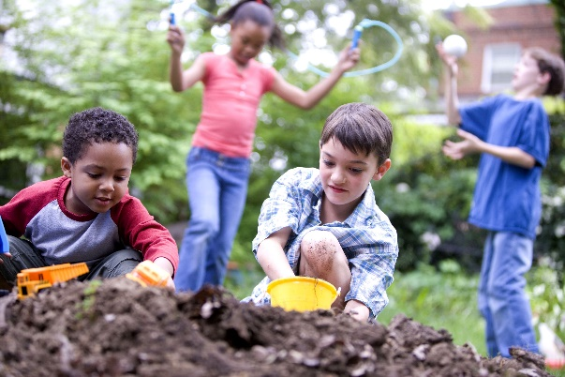
ENJOY
To enjoy means to do something that you love. What do you love to do?
What are your favourite things to do?

Slide 8
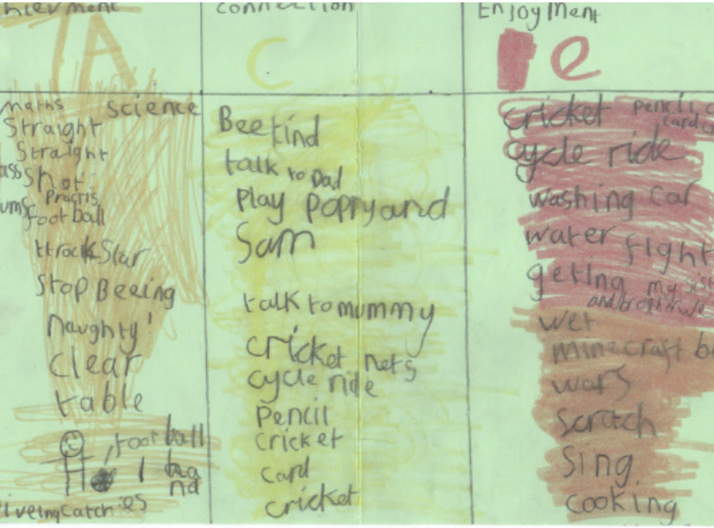
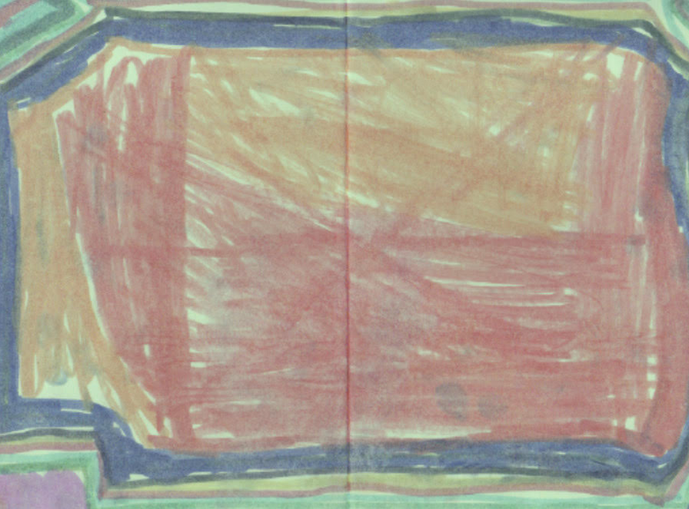
Can you make you’re A.C.E card as colourful as this?

Slide 9
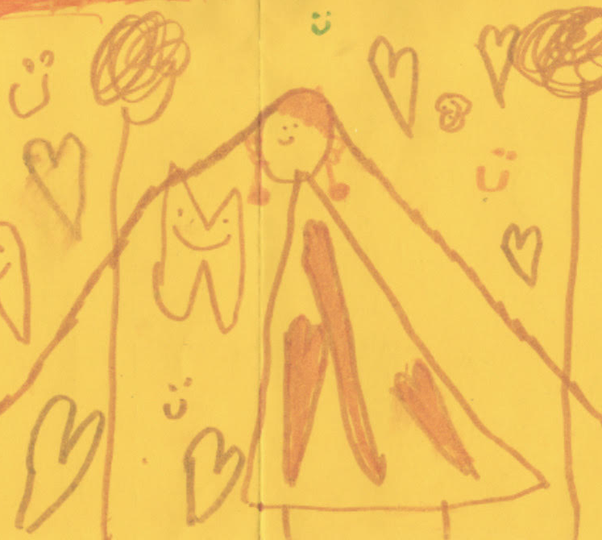
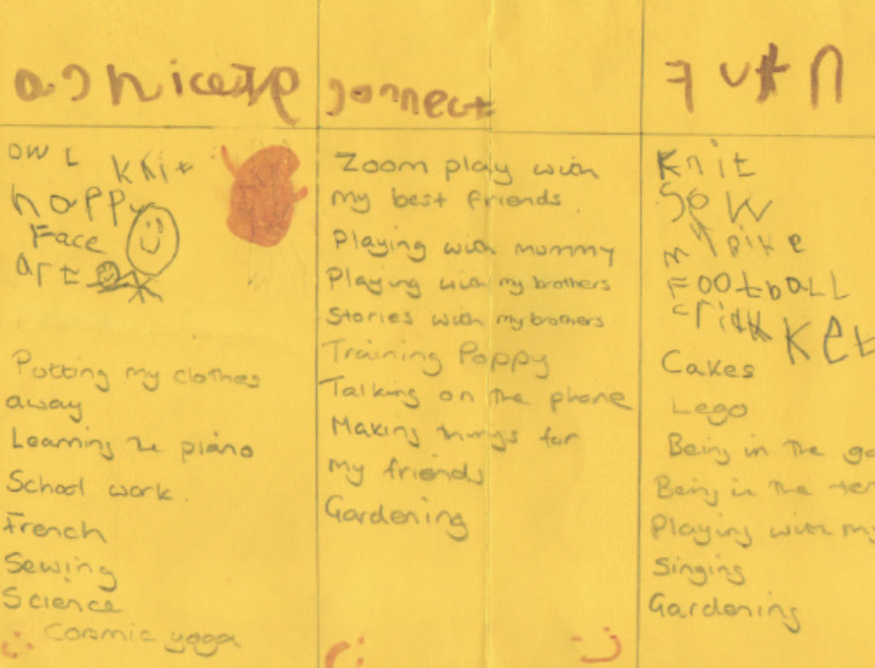

Look at how this A.C.E card has been decorated? How do you feel when you look at it?
How does this child like to connect with others?

Slide 10
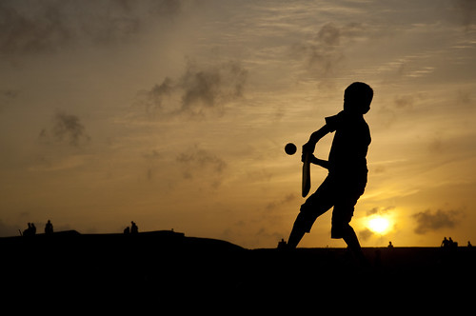

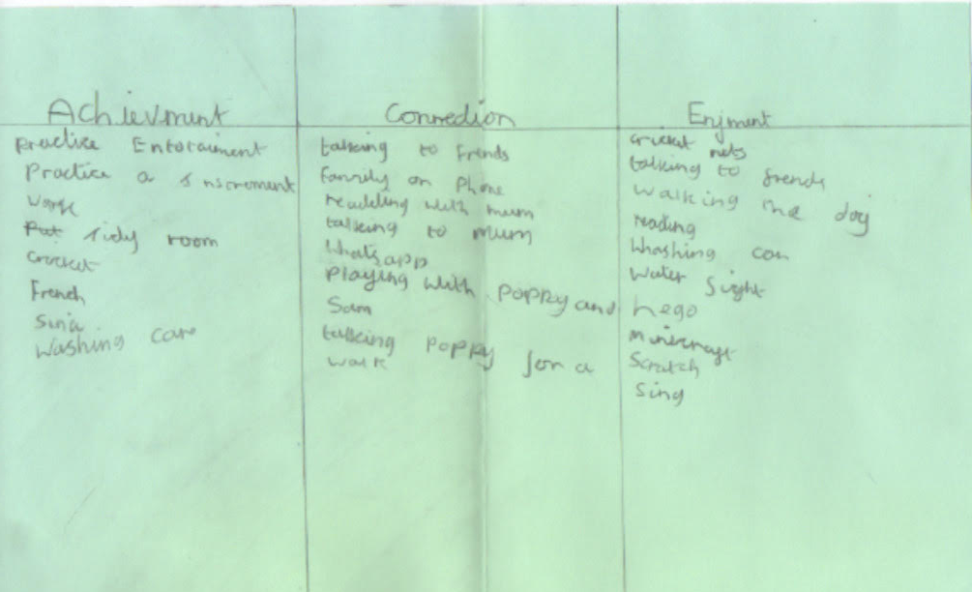
Look at how intricate this
front cover is!
What does this child enjoy?
Do you have anything in
common?

Slide 11
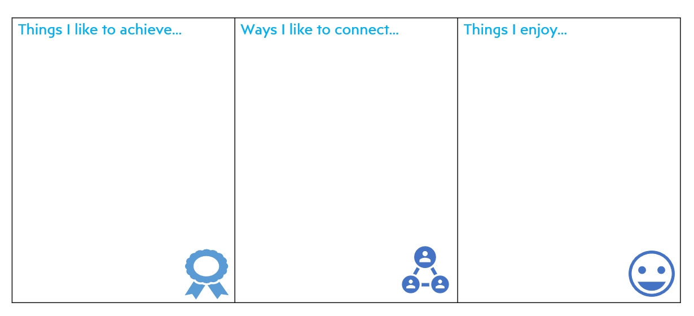
You can make your own ACE plan!

