Slide 1
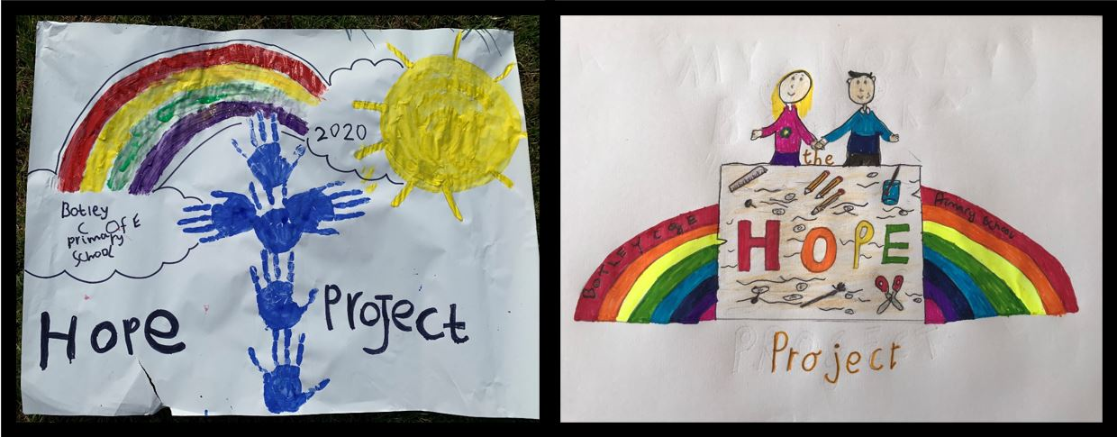
The Botley School Hope Project!

Slide 2
Who are our new Botley Primary school
C H A M P S?
C OMPASSION
H OPE
A ND
M INDFULLNESS
P ROJECT
S TEWARDS

Slide 3
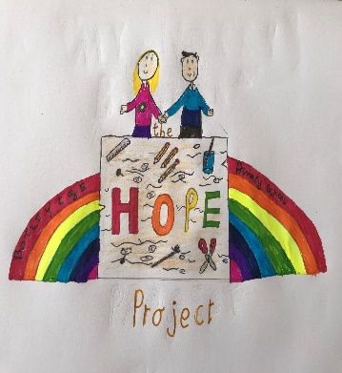
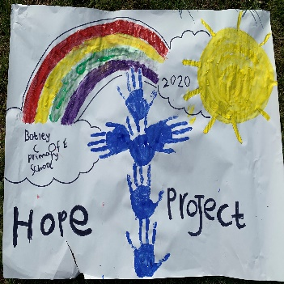
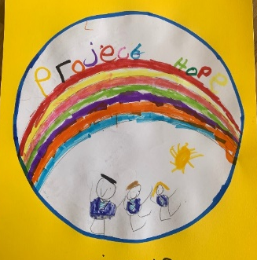
Congratulations to those who took part in our first week’s challenge!
COMPASSION
HOPE
AND
MINDFULLNESS
PROJECT
STEWARD
You are on your way to your first badge!
Remember, to earn a badge, you need to show that you have completed 2 Hope Project challenges.
There are 12 badges to collect!
Botley C of E Primary School
Hope Project Award 1
Botley C of E Primary School
Hope Project Award 2
Botley C of E Primary School
Hope Project Award 3

Slide 4
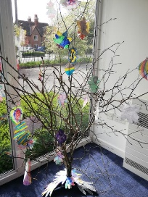
Week 2- Challenge
We are going to recreate our Gratitude Tree.
This time it will be using one of our trees on the outside of the school - that way our whole community will be able to enjoy it.

Slide 5
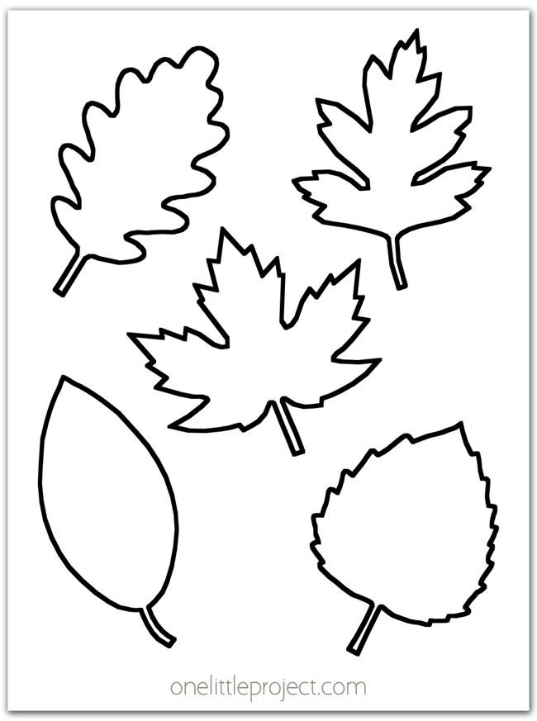
What are you grateful for?
This week, we would like you to think about the things that you are grateful for at this time.
Create a leaf for our Gratitude tree.
Make it as colourful as you like.
Write what you are grateful for onto
your leaf.
Send them to Miss Mac in Ladybirds class.

Slide 6
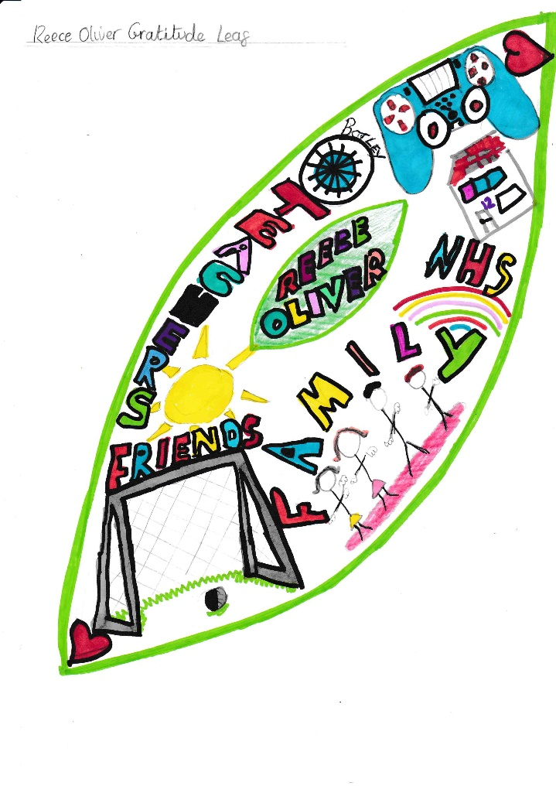
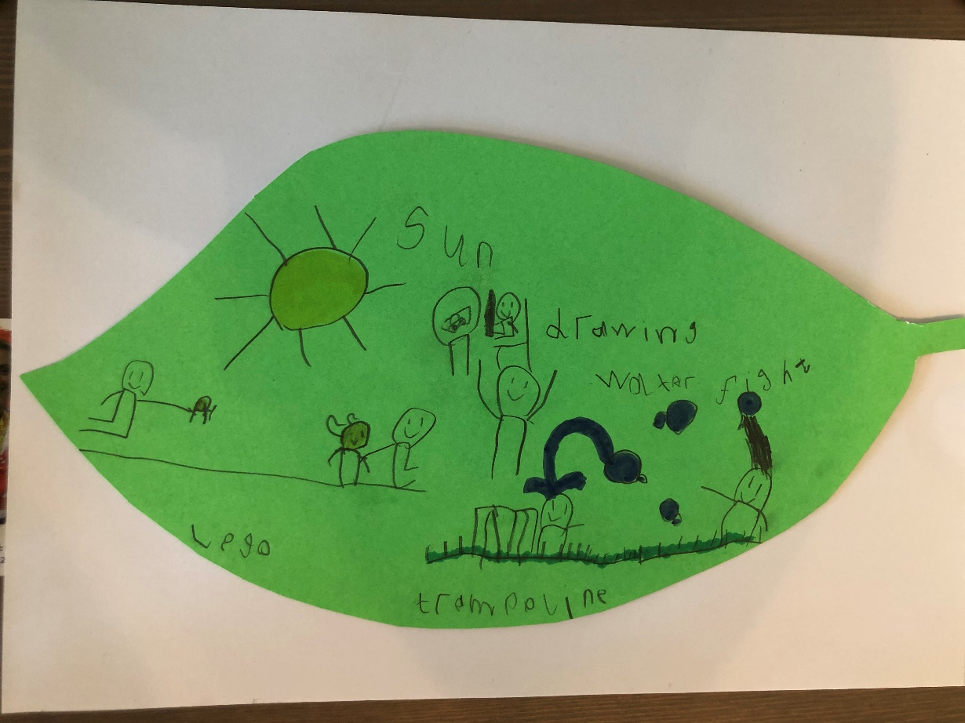
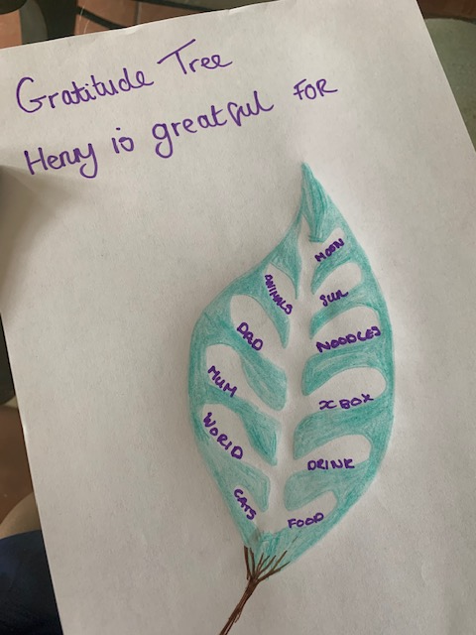
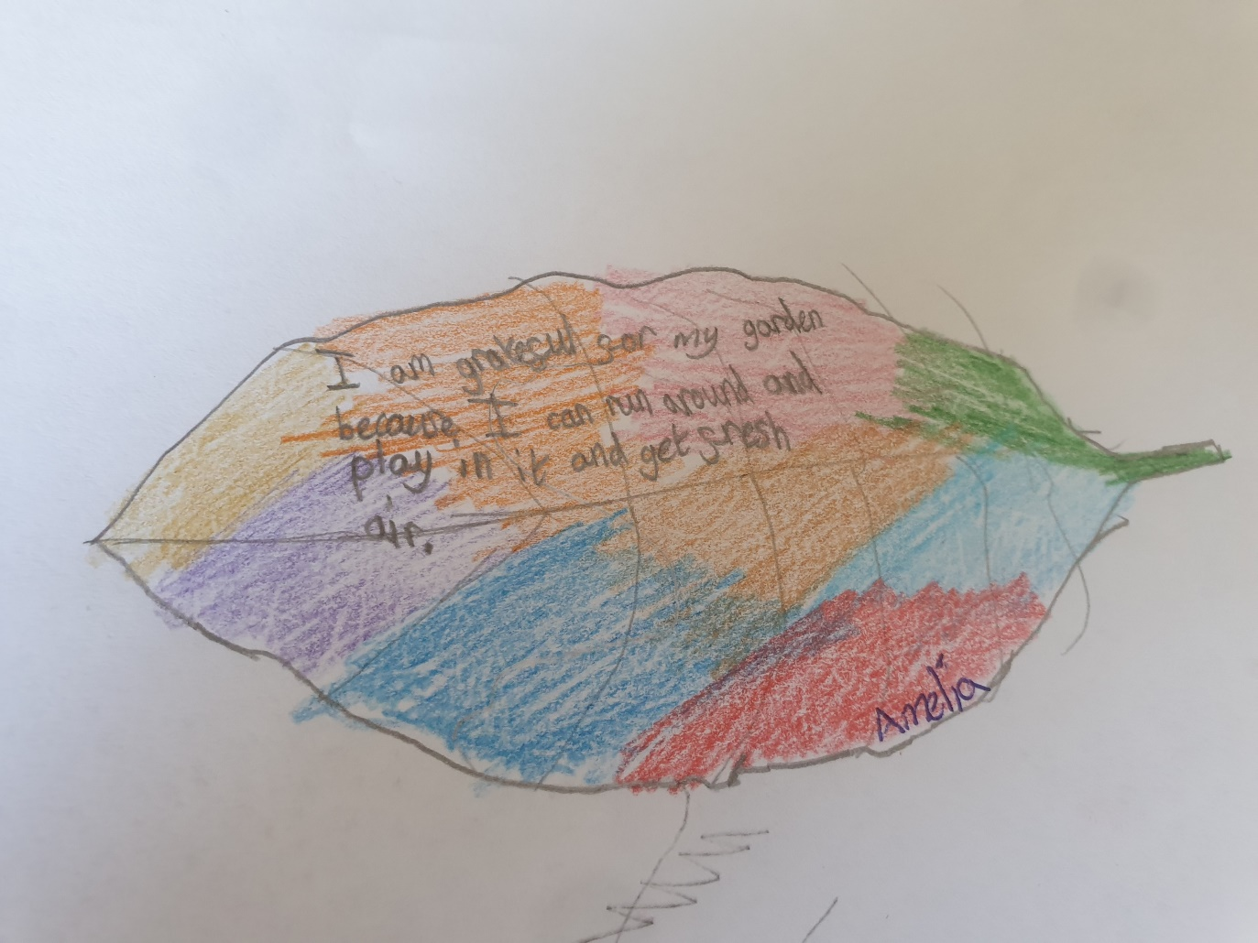
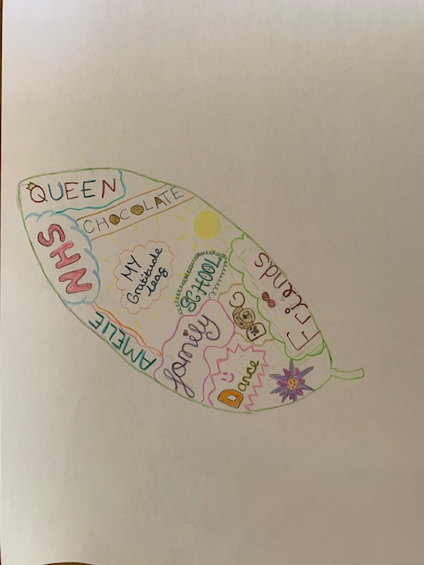
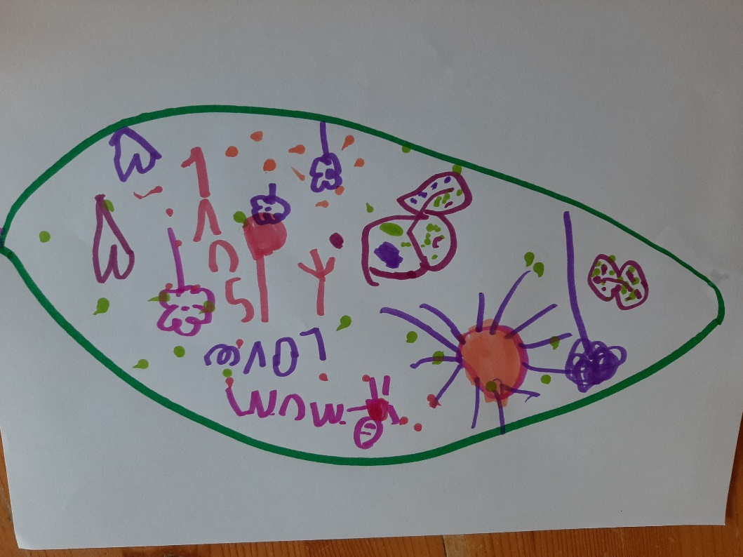
Look at these lovely examples

