Slide 1
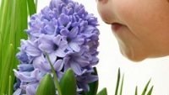
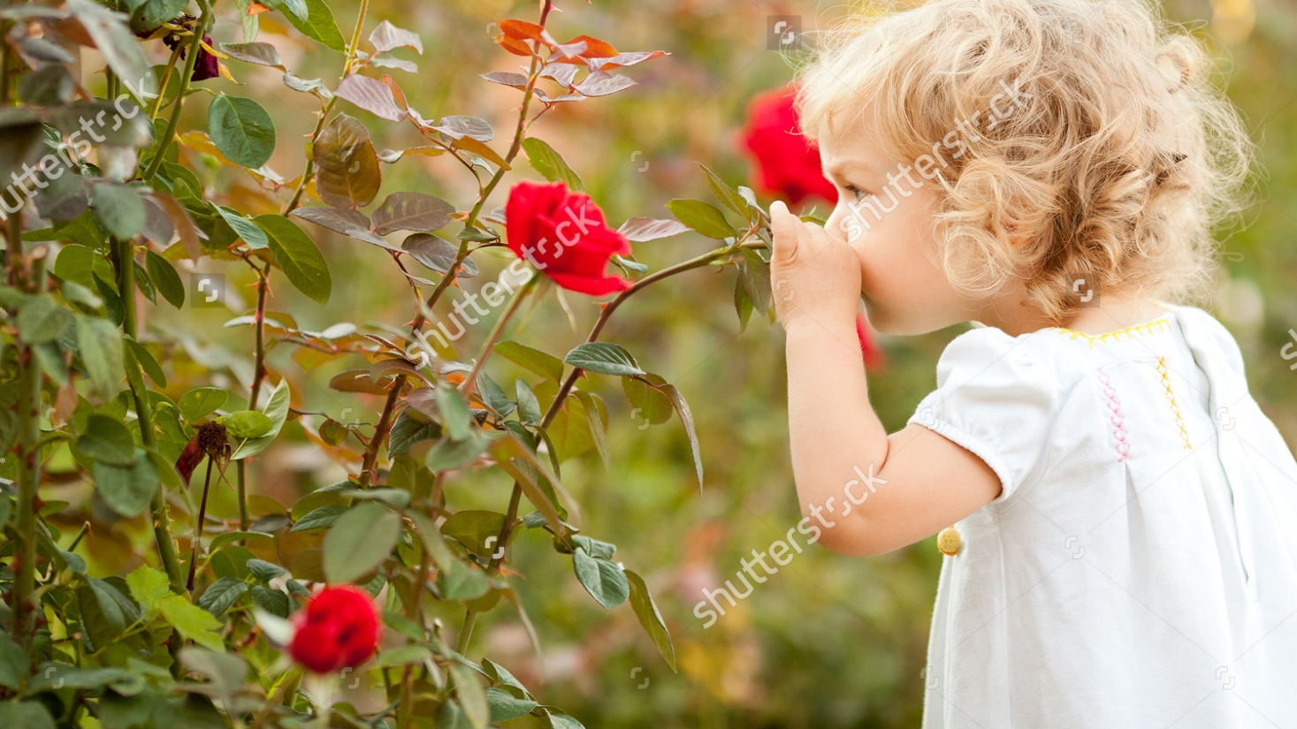
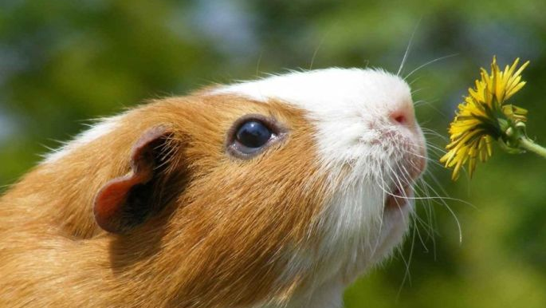
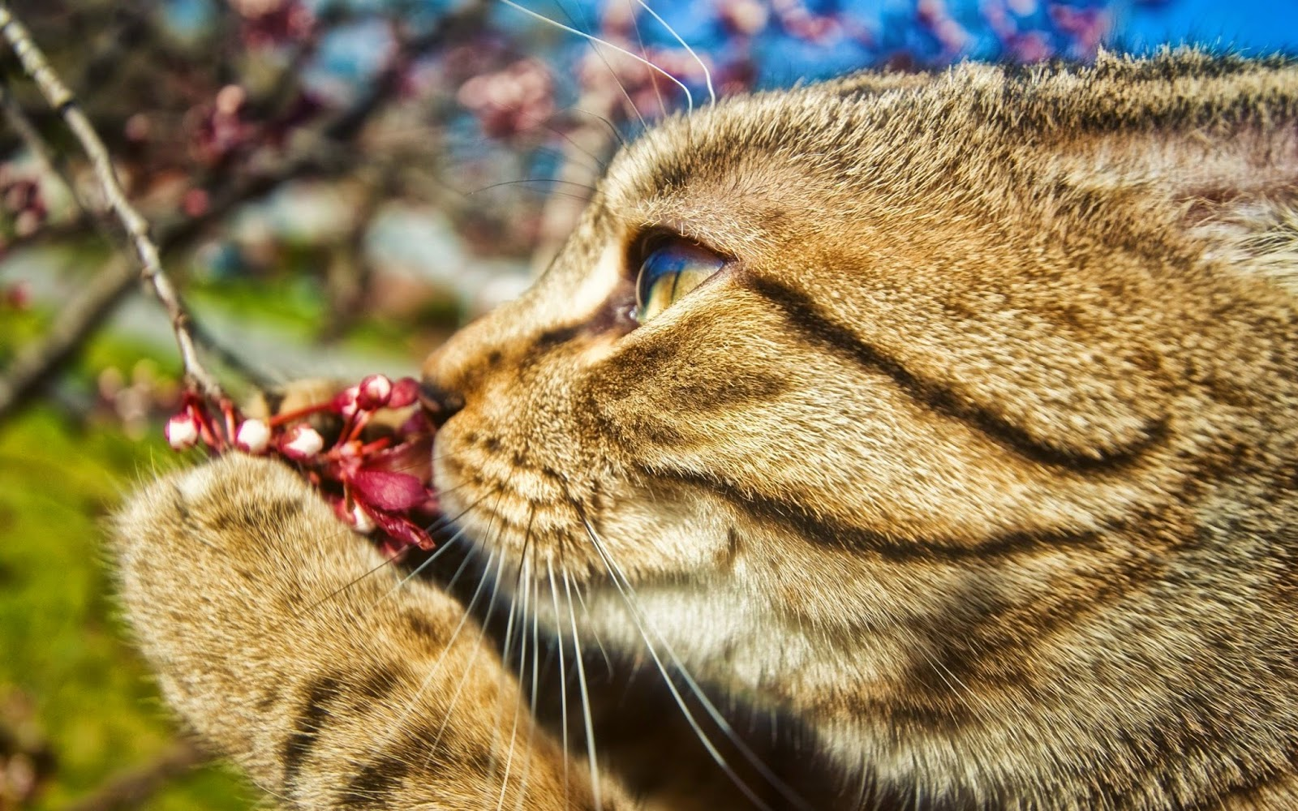
This week’s Hope Project challenge
Awaken your senses!

Slide 2
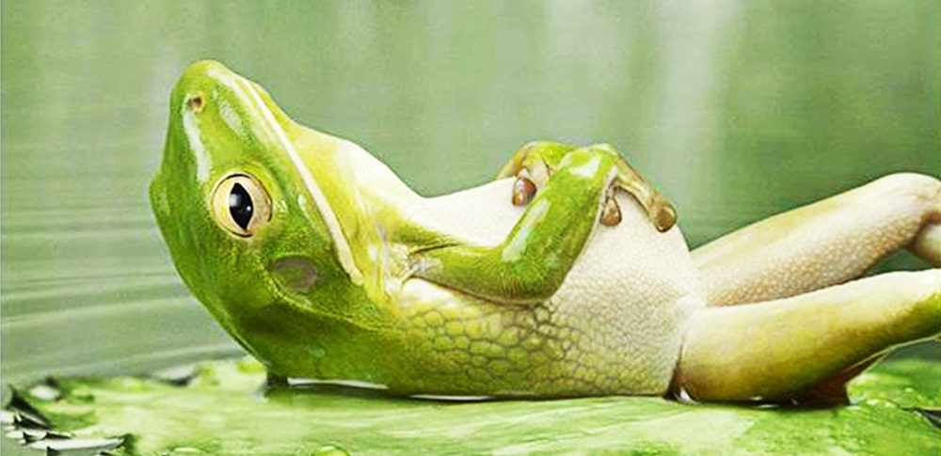
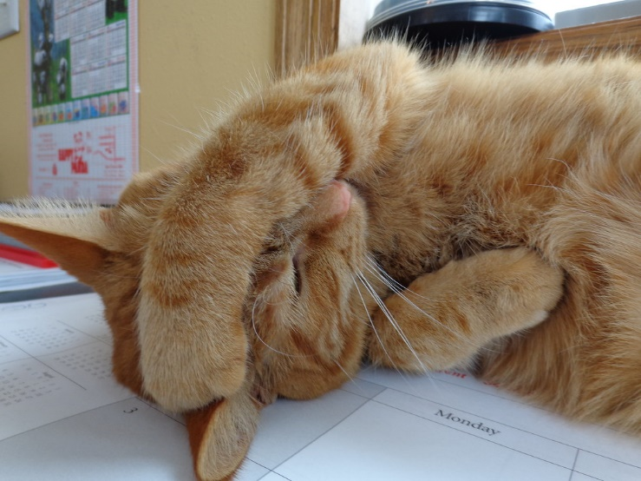
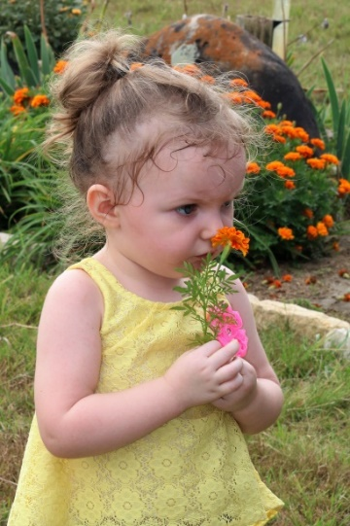
In these strange times, it is important that we keep as calm as possible and take time to relax.
If our senses get overloaded we can feel overwhelmed and more anxious.
Your task this week is to awaken your sense of smell with something lovely and relaxing!

Slide 3
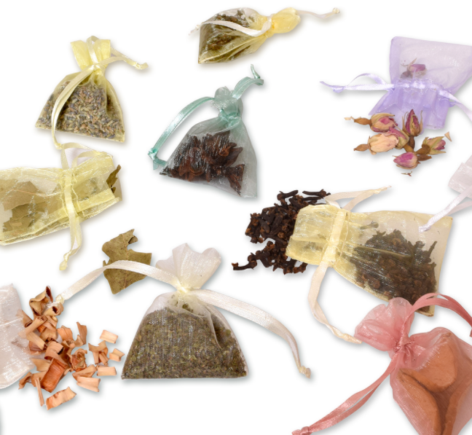
Your Hope Project task this week is to make a sensory smelling bag – a bag full of things that smell lovely, calm and relaxing.
What can you see in these sensory smelling bags?

Slide 4
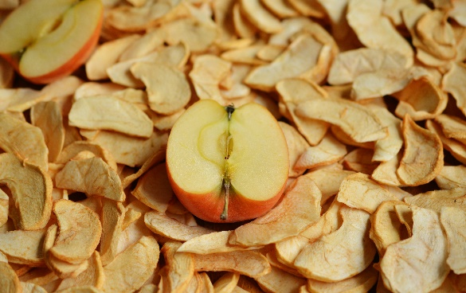
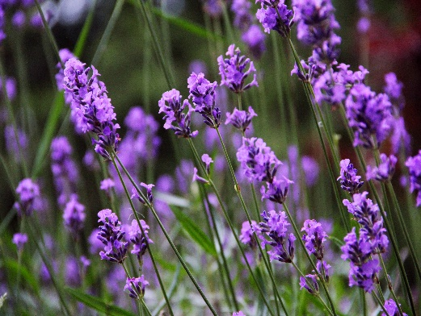
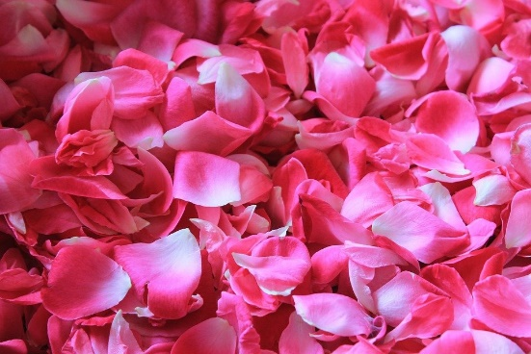
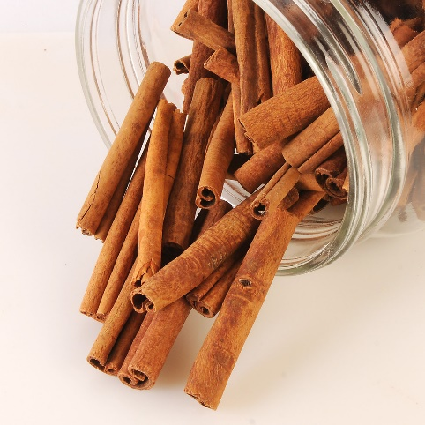
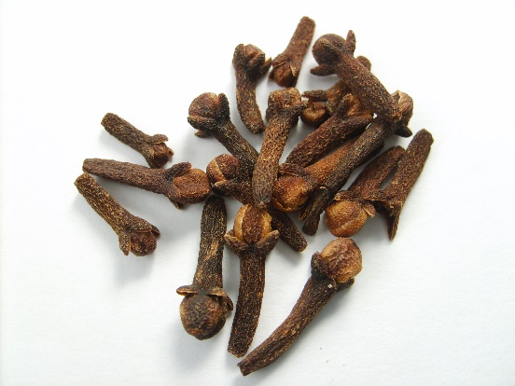
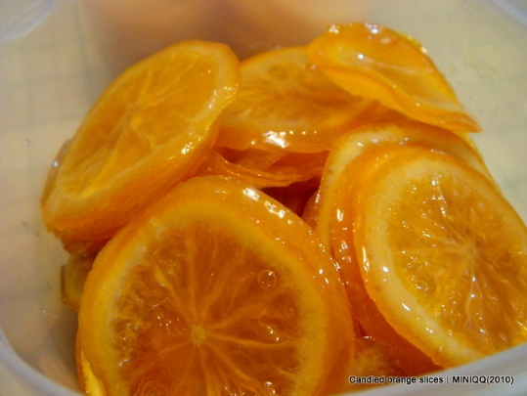
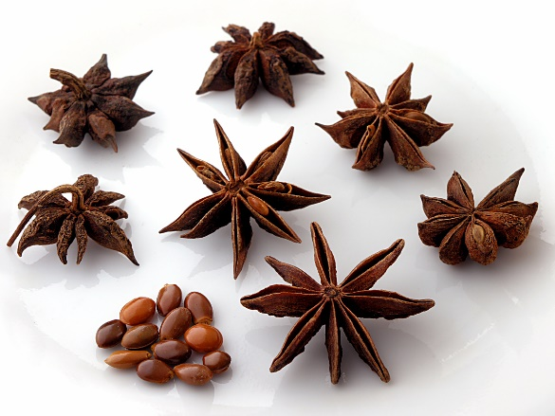
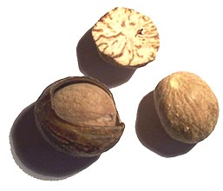
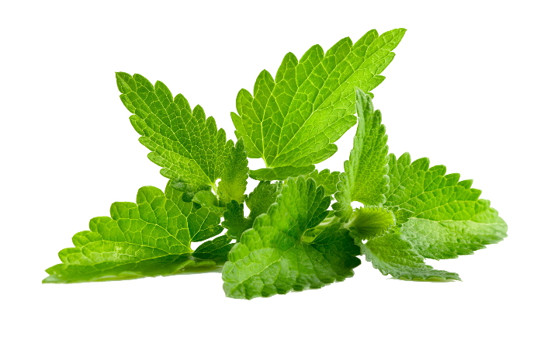
What could you put in your bag?
Lavender
Dried Apple
Rose Petals
Cinnamon
Cloves
Candied Orange
Nutmeg
Aniseed
Mint

Slide 5
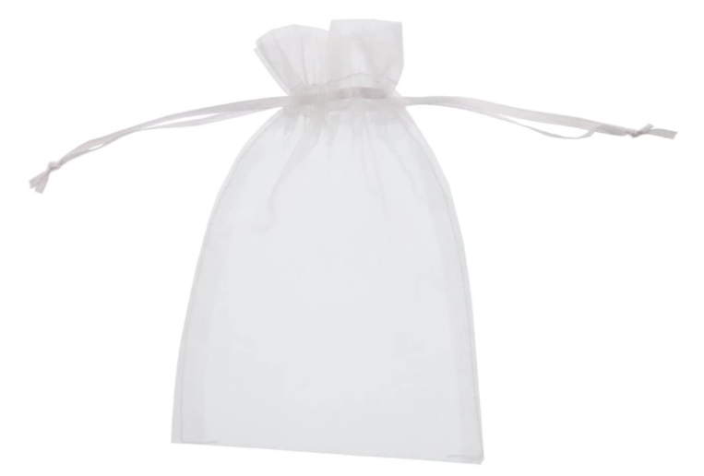
Ask one of the CHAMPS from your bubble for a bag if you would like to complete this Hope Project Challenge
Then fill it up with lots of gorgeous smelling, calming loveliness!

Slide 6
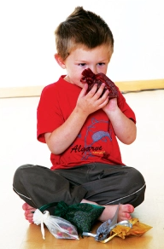
Finally, if you start to feel overwhelmed or anxious, find a quiet spot and take a big sniff of your sensory smelling bag. Sit back and enjoy the calming feeling …..

