Slide 1
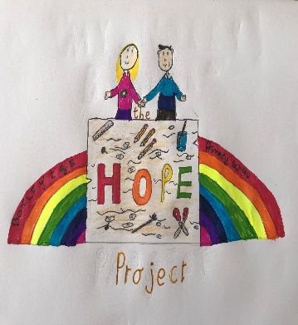
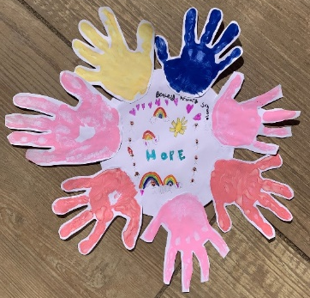
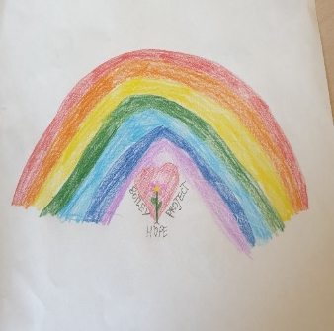
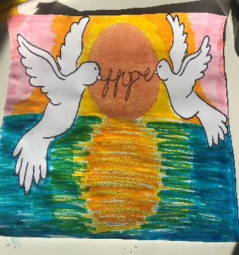
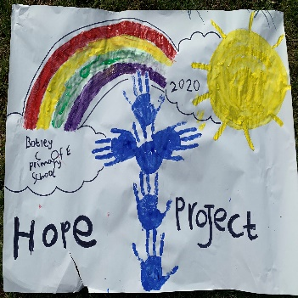
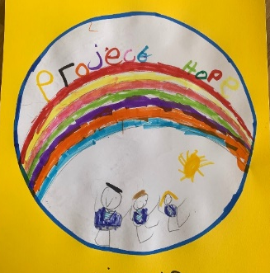
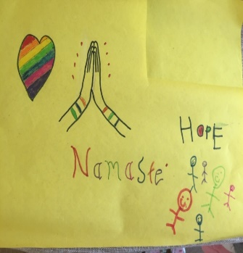
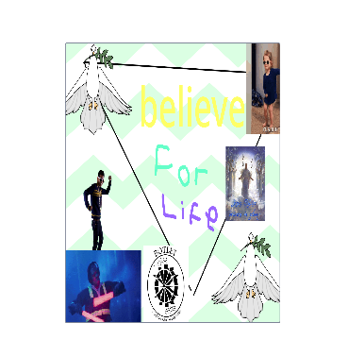
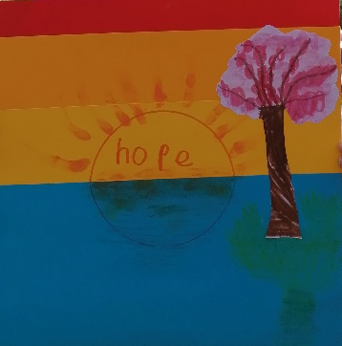
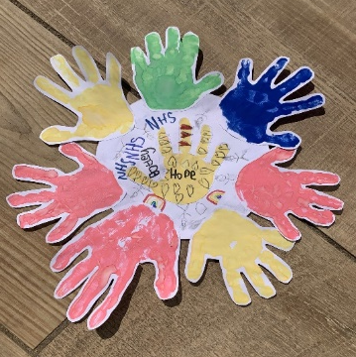
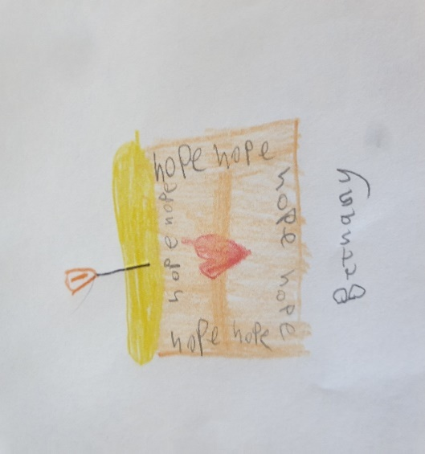

Congratulations to those who took part in our last few challenges!
COMPASSION
HOPE
AND
MINDFULLNESS
PROJECT
STEWARD
It is lovely to see so many children sporting one of our fantastic badges already!
Which badges are you looking forward to owning?
Botley C of E Primary School
Hope Project Award 1
Botley C of E Primary School
Hope Project Award 4
Botley C of E Primary School
Hope Project Award 5
Botley C of E Primary School
Hope Project Award 6
Botley C of E Primary School
Hope Project Award 2
Botley C of E Primary School
Hope Project Award 3
Botley C of E Primary School
Hope Project Award 10
Botley C of E Primary School
Hope Project Award 11
Botley C of E Primary School
Hope Project Award 12
Botley C of E Primary School
Hope Project Award 7
Botley C of E Primary School
Hope Project Award 8
Botley C of E Primary School
Hope Project Award 9

Slide 2
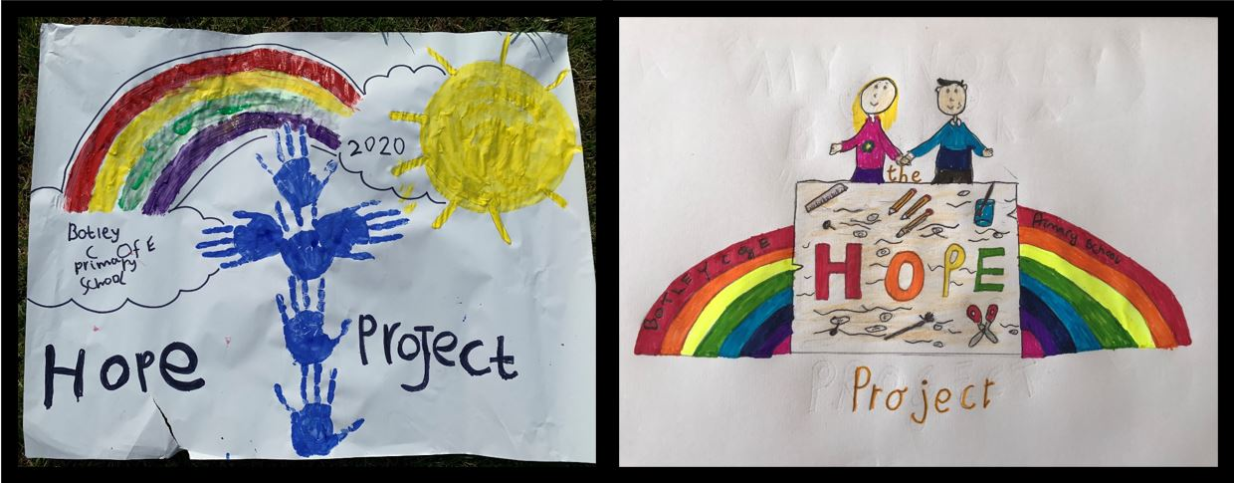
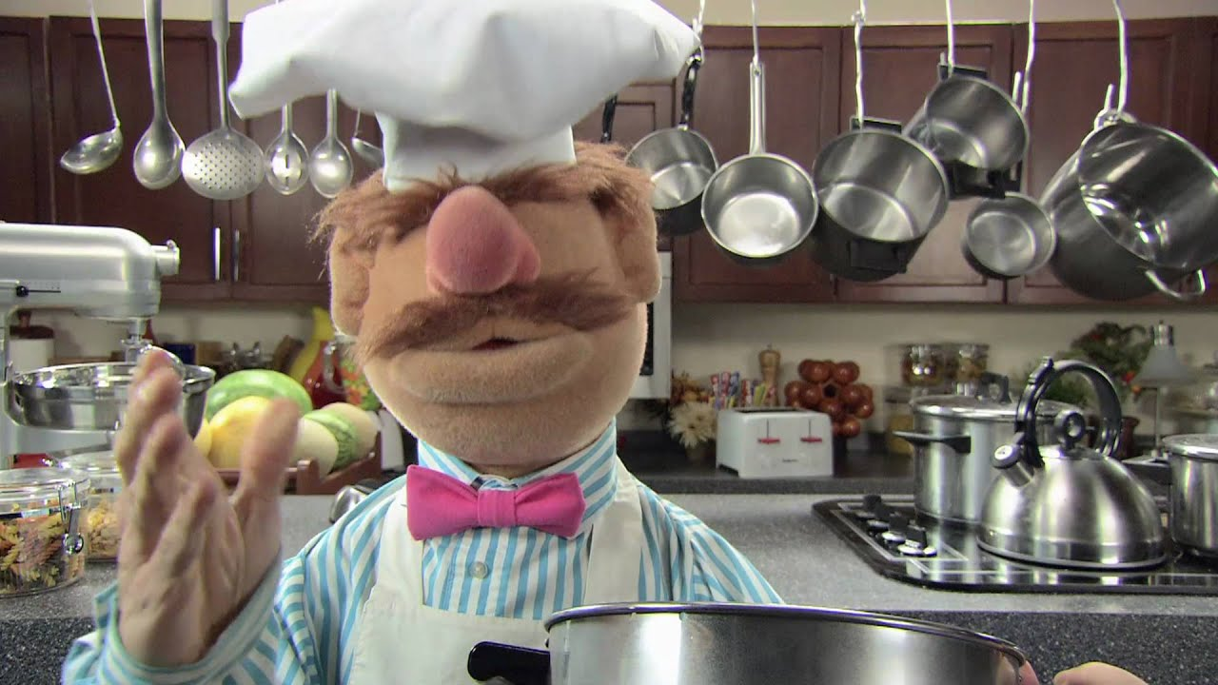
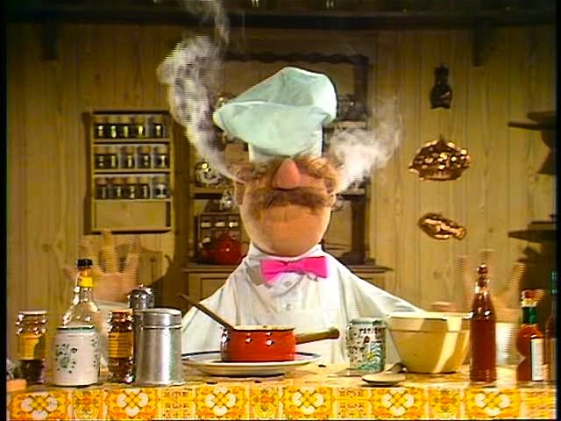
Week 4- Challenge
Continuing on with our sensory theme, this week we are thinking about our sense of taste.
Eating nice things can also be something which we enjoy doing and cooking can be very relaxing! So this week, we challenge you to become chefs!
Maybe not like this one though!

Slide 3
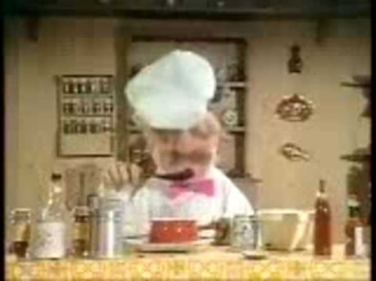
Week 4- Challenge

Slide 4
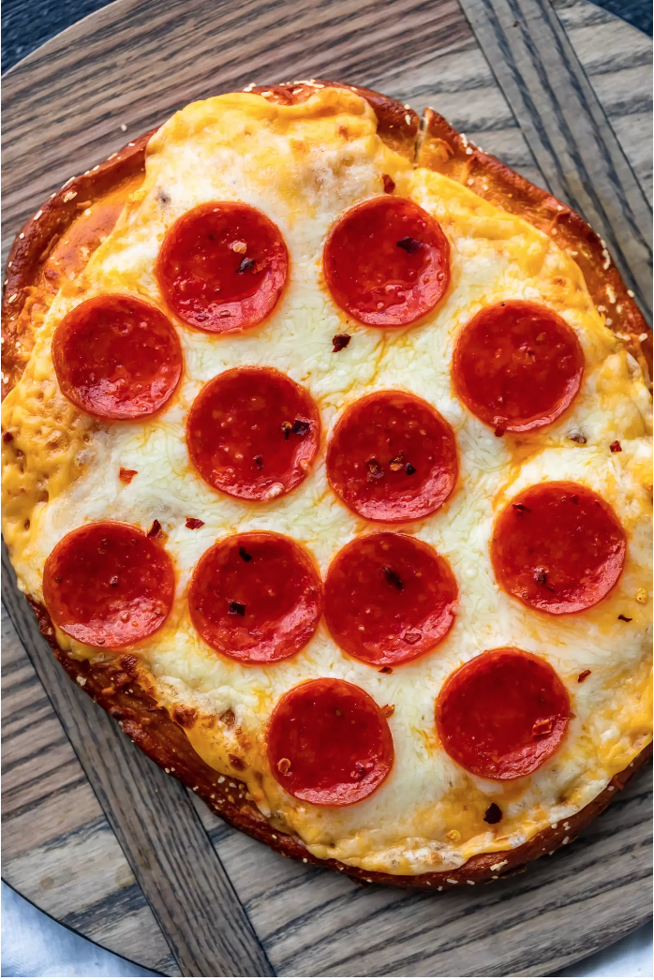
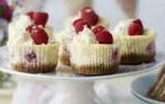
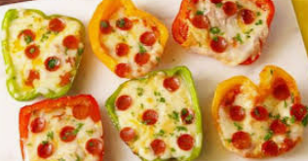
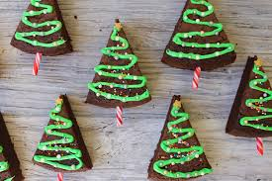
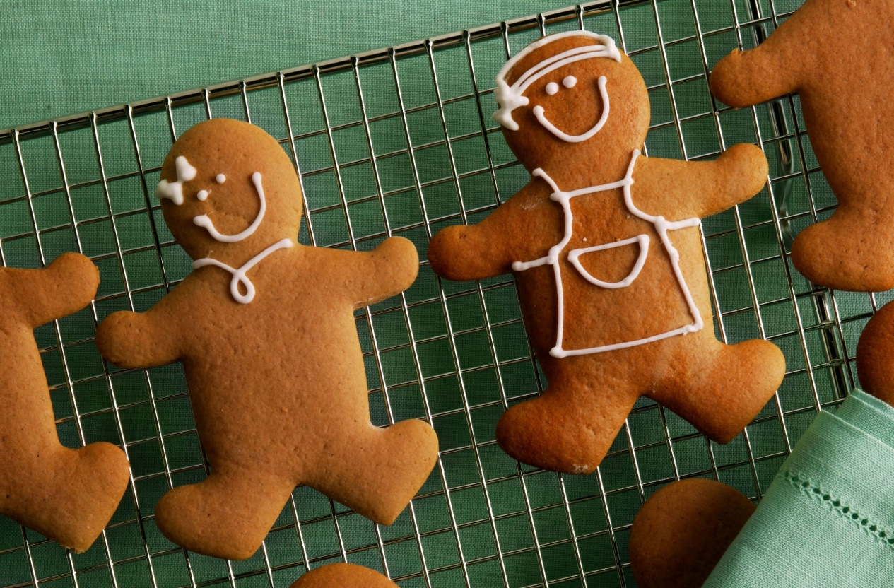
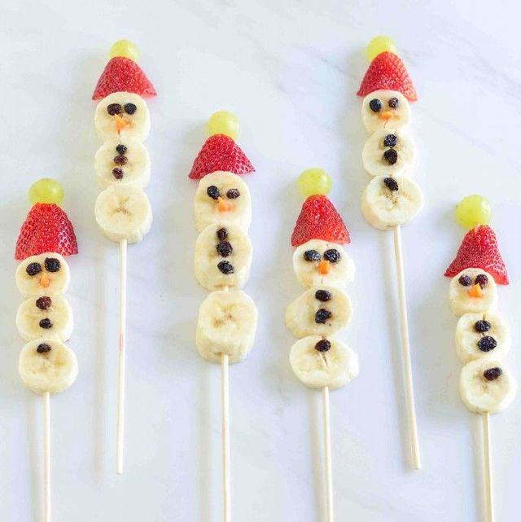
It can be anything you enjoy making!

Slide 5
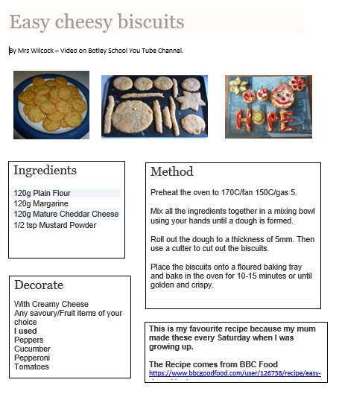
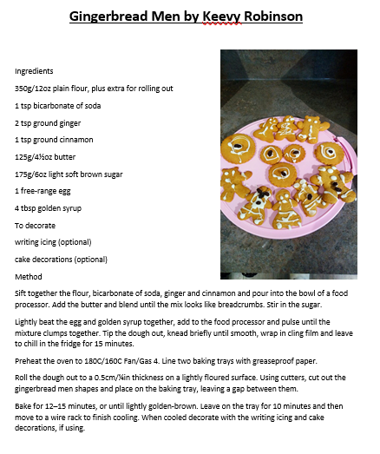
If you make something at home, we would love to see your recipes!
You can email it over to us or bring in a copy of it to give to me.
We plan to compile all of your amazing recipe ideas into our Hope Project Recipe book!
Here are some examples recipes we have already been sent!

