Slide 1
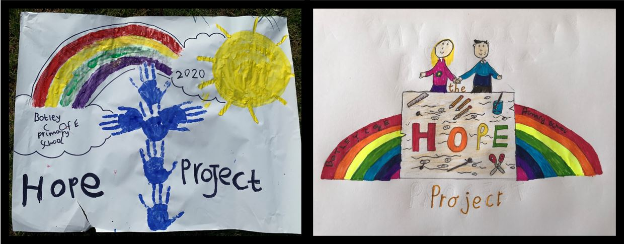
Botley School Hope Project!

Slide 2
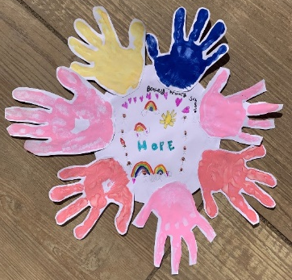
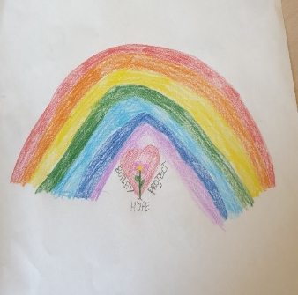
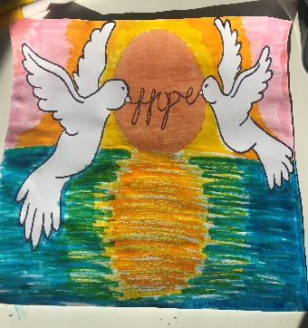
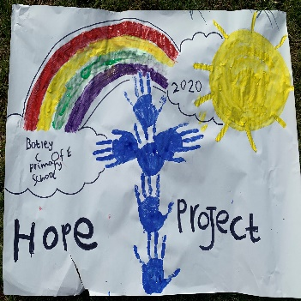
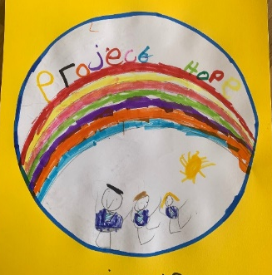
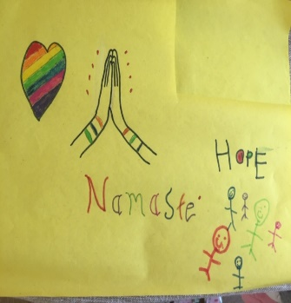
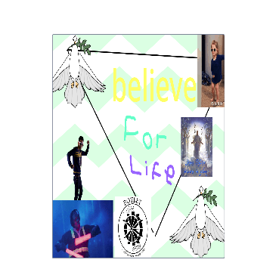
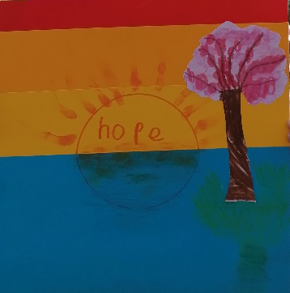
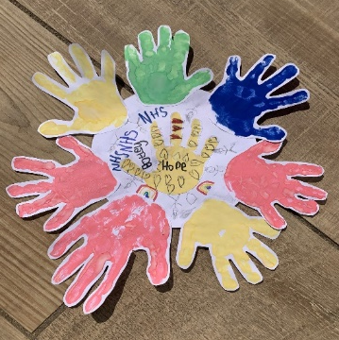
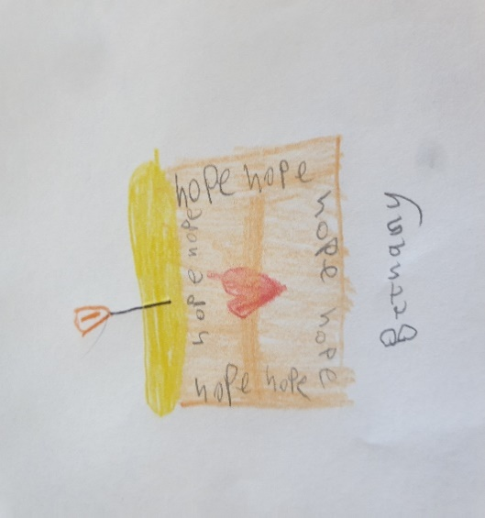

Congratulations to everyone who is the proud owner of more than one badge now!
COMPASSION
HOPE
AND
MINDFULLNESS
PROJECT
STEWARD
Don’t forget to let your class CHAMP know if you have completed and challenge!
Botley C of E Primary School
Hope Project Award 4
Botley C of E Primary School
Hope Project Award 5
Botley C of E Primary School
Hope Project Award 6
Botley C of E Primary School
Hope Project Award 2
Botley C of E Primary School
Hope Project Award 3
Botley C of E Primary School
Hope Project Award 10
Botley C of E Primary School
Hope Project Award 11
Botley C of E Primary School
Hope Project Award 12
Botley C of E Primary School
Hope Project Award 7
Botley C of E Primary School
Hope Project Award 8
Botley C of E Primary School
Hope Project Award 9

Slide 3
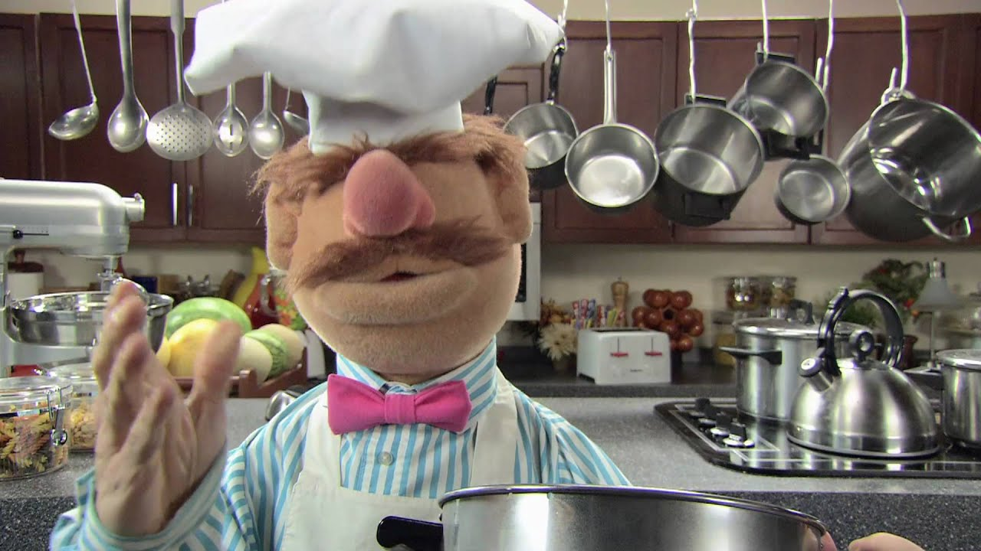
Reminder of Week 4’s- Challenge
Last week we challenged you get busy in the kitchen at home making something which you enjoy eating. BUT, more than that we asked you to write down the recipe and method and present it beautifully so that we can gather
them all together to make one big Botley
Church of England Primary School
Hope Project Recipe Book.

Slide 4

Week 5 challenge
This week’s Hope Project Challenge is to join in with the whole Botley community and Make Botley Shine!
We would love to fill the village with
the most beautiful stars anyone has ever seen!
You can make as many as you would like and from any materials you like!
Make sure you share either the actual star(s) with your CHAMP or email me a photograph to have it ticked off as a challenge completed.

Slide 5

Enjoy making Botley Shine

