Slide 1

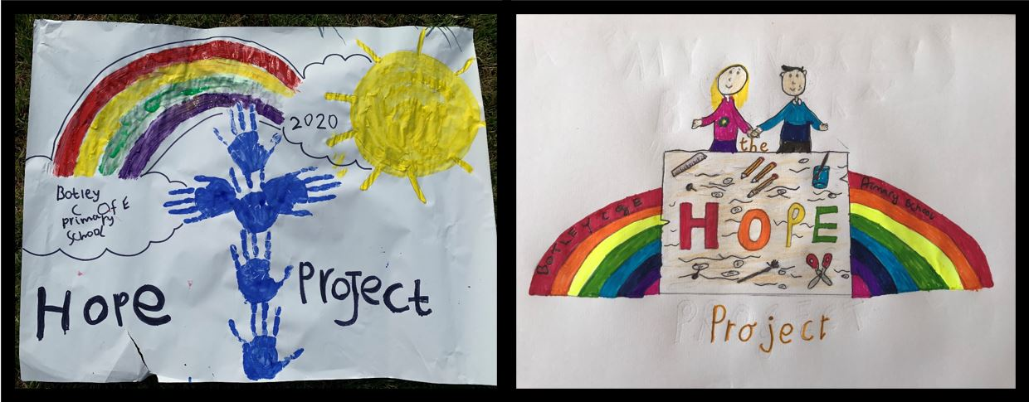
Have you got it?

Slide 2
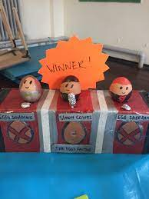
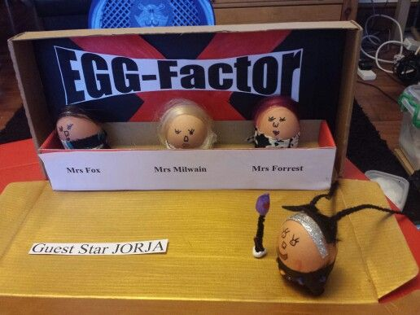
Eggs are NOT just for Easter….
Mr Cooil Mrs Ellery Miss McIntosh
We are looking for some …
Eggsellent creativity!

Slide 3
Would YOU like to take part in The Hope Project Eggs –Factor
Competition?
the task is to design an EGG-citing art display which involves an egg
or some eggs.
Please make sure that you hard boil the egg first OR blow out the
egg whites and egg yolk from the inside.
See if you can come up with an interesting title for your display
(it could be a play on words and use the word ‘EGG’ in the title).

Slide 4

Will your title make your friends ‘crack up’?
Egg-cellent Egg Puns could be something like….
-Don’t yolk with me
-Are egg-noring me?
- I’m shell shocked
-Don’t be such a chicken
-Let’s hatch a plan
-What a crackin’ idea!

Slide 5
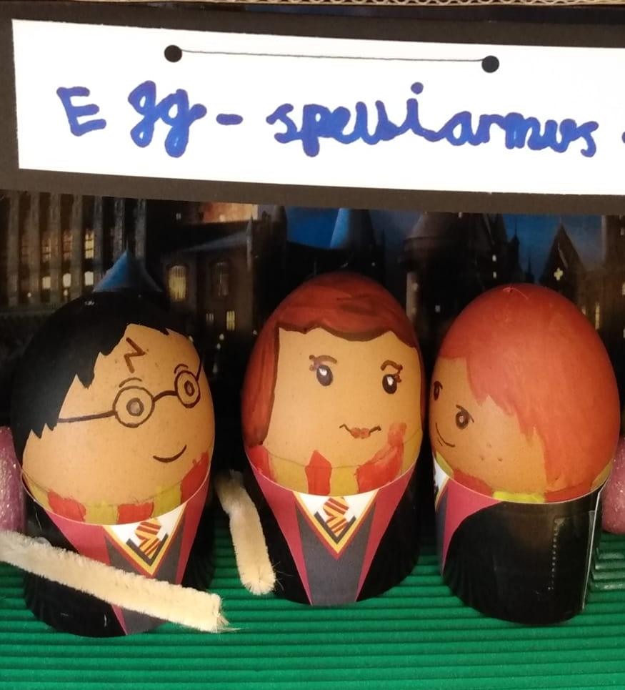
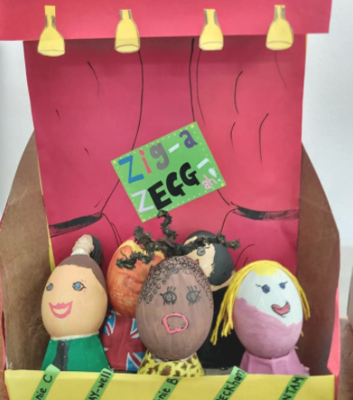
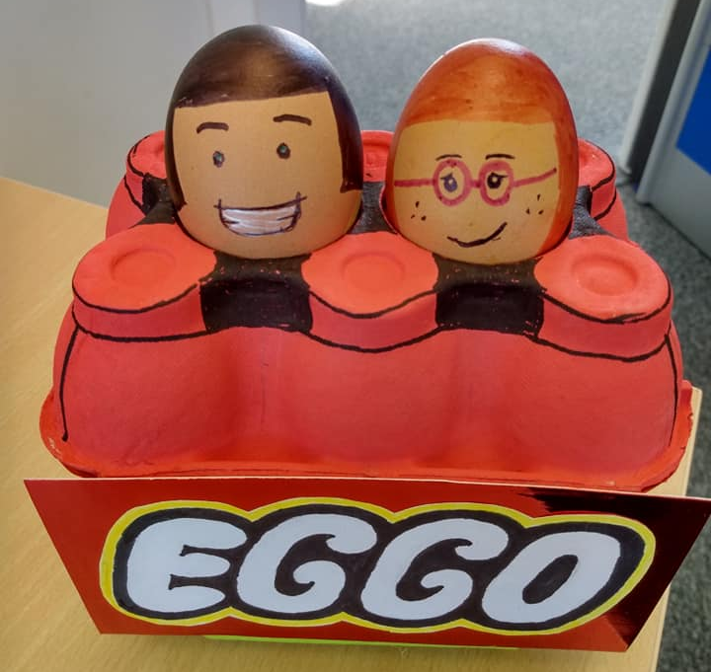
Some eggsellent eggsamples!

Slide 6
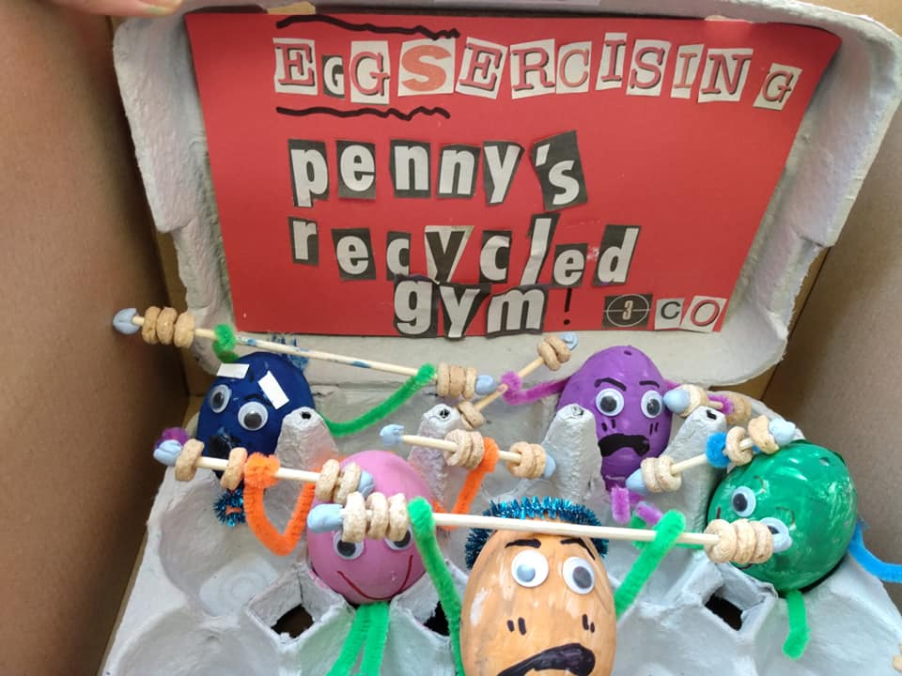
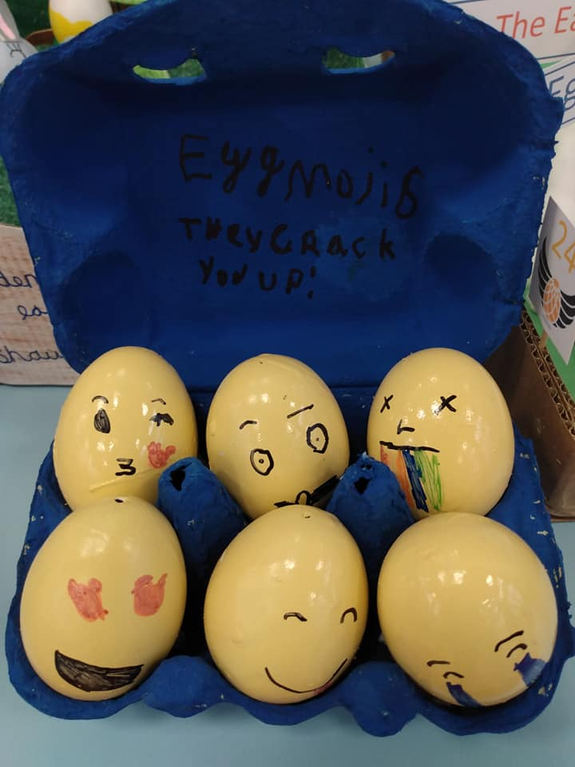
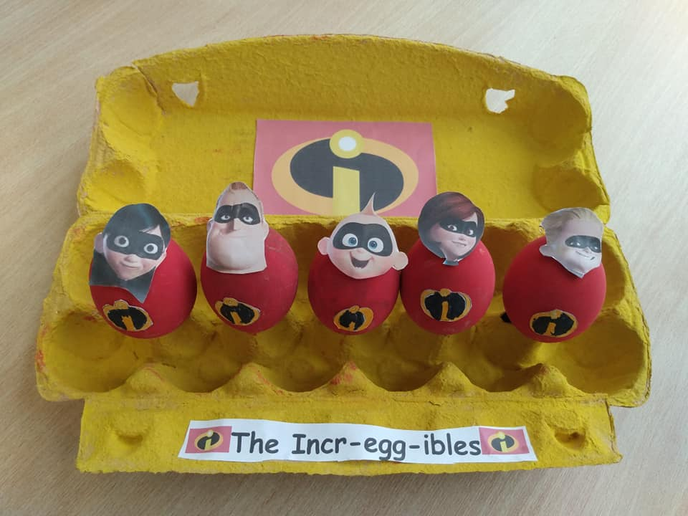
There will be a prize for
the most inventive egg
display from each year
group.
P.S. It's not an Eggs-box

Slide 7
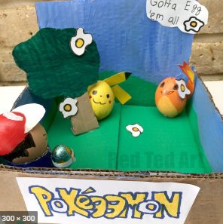
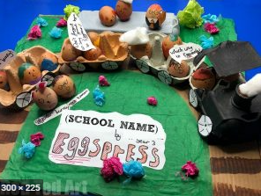
The closing date for your eggtries, is Friday 7th May
The winners will be revealed the following week.

