Slide 1
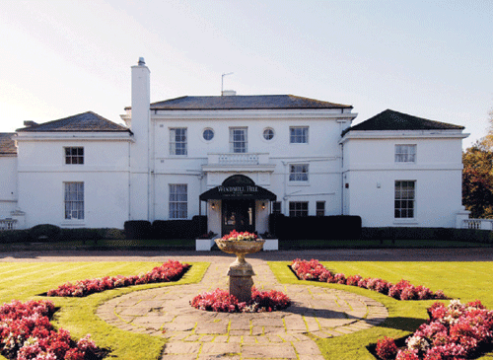
Botley C of E Primary School
Windmill Hill 2018

Slide 2
Staffing
Miss Stanton Mrs Troup
Mrs Grist/Mrs Bundy
Mrs Willcock Mrs Ellery Miss Wilson
Mr Cooil Mr Rowles Mr Poore
The children will be put in activity groups and will be supervised by Botley Staff at all times, as well as by the PGL Leaders.

Slide 3
Peace of mind
All PGL staff are DSB checked
All PGL staff are First Aid trained
All PGL staff are trained to a very high standard for the specific activities that they lead.

Slide 4
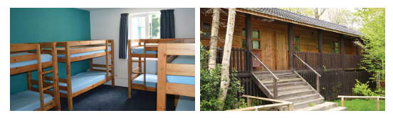
Accommodation
Lodges with en suite rooms, sleeping 5-6 children.
Full central heating.
Mixture of bunk beds and single beds.
Fully locking doors.
Separate twin teachers rooms next to children’s rooms.
Children will find out their rooms this week.

Slide 5
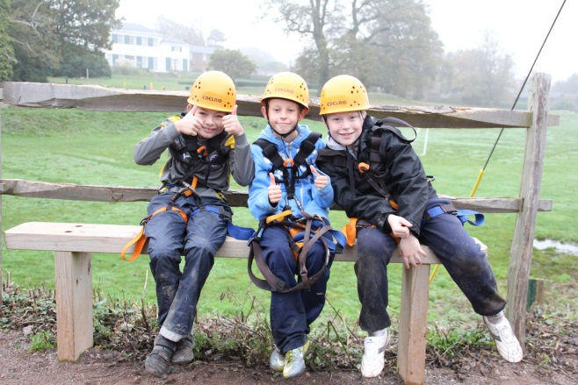
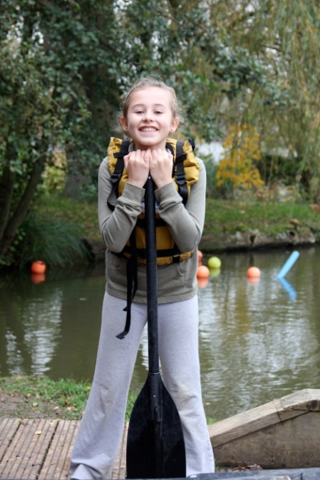
Day Time Activities
Abseiling Aeroball
All Aboard Tunnel Trail
Climbing Giant Swing
Orienteering Problem Solving
Raft Building Sensory Trail
Trapeze Zip Wire Fencing
Challenge Course

Slide 6
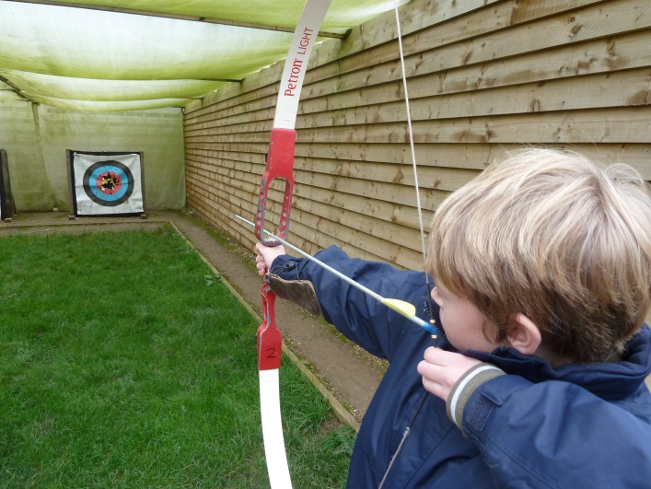
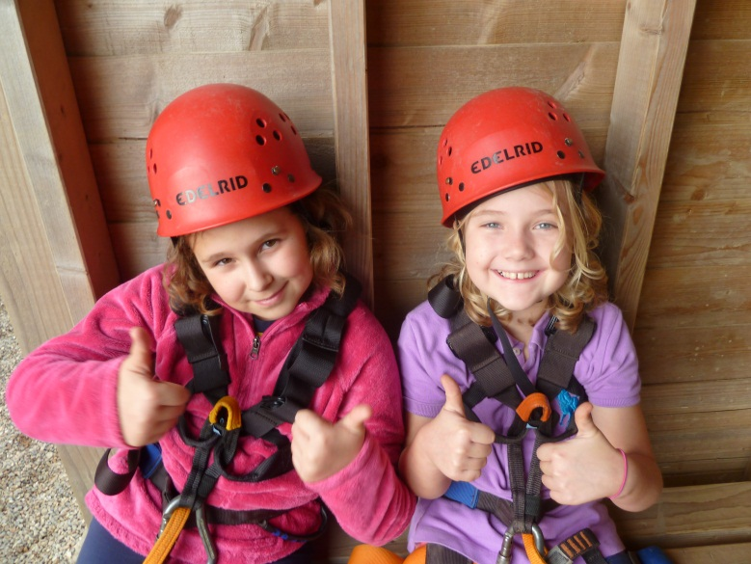
Evening Activities
Camp Fire
Passport to the world
Ambush
Disco
Start at 7:00 and usually last until
Around 8:30

Slide 7
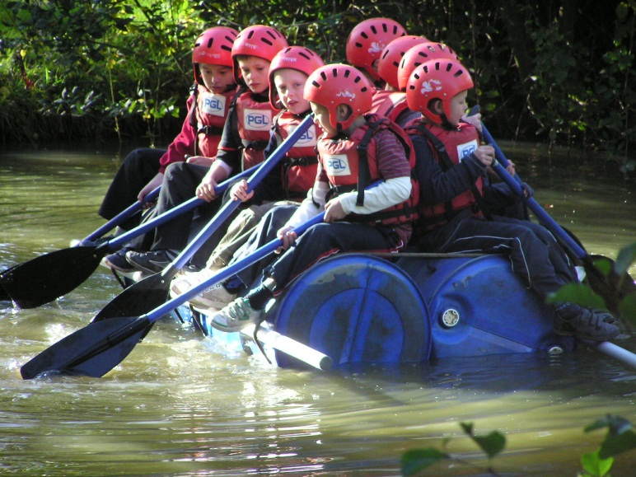
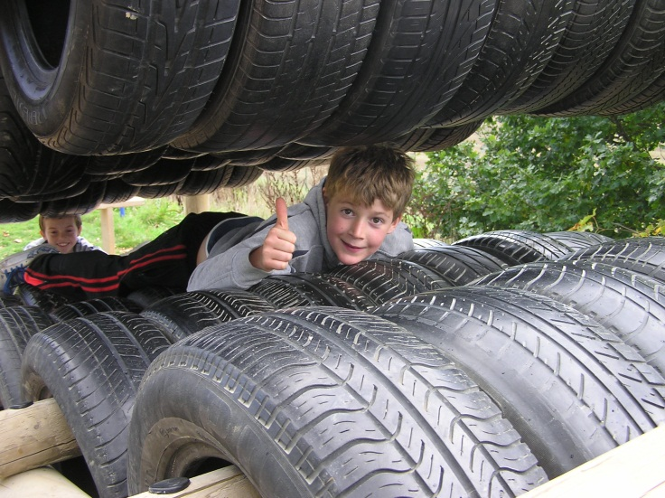
Food
3 meals a day
Choice of foods from a wide selection.
Salad bar at lunch and dinner
Tuck shop opportunity once during the week

Slide 8
Outward Journey
This year, we will be leaving, at 11.00am , as we will be having a lunch stop on the way.
This means your children need to be in school at 10:00 in the hall .We will take delivery of medicines and money at that time.
They will need a packed lunch for the journey as we will be stopping off on the way.

Slide 9
If you need to drop off at normal time because of siblings, we can look after them in school. You will need to make sure we have money and meds if you drop off early.
If you want to come back and wave them off from outside the school at 11.00 am, you will be very welcome!

Slide 10
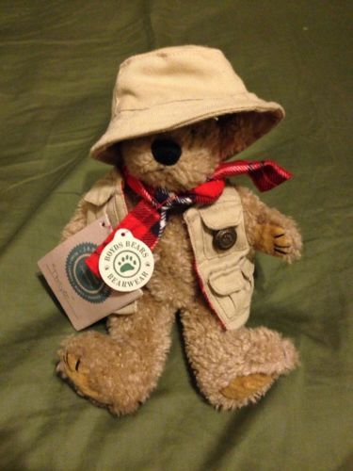
We are asking the children to bring a small soft toy, with an appropriately adventurous name and an adventurous story to tell!

Slide 11
They may bring some money with them - £10.00 is the absolute limit. Please could they bring the money in a named purse or wallet and we would suggest in small denominations such as pound coins.
The money will be collected by staff on Monday 15^{th.} Children will have one opportunity during the latter part of the week to visit the tuck/gift shop. After their visit, they will be responsible for the rest of their money.

Slide 12
Please read the accompanying leaflet for the types of clothes your child will need for each activity. There are several that require long sleeve tops. Long hair will need to be tied back all week.
Please make sure your child has packed clothes that you don’t mind getting dirty, wet and smelly. Some of the activities are water or mud based and the chances are, that some of their clothes will be very muddy. Do not forget binbags for dirty clothes!

Slide 13
The same goes for shoes – it would be really helpful if they have a really old pair of trainers or something for Raft building and Canoeing, as it has been known for shoes to be sucked off and stuck in the mud! We are not doing anything that requires smart clothes. They do not need to wear uniform at any point during the trip.

Slide 14
We ask, please, that children do not bring electrical goods – including phones – the danger of such equipment being lost or damaged means it is not practical. Also, there are safeguarding issues regarding photos being published on social media.
Furthermore, the children’s programme is so packed, that they will not have time for electronic games.
They can bring a pack of cards, a book or travel game for the journey.

Slide 15
Please get in contact with the school if there is a problem and they will contact us.
We will do the same if there is a problem at our end. In an emergency, a child will be given access to a staff phone.
We will send bulletins every day to the school, which will be sent out to parents through the texting service.
Mr Rowles will also be updating our Twitter account.

Slide 16
Children may bring some sweets for the journey and a few for the week. However, we do not want to be dealing with sick children who have over indulged. It will spoil their trip, so please do not pack vast amounts of sweets. If a child arrives with too many, they will be rationed through the week by staff.

Slide 17
Please make sure your child can handle the. size and weight of their own luggage – they may need to practice before they go.

Slide 18
We are very much looking forward to this trip; having this chance to get to know the children in a very relaxed way. I’m sure your son or daughter is also feeling excited , if not a little apprehensive! Please encourage them to give everything a go and make the most of this amazing opportunity!
It is a fantastic experience for them, which allows them to grow in independence, confidence, self reliance and resilience in a safe but exciting atmosphere.

Slide 19
WE look forward to taking your children on a fantastic residential week!
Any questions?

