Slide 1
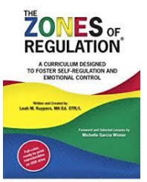
Zones of Regulation

Slide 2
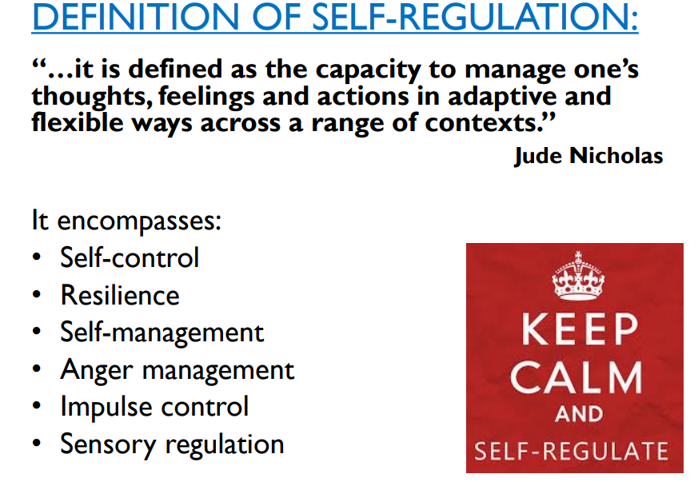

Slide 3
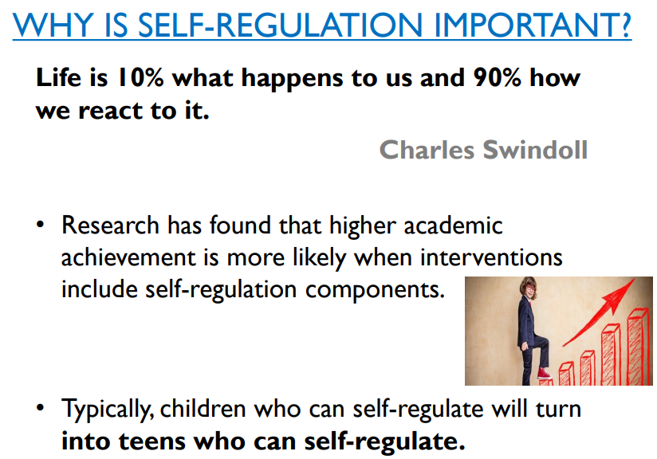

Slide 4
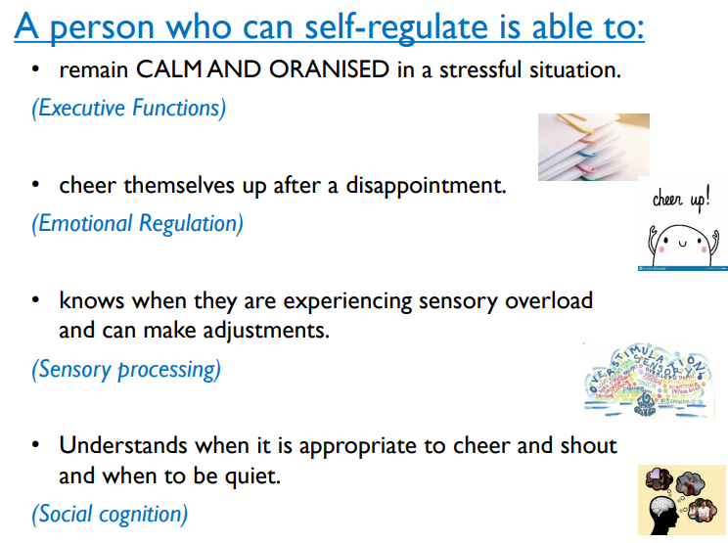

Slide 5

What is the Zones of Regulation program?
The Zones of Regulation is a curriculum geared towards helping children gain skills in consciously regulating their actions, which in turn leads to increased control and problem solving abilities.
The activities are designed to help children recognise what ‘zone’ they are in, with each Zone represented by a different colour.
Children learn strategies or ‘tools’ to learn how to stay in a Zone or move to another.
They explore calming techniques, cognitive strategies and sensory supports so they have a toolbox of methods to use to move between zones.
From the learning activities, children should to learn to: read others’ facial expressions, recognise emotions, learn their triggers and gain perspective into how others see their behaviour.

Slide 6
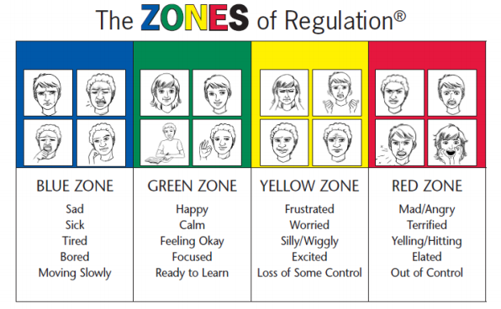

Slide 7
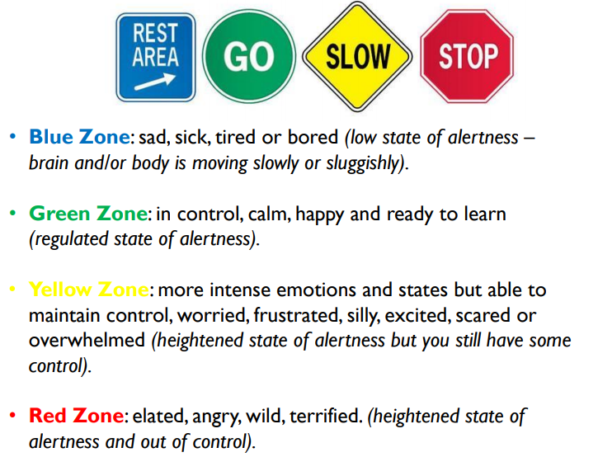

Slide 8
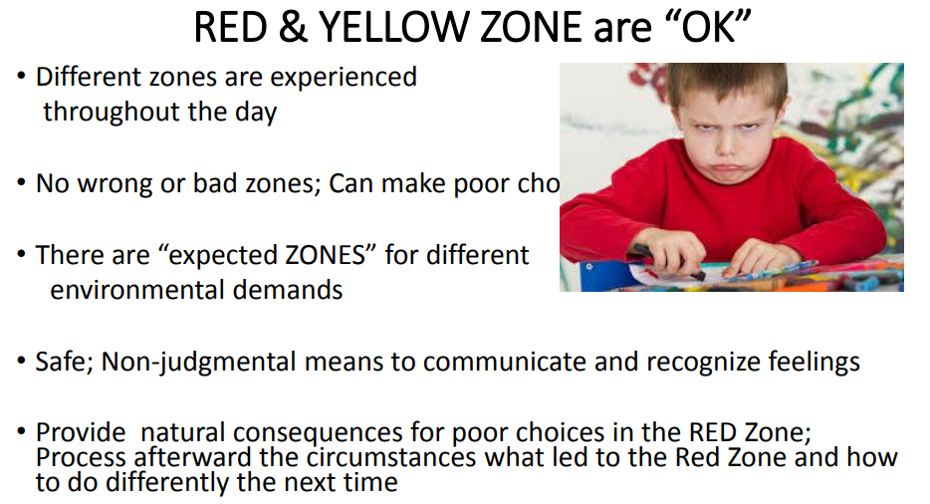

Slide 9
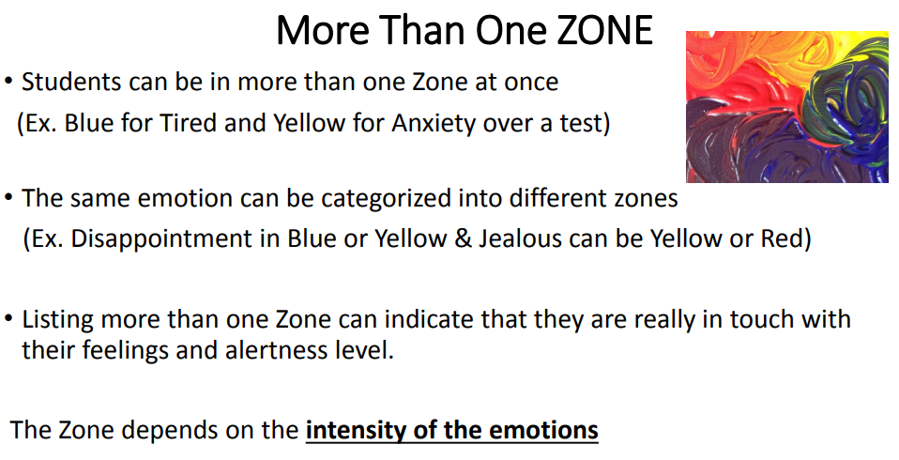

Slide 10
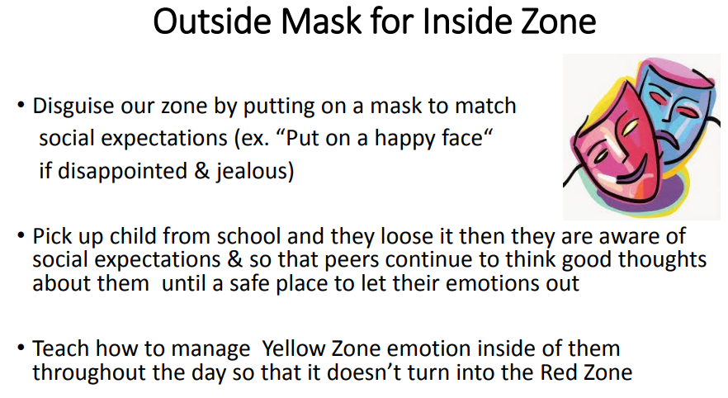

Slide 11
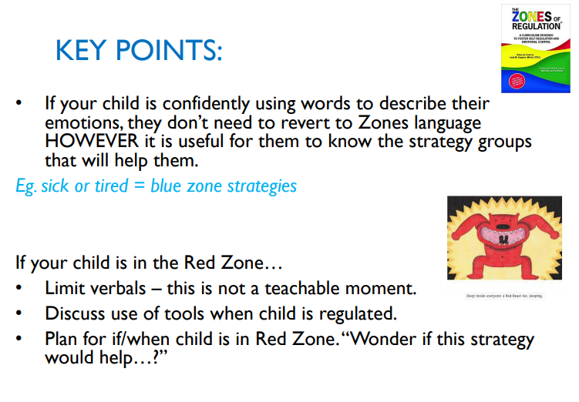

Slide 12
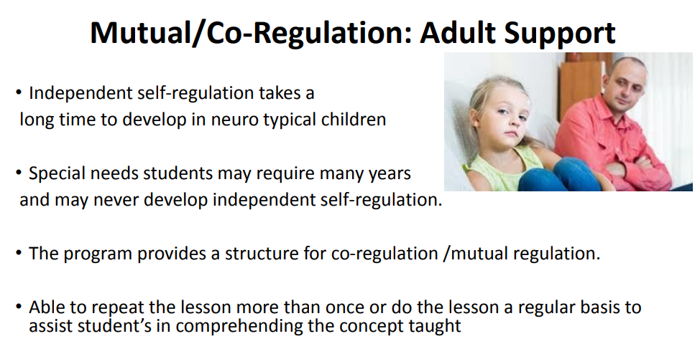

Slide 13
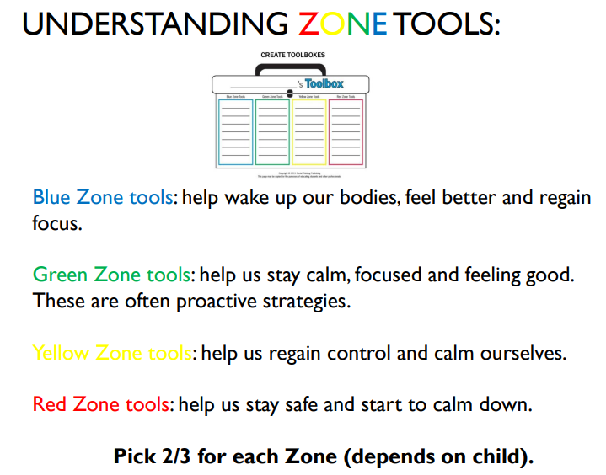

Slide 14
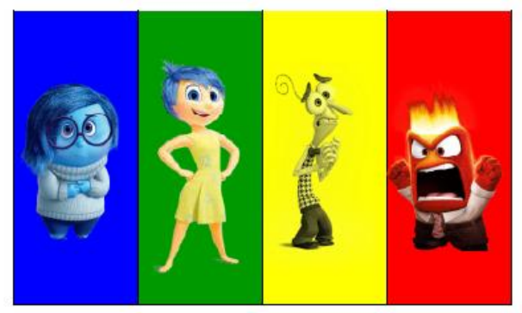
Talking about the Zones

Slide 15
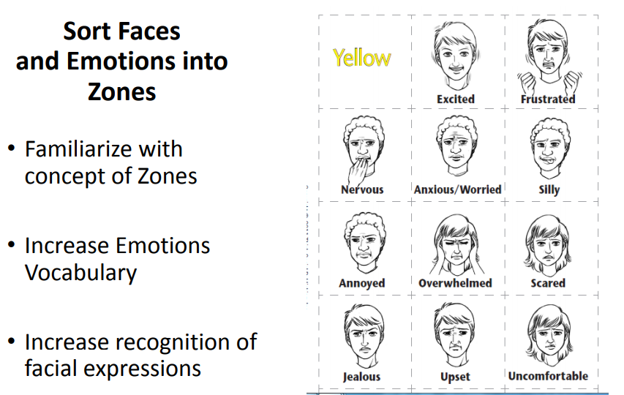

Slide 16


Slide 17
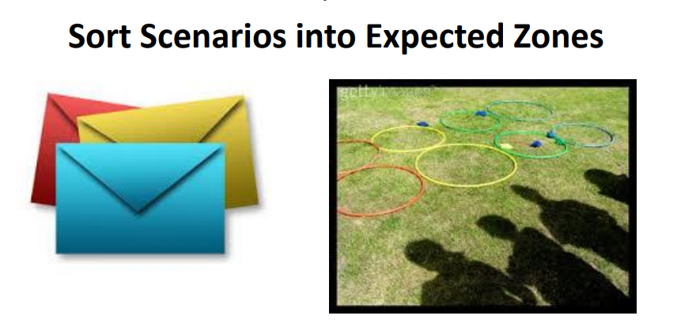

Slide 18
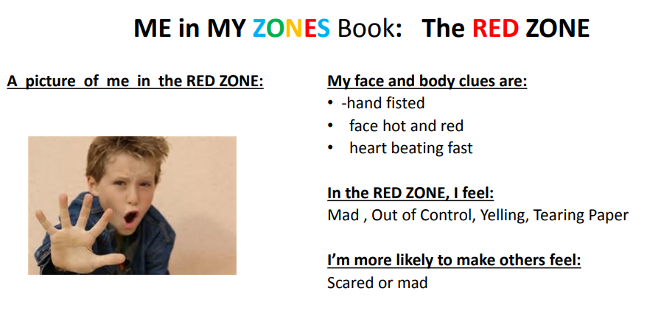

Slide 19
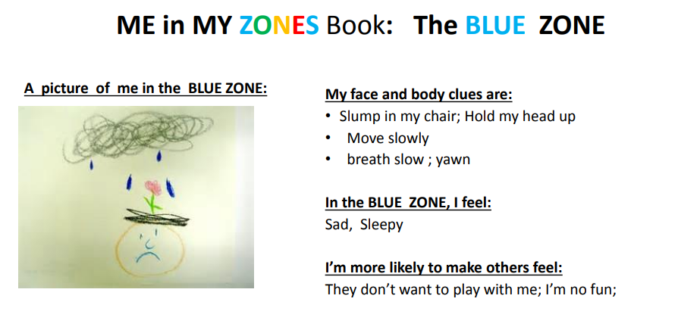

Slide 20
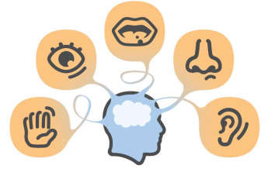
Sensory Strategies

Slide 21
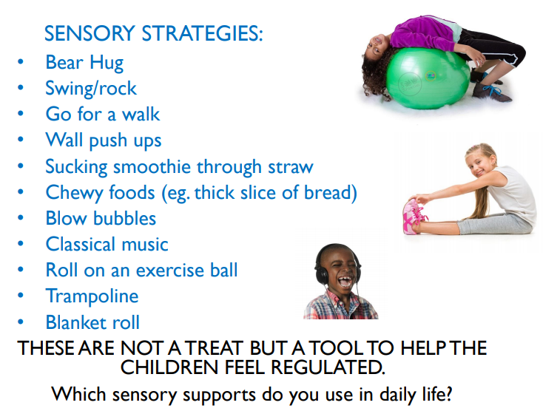

Slide 22
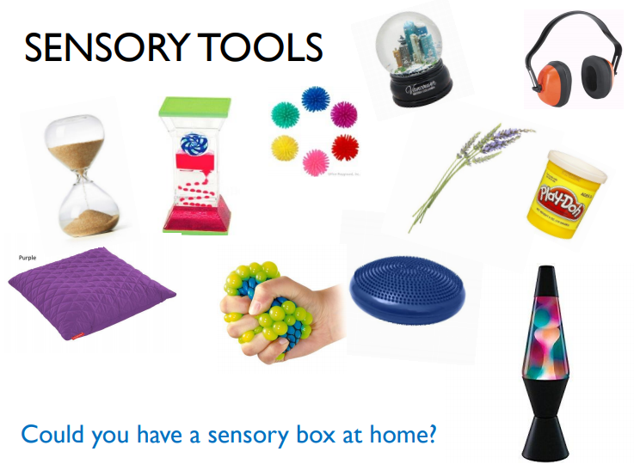

Slide 23
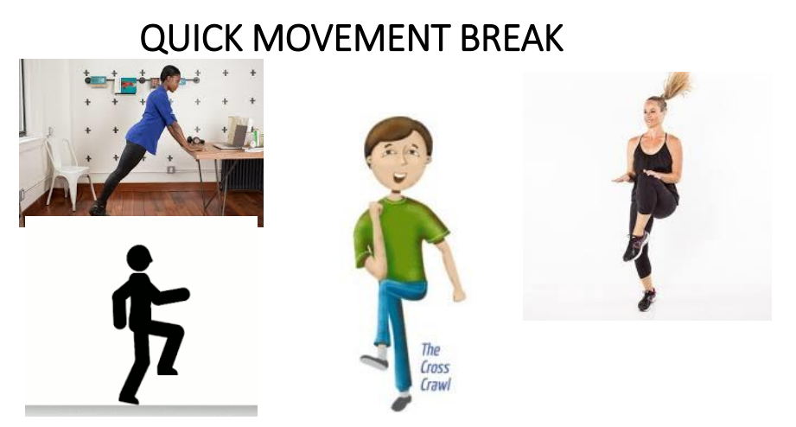

Slide 24
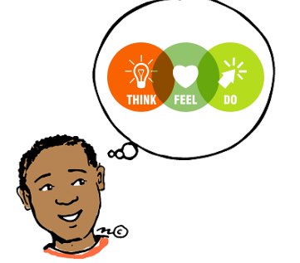
Thinking Strategies

Slide 25
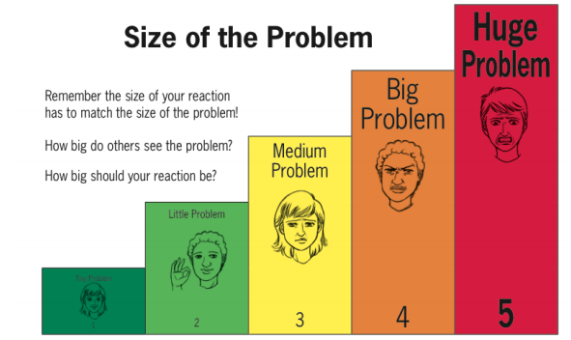

Slide 26
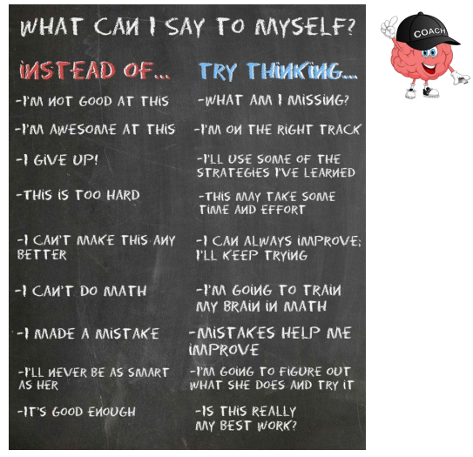

Slide 27
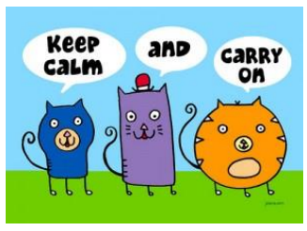
Calming Strategies

Slide 28
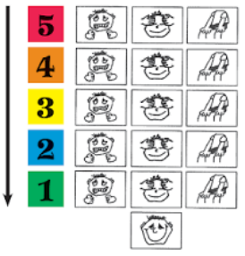
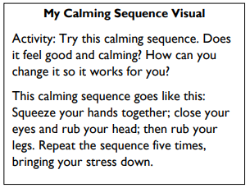
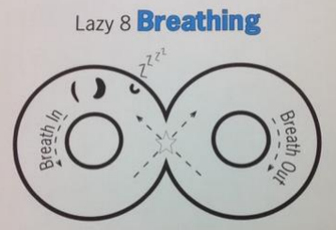
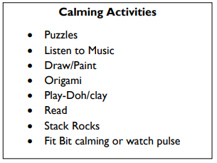
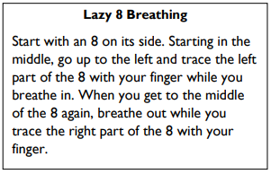
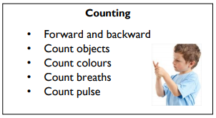
Remember with breathing techniques, it is important to breathe our for longer than you breathe in.

