Slide 1
What is bullying?

Slide 2


Slide 3
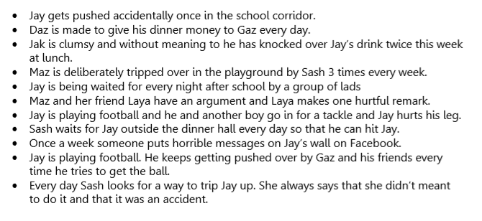
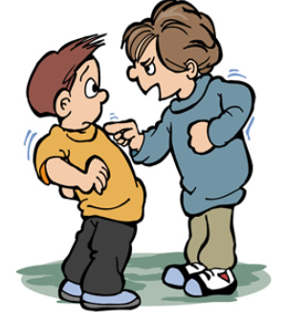
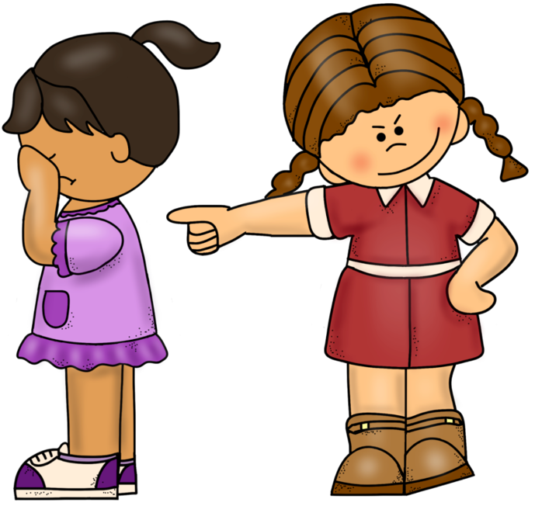
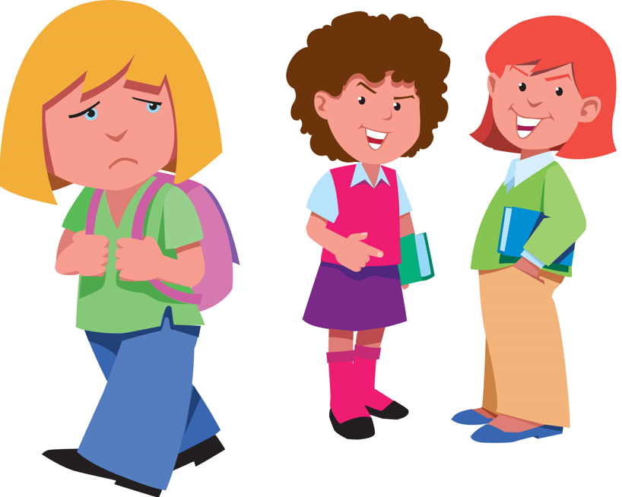
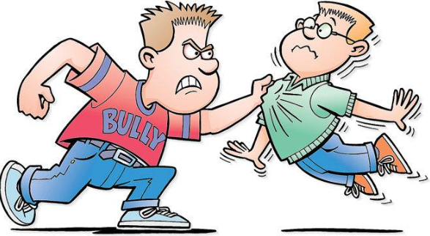

Slide 4
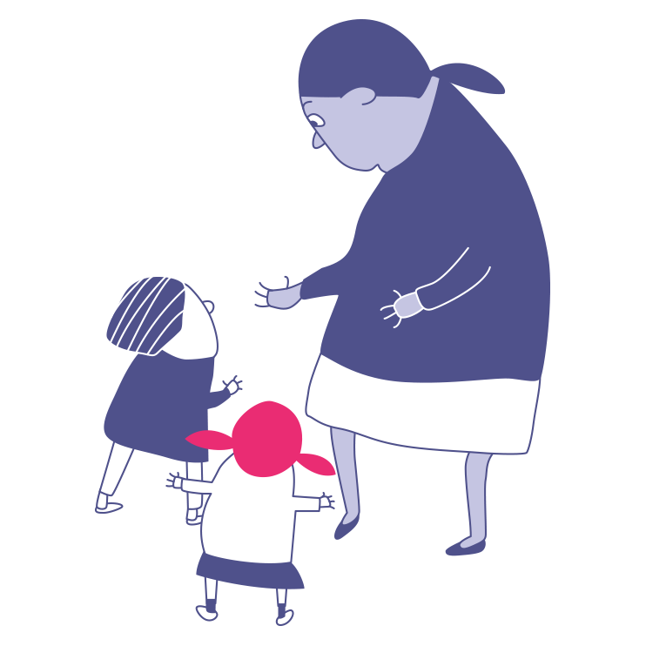
Who are the people in school that can help us to reduce and respond to bullying?

Slide 5
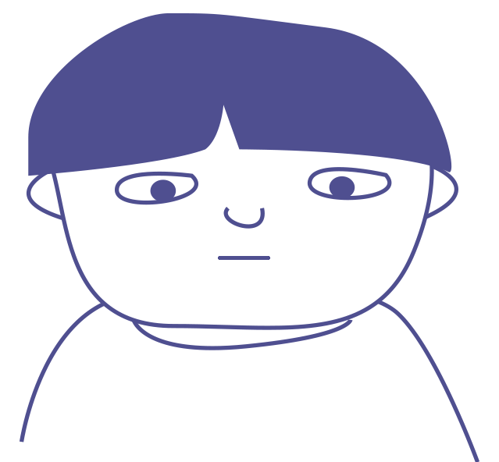
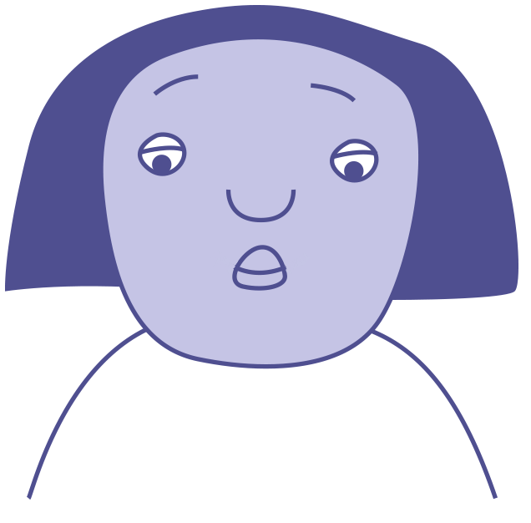

Change starts with…?
What could you do?
Max is not himself today. He has hardly said a word.
Smile
Compliment them
Laugh
Find an adult
Jasmine is sitting on her own at lunch. She looks lonely.
Sit with them
Walk away
Ask if they are OK
Invite them to join
You hear snuffles coming from one of the toilets. It sounds like crying.
Ignore them
Ask if you can help

Slide 6
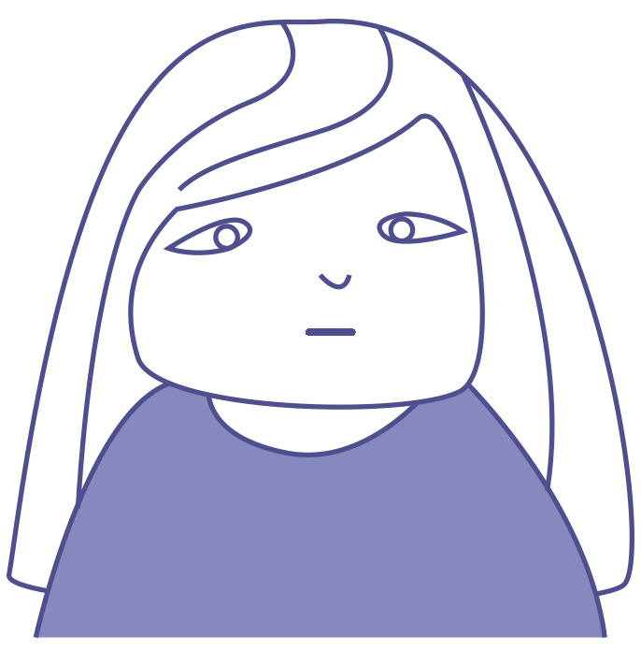
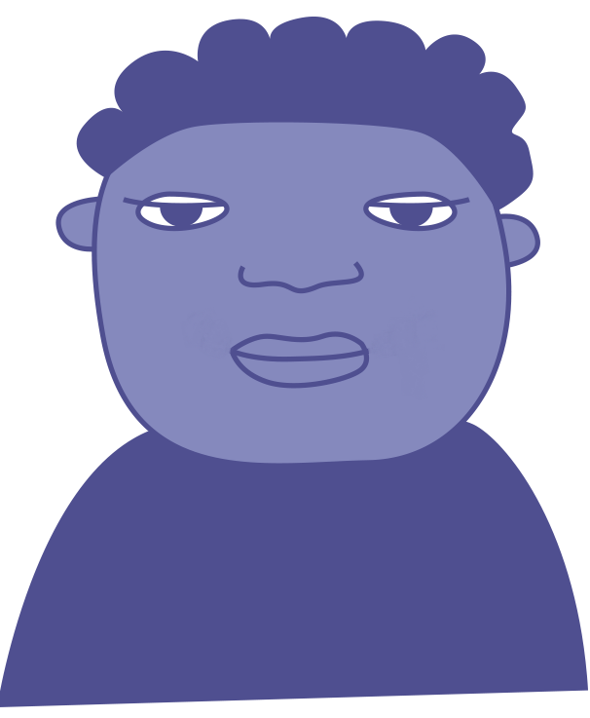
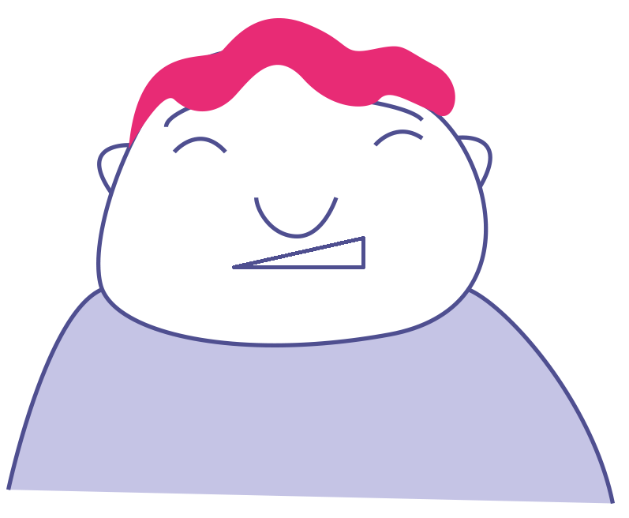
Change starts with? …
What could you do?
Faiza is reading a message on her phone. She looks worried.
Smile
Compliment them
Laugh
Find an adult
You hear someone saying something nasty to Grace in the playground.
Sit with them
Walk away
Ask if they are OK
Invite them to join
A pupil from another class is wandering around with no one to play with.
Ignore them
Ask if you can help

Slide 7
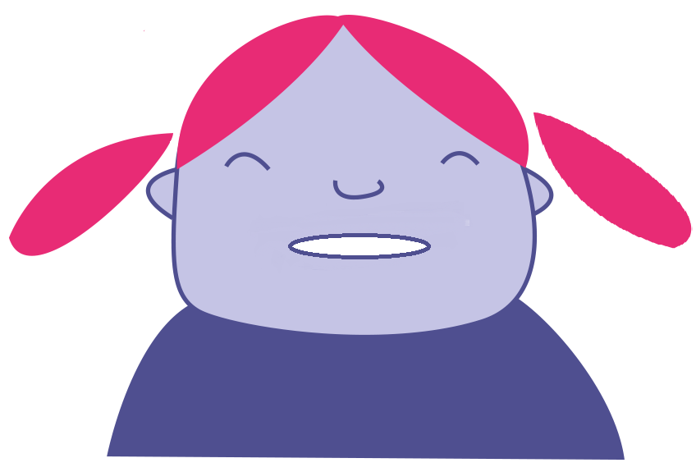
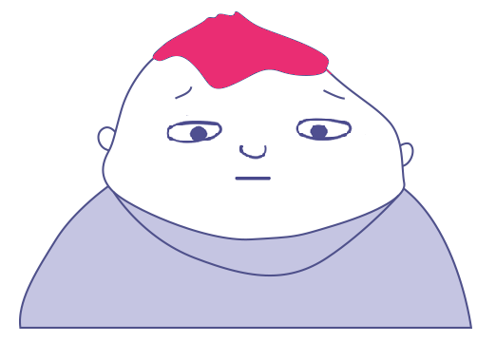

Change starts with? …
What could you do?
You see your friend push someone & say, ‘You can’t play with us’ to another pupil.
Smile
Compliment them
Laugh
Find an adult
Someone makes a joke about Isaac. He doesn’t laugh and looks upset.
Sit with them
Walk away
Ask if they are OK
Invite them to join
Someone sends a mean message to you about a person in your class.
Ignore them
Ask if you can help

Slide 8

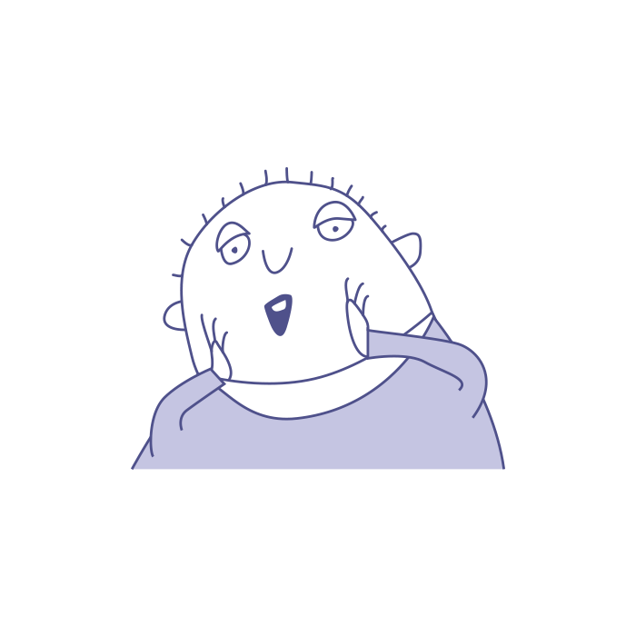

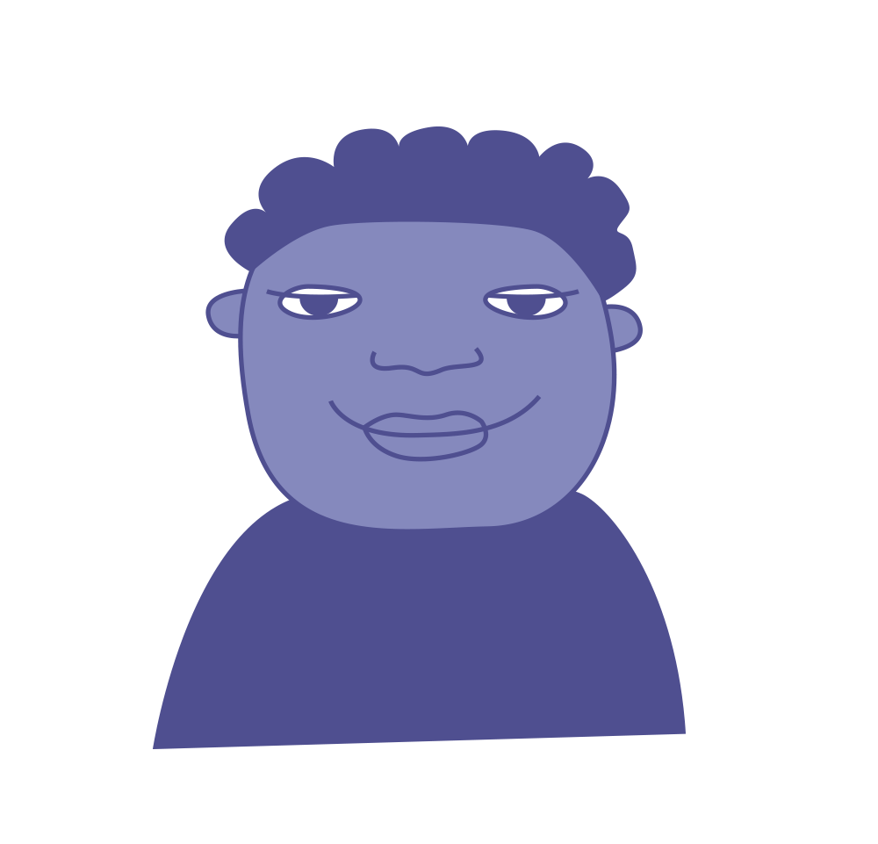
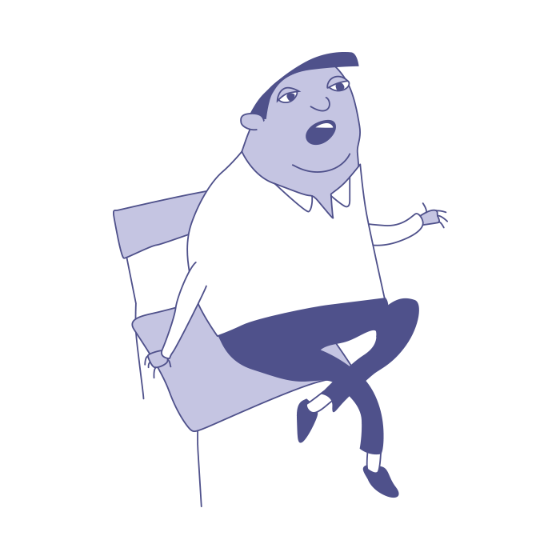

What can you do?
“…choosing not to share things that could upset someone else.”
“…looking out for children who look lonely at lunch.”
“... asking pupils how their lunch break has been every day!”
“…inviting people to join in even if they aren’t my friends.”
“… making sure my friends always know they can talk to me.”

