Slide 1

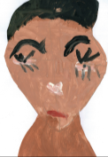
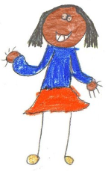
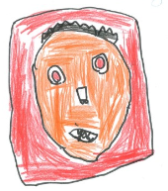
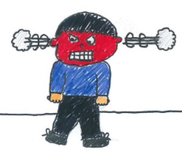
Introduction
Can you think of a time when you had a big or difficult feeling?
How might we notice big feelings in ourselves and others?
sad
worried
excited
angry
Slide 2

Slide 2
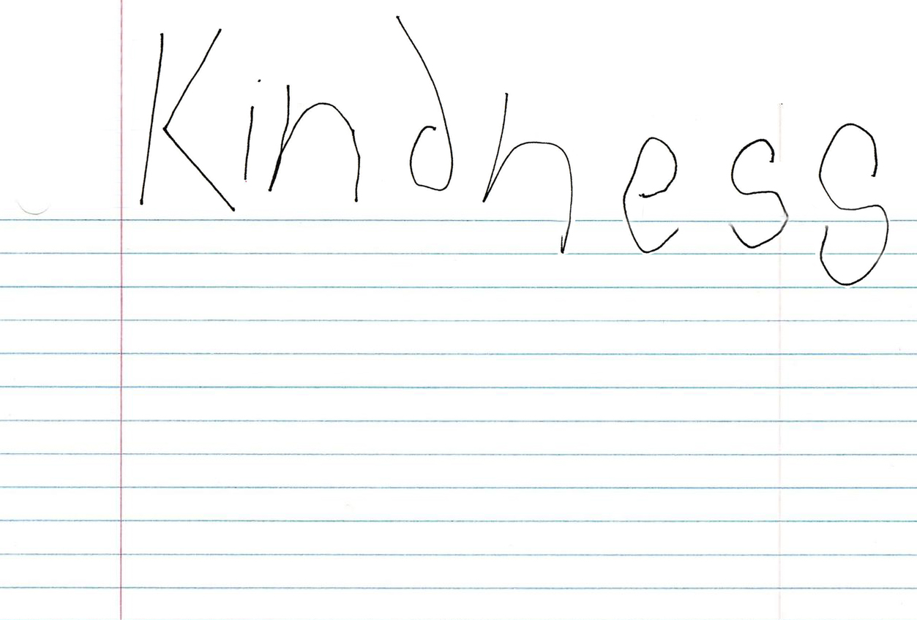
How do the people in the story show kindness?
Slide 3

Slide 3

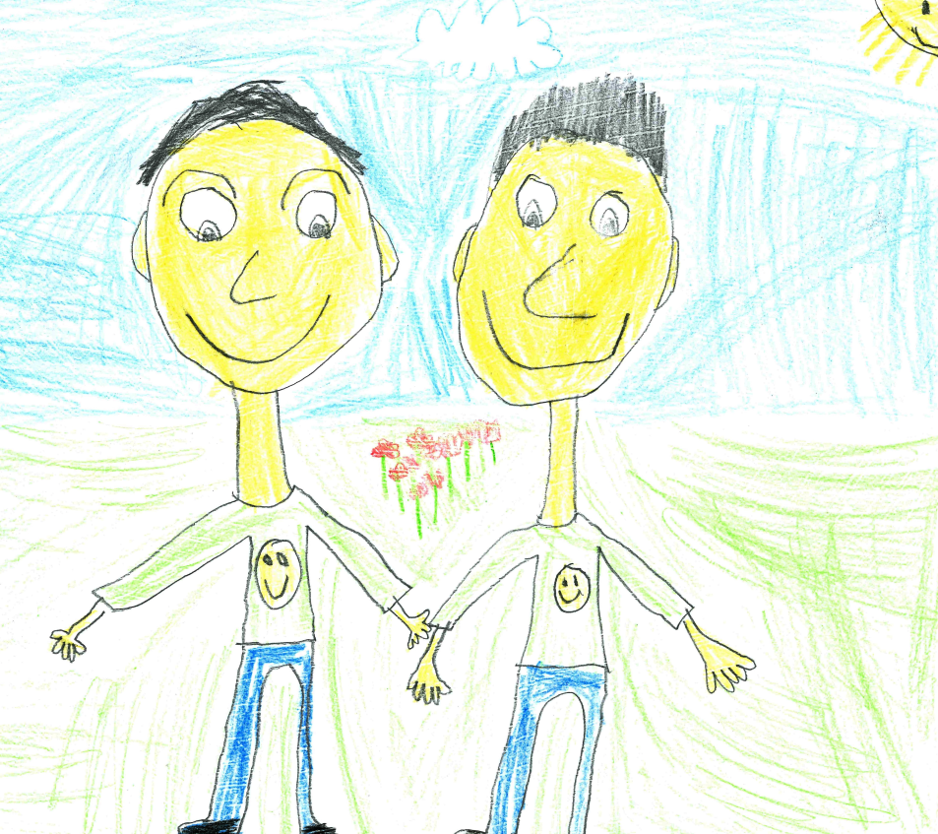
What does kindness mean to you?
How can we spread a little kindness in our school?
Slide 4

Slide 4
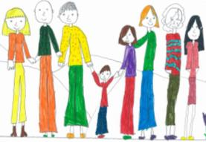
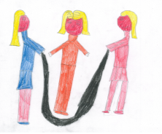
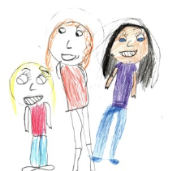
How can I be kind to myself?
Play my favourite game
Spend time with my family
Talk to a friend when I am feeling sad
Slide 5

