Slide 1
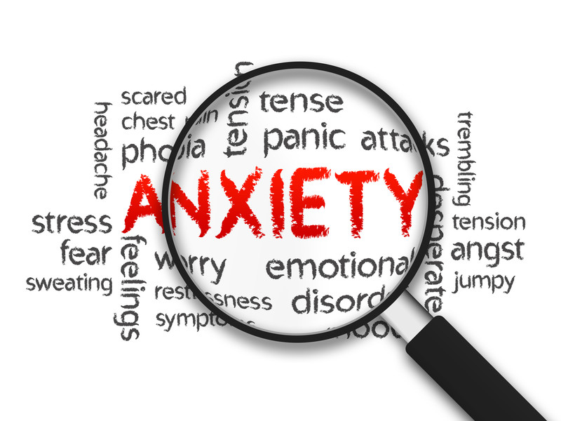
Supporting your child to manage their anxiety

Slide 2
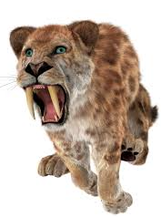
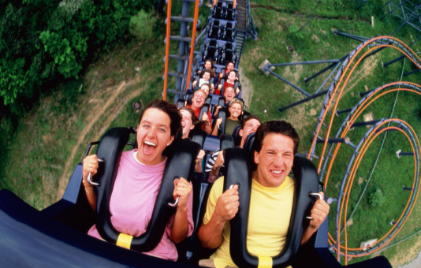
Why do we experience anxiety?
We all need a certain amount of anxiety and worry. It helps us to recognise things that we should be fearful of and act accordingly.
Our brains are ‘hard-wired’ to manage anxiety as a response to dangers. This comes from early man, who had to be poised and ready to respond to attacks by sabre-toothed tigers and the like!
Those ‘response to danger’ systems are still there in the human brain.
Therefore if our brain senses danger, whether it is real or imagined, it will act.
Whether the ‘danger’ is real or imagined, our physical reaction will feel the same because of our brain’s natural response.

Slide 3
What are common fears and worries?
Age | Physiological and social factors | Common outcomes of anxieties | Principal anxiety disorders
2-4 years | Thinking imaginatively but difficulty distinguishing from reality | Imaginary creatures Burglars The dark | Separation anxiety
5-7 years | Thinking capacity to think in concrete terms | Natural disasters Media based fears Animals Injury | Animal and blood phobia Separation anxiety
8-11 years | Self-esteem centres on athletic and academic success | Inadequate athletic and academic success | School phobia OCD
12-18 years | Formal organisational thoughts Self-esteem derived from peer relationships Capacity to anticipate future dangers | Health and personal safety Peer relationship problems Being different | Social phobia Agraphobia OCD

Slide 4
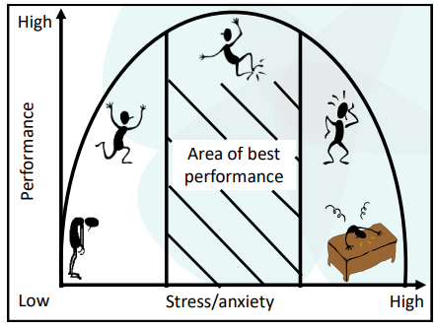
Why do we need stress and anxiety?
If we have no anxiety, we will have little motivation to engage with things around us, take healthy risks and try new things. A degree of anxiety pushes us on to challenge ourselves and can help us to perform better.
However, too much anxiety and stress will prevent us from performing well as we will be consumed by unhelpful thoughts and unpleasant physical symptoms.
Our best performance comes when we have a healthy balance of stress that we can manage.

Slide 5
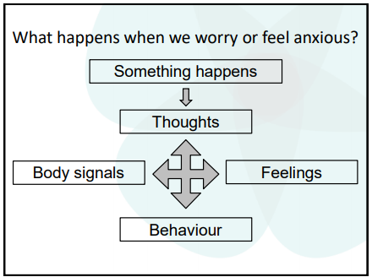
What is anxiety?
Research, particularly research related to Cognitive Behavioural Therapy, has broken down the complex tangle of anxiety into four stages.
Thoughts – these can be negative, thoughts we have about ourselves and our actions or even when our mind goes blank
Feelings – frustration, worry, anger, sadness
Behaviour – running away, panicking, fidgeting, distraction, avoidance, anger
Body signals – sweating, feeling hot/cold, heavy breathing, butterflies, fainting
One of these factors can trigger all the others. For example, if we start to have a negative thought it will make us feel frustrated or angry. Or if we start to feel hot then we can start to feel panicky.
It also means that if we can work on just one of these factors, we can reduce the others and have a reduced stress response.

Slide 6

How might the cycle work?
A friend doesn’t look up from what they are doing and say hello when you walk in the room.
Thoughts: They’re not speaking to me. I must have upset them.
Body reaction: palpitations, tension in the body
Feelings: sadness, worry, loneliness
Behaviour: Leave the room, withdraw, stop doing things you enjoy with your friends

Slide 7
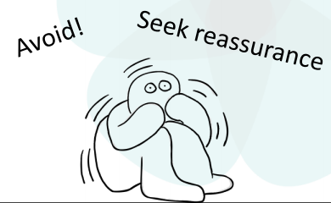
What do we need when we are anxious?
It is natural for us to either seek reassurance or avoid situations if we are anxious.
This gives us short term relief which makes us feel better in the short term.
However, reassurance and avoidance do not help with anxiety in the longer term.

Slide 8

How might the avoidance cycle work?
Your child does not achieve a high score on their spelling test.
I told you I’m no good at spelling!
Thoughts: I’m not good at spelling.
Body reaction: tension in the body, distraction, shouting
Feelings: worry, frustration, feelings of inadequacy
Behaviour: Avoid practicing spelling, become distracted in spelling test

Slide 9
How might the reassurance cycle work?
Your child lacks confidence in their spelling
I can only get my spellings right if I have help.
Thoughts: I’m not good at spelling.
Body reaction: quicker breathing, tiredness, pulse racing
Feelings: worry, frustration, feelings of inadequacy
Behaviour: seeking continued support with spelling, asking to have work checked, over-analysing their own writing

Slide 10
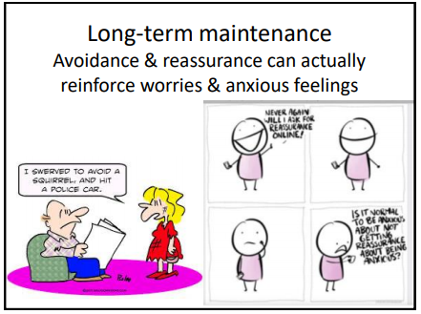
What impact could avoidance and over-reassurance have on anxiety?
Even though experiencing our ‘worst case scenarios’ can be difficult, if we never do that then we don’t believe we can manage them and cope.

Slide 11
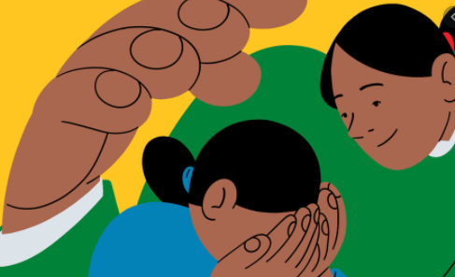
How do I talk to my child about anxiety?
Firstly, don’t worry about your response and saying the ‘right thing’. What is important to your child is that you have given them time and space.
Have conversations – make time and a safe space. Often saying things out loud makes us see that we are having unhelpful thoughts.
Actively listen – show you are listening, repeat back or paraphrase, don’t interrupt
Be honest – it’s okay to say you don’t have the answers and cannot make something better
Validate your child’s feelings – say that you can notice they’re finding things hard, name the feelings they are having for them. A useful phrase is ‘I wonder if you are feeling ….’
’Be with’ – make time and space for your child to talk to you even if what they are saying is uncomfortable
Normalise – let your child know that it is okay to have those feelings, make it a normal part of family life to talk about feelings. Talk about your feelings and how you are managing them
Clarify/question – question in a way that helps your child to find solutions for themselves, for example ‘What would you say to your best friend if they felt like that?’ or ‘Are their times when you don’t feel like that?’
Encourage next steps – but not too soon. You need to have built the connection and your child needs confidence before they can move onto actions
Thank them for sharing – tell your child you are proud of them for sharing and you will be there for them if they want to talk again.

Slide 12
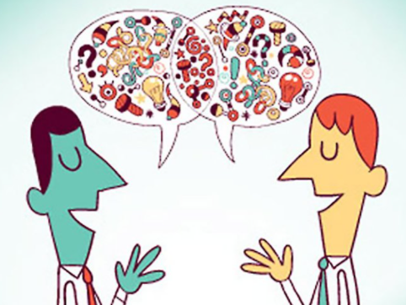
How can I change my child’s unhelpful thinking pattern?
Unhelpful thinking can fall into one of these categories:
Catastrophising – blowing things out or proportion. Ask your child: what is the evidence to support what you are thinking?
Labelling – naming things e.g. ‘I’m stupid’. Again, ask your child what evidence there is to support their thinking.
Jumping to conclusions – predicting what the outcome will be. Ask your child to test out their theory with you.
Mind Reading – assuming we know what others are thinking. Again, ask your child to test out if what they think is absolutely accurate.
Filtering – only hearing the bad and not the good. Question your child to try and get them to identify the good for themselves.

Slide 13
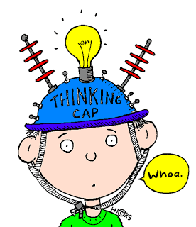
Balanced thinking – questions to ask yourself (and others!)
What’s the best that can happen here?
What’s the worst that can happen?
What’s the most likely to happen?
Is that a thought or a fact?
What’s the evidence for that thought?

Slide 14
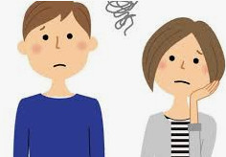
Any other top tips?
You need to validate your child’s response and understand that they cannot always distinguish a real ‘danger’ from an imagined one. You could start by saying, ‘That sounds like a real worry for you. What could we do about that?’
Try not to brush off your child’s worry by saying, ‘You don’t need to worry about that!’ They are worried about it so it is important to them.
Even if there is a simple solution, don’t jump in and give it. It is important that your child forms their own solutions, with your support, as this will help them to manage anxiety longer term.
Make steps small. By doing this they are achievable and, if your child does not manage a step, it is not a big set back.

Slide 15
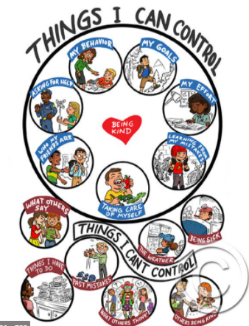
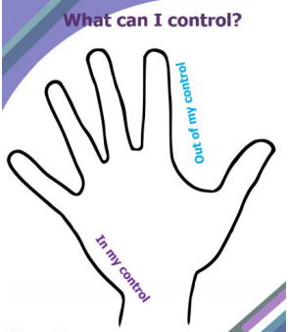
How can I change unhelpful thoughts?
Try putting things you can control in a tricky situation in a circle. Filling up the circle with lots of ideas helps us to feel more in control which then can make us calmer.
Put things we cannot control on the outside. We need to let go of these. You might need to talk to your child about how to let go of them and strategies they can use for letting them go. Give examples of what you do. Model it in everyday life, for example ‘I’ve got a really tricky meeting to do tomorrow, so I’m going to make a to-do-list for the morning and then I won’t have to think about it anymore tonight’.
Drawing around your child’s hand or even their body on large paper can also be used for this, with things they can control in the middle and things they can’t on the outside.

Slide 16

What do we mean by calm?
In the model of thoughts-feelings-behaviour-body reaction, our body reactions can be the best one to calm first. This is because we often experience them early on when we feel anxious. Also, if your child does not have the language to name their feelings, they can still often describe how their body feels.
When our body senses ‘danger’, it starts to react quicker so that it can deal with it. This is the inbuilt body response – you might breathe quicker, pumping oxygen around your body quicker, which gives you additional energy. But that additional energy can make us react quickly without thinking through the best response.
It is helpful if your child starts to recognise their anxious body reactions e.g. biting nails, sweating, fidgeting. They need to then see that as a time to pause and think about their thoughts that are causing that reaction.

Slide 17
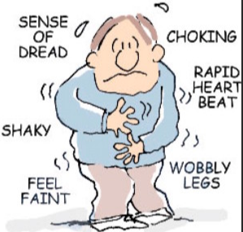
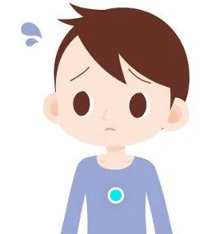
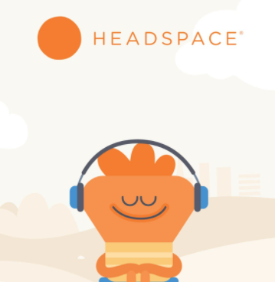
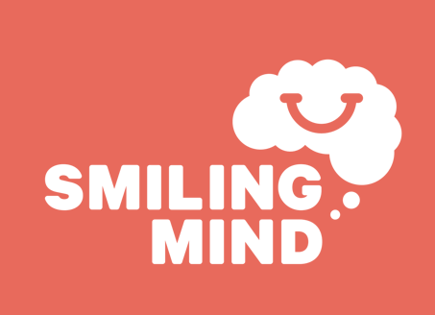
Why mindfulness?
Mindfulness can help children to notice and observe their feelings and thoughts without judging them. It isn’t about pushing the feeling away. It is about stopping and having the time to recognise and accept how we feel.
A mindfulness strategy …….
What 5 things can you see?
What 4 things can you feel?
What 3 things can you hear?
What 2 things can you smell?
What 1 thing can you taste?
How are you feeling?
Here comes that anxious feeling! I don’t want it but I’m not going to struggle with it. I’m going to accept that’s how I feel.
I don’t want this …

Slide 18
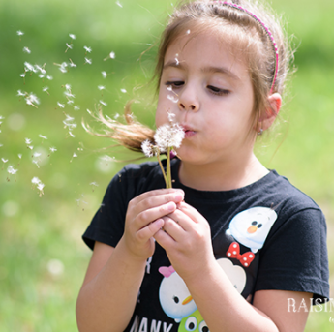
Other helpful websites and resources…
www.shambhala.com/sittingstilllikeafrog/ - guided ‘meditation’ for younger children
Cbeebies – 7 ways to keep kids calm
MyLife – calming app to download
Save the Children – https://resourcecentre.savethechildren.net/library/stress-busters
Anna Freud Centre website
CAMHS website
Headspace for Kids
Smiling Mind app
School website

