Slide 1

Teaching the Equality Act at Botley Primary School

Slide 2
What is the Equality Act?
The Equality Act 2010 states that it is against the law to discriminate against anyone because of:
Age
Disability
Gender reassignment
Marriage or civil partnership
Pregnancy or maternity
Race
Religion or belief
Sex/gender
Sexual orientation
(Government, 2010, p1)

Slide 3
Why are we looking at this now?
The public sector Equality Duty came into force on 5th April 2011 and requires that public bodies (including schools):
Have due regard to the need to eliminate discrimination.
Advance equality of opportunity.
Foster good relations between different people when carrying out their activities.
(Government Equalities Office 2013, p1)
This makes it clear that promoting some of the protected characteristics of the Equality Act while ignoring others is against UK law.
At Botley School we constantly reflect on what we are teaching and promoting in school, highlighting strengths and weaknesses. Recent audits of our teaching of British Values showed that we excel in teaching and building understanding in some areas of the Equality Act, some we do not cover as well as we could and some we do not cover effectively and so do not fully fulfil our duties under the Equality Act.

Slide 4
How are we aiming to improve?
At Botley School we will address this through a project called ‘No Outsiders’.
‘No Outsiders’ aims to develop the ethos of the school into one where every member of the school community, as well as every visitor through our doors, feels welcome and able to be themselves without fear of discrimination.
Through a series of lessons based around common children’s picture books, pupils will be taught the message:
that every individual is equal regardless of their age, gender, race, religion, belief, marital status, transgender identity or sexual orientation.
that each individual should be met with respect and tolerance without discrimination or hatred.

Slide 5
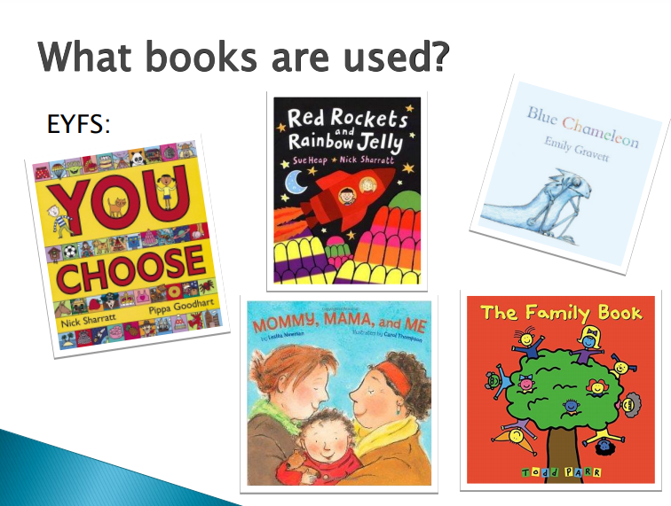

Slide 6
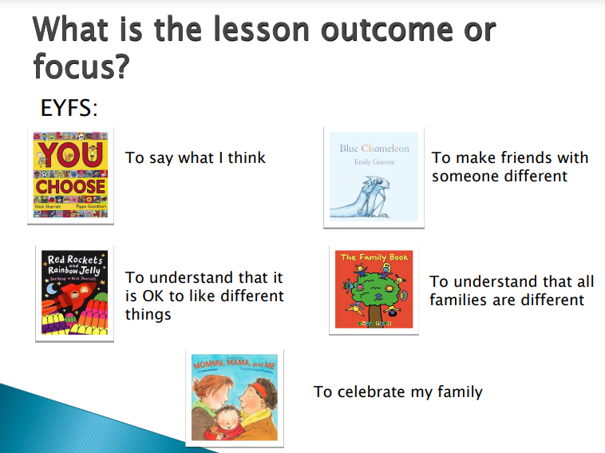

Slide 7
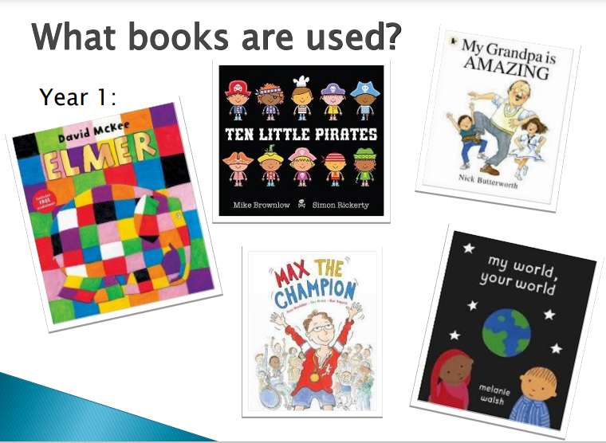

Slide 8
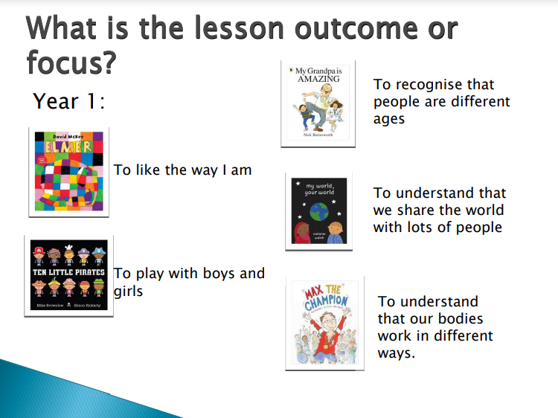

Slide 9
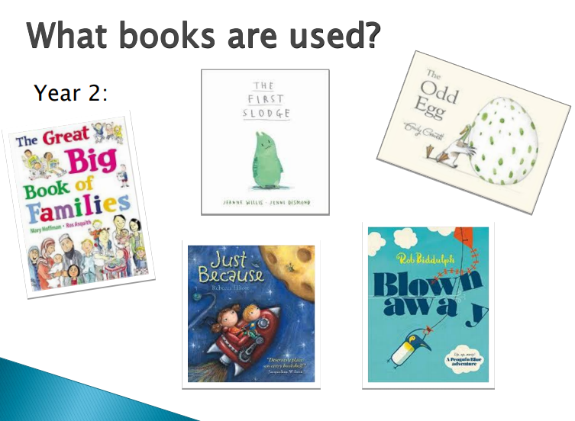

Slide 10
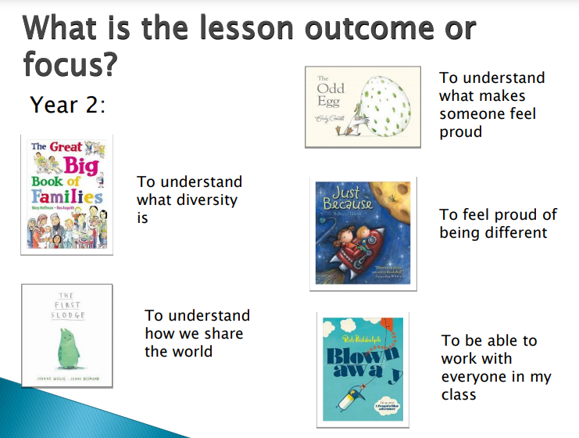

Slide 11
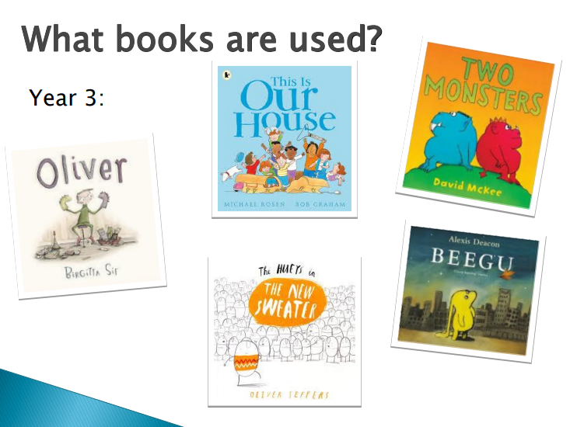

Slide 12
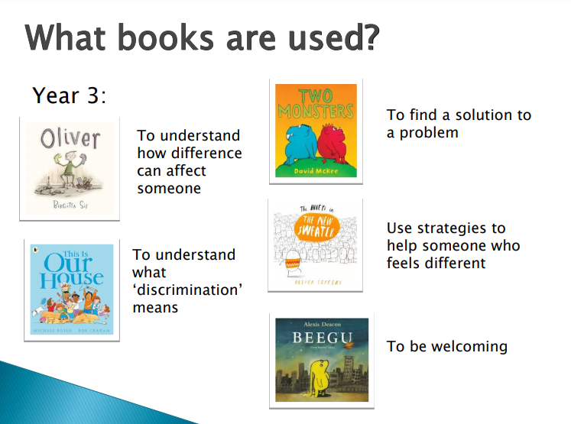

Slide 13
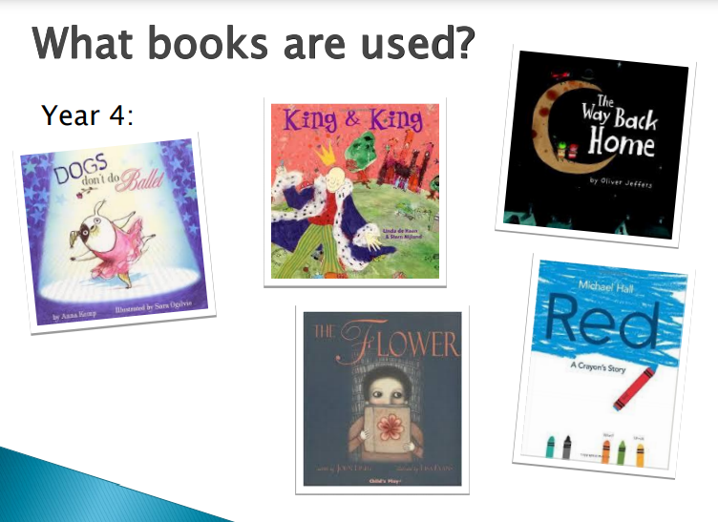

Slide 14
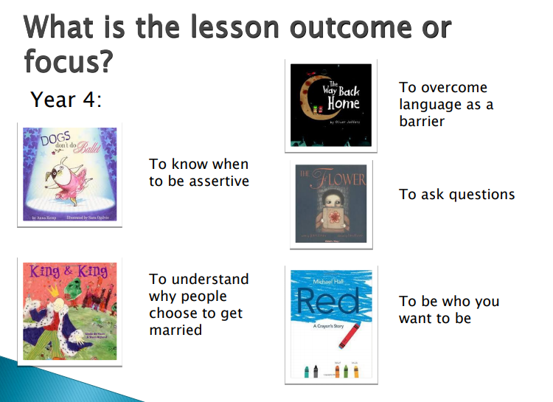

Slide 15
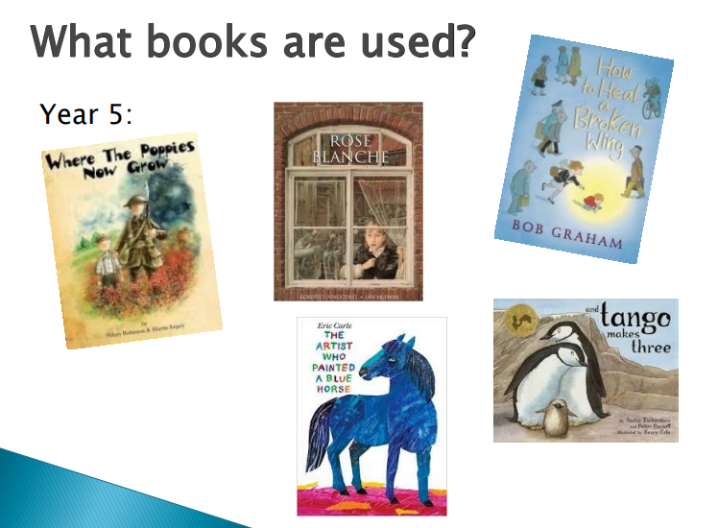

Slide 16
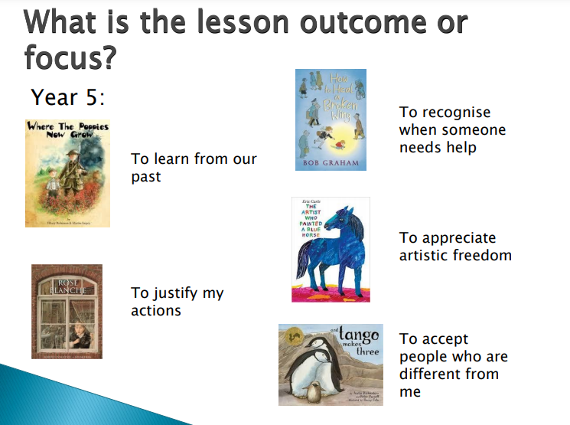

Slide 17
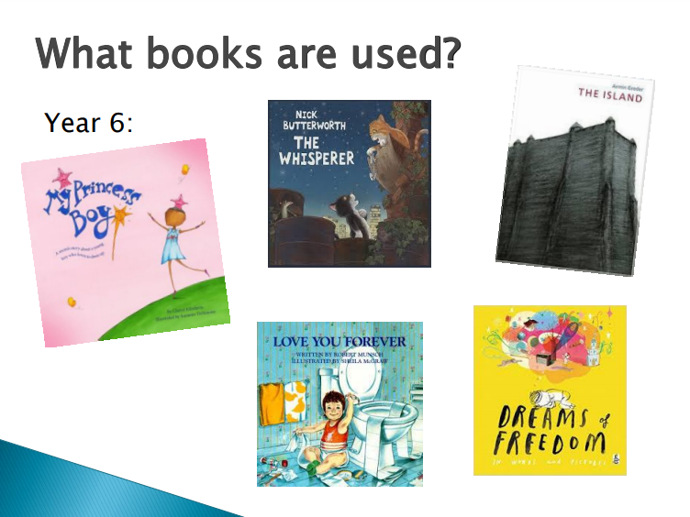

Slide 18
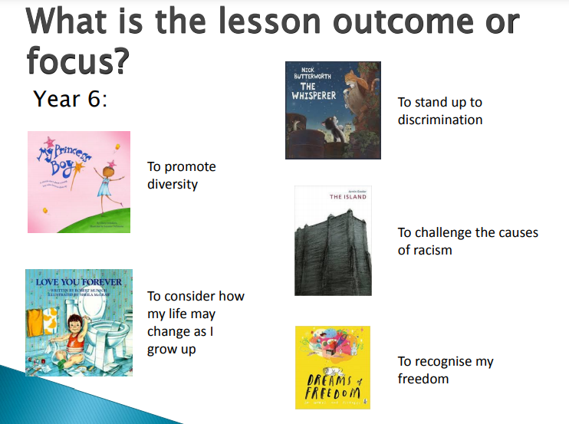

Slide 19
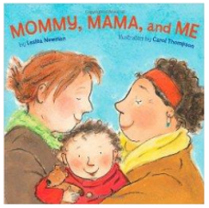
What might a lesson look like in Year R?
Read the book. Discuss what activities from the book the children like doing with their family.
Make a list of activities from the book that the family share. Act them out.
Write a sentence and draw a picture about an activity the children like doing with their family at home.
Look at the faces of the children in the book. How are they feeling?
What is your family good at? Who loves you in your family?

Slide 20

What might a lesson look like in Year 1 or 2?
Read the book. What examples of diversity (difference) are in the book?
Have categories: transport, festivals, homes, religions. Teams of children have to race to think of as many examples as possible to show the diversity within each category.
Around a map of the UK, children write ways in which we are diverse e.g. families, religions, homes, jobs
What would it be like if we were all the same? Why is diversity a good thing?

Slide 21
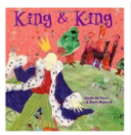
What might a lesson look like in Year 3 and 4?
What does marriage mean?
Read the story. Why doesn’t the son tell the Queen he does not want to marry a princess? Is she okay when he tells her?
Discuss: why do people get married? Discuss the royal wedding. How did people feel watching?
Children design a wedding invitation for people who they know are married in their family or a famous couple, or for the couple in the story.
Show images of different marriage ceremonies. What is the same and different about them? What is the law regarding marriage in the UK?

Slide 22

What might a lesson look like in Year 5 and 6?
Read the book. How do we know that Roy and Silo love each other? Were they good Dads? How do we know?
Give out snap playing cards with animals on. Each child has one card and must not show anyone their card. They must find their ‘pair’ without talking; they must use movements or noises.
Keep one card back so one child does not find a partner. What can we do with this lonely animal? Encourage children to let them join their family, as families can be made up of different people (animals).
Look at the story of two male vultures in Alwetterzoo, Munich, Germany. Write letters to the zoo giving advice.
Read the author’s note – this is a true story. Do any of the other penguins bully Roy and Silo? Why? Would we do this at our school?

Slide 23
Will these lessons prompt my child to ask challenging questions?
Possibly, your child or children trust you and will be likely to ask you questions to test your beliefs and opinions.
Please don’t avoid them, talk openly about diversity and equality.
Teaching about diversity and equality is teaching about:
Difference
Acceptance
Tolerance
Diversity
How to challenge discrimination
Teaching about equality helps our children to prepare for the next stages in their lives.

Slide 24
The scheme includes books that mention sexual orientation and transgender issues…
We are teaching about equality. Our school ethos says that everyone is welcome and there are no outsiders. This means that everyone is welcome regardless of their sexual orientation and gender identity.
Some children grow up in families with gay or lesbian people and it is important that they feel they can talk confidently about their family. We want all of our children to know that every family is different and special, and their own family is accepted in school.
Our children will all have to interact with people from different backgrounds as they grow, and we want them to treat all members of the community with the same respect.

Slide 25
Tackling prejudicial language…
Every child and adult in our school community has the right to be protected from prejudicial views and behaviours. Prejudicial language or behaviour can be words or acts based on preconceived opinion. They are not based on reason or actual experience, for example, not liking someone based on their skin colour or sexual identity.
Within our school we will not tolerate any prejudicial language or behaviour aimed at students or adults.
We want everyone at Botley School to feel welcome. We want there to be no outsiders.

Slide 26
Possible parental concerns….
But no children are gay here, why does it need to be mentioned? Some of our children will turn out to be gay so we need to make sure they do not grow up thinking there is something wrong them. Also some of our families may have gay people in them.
Can I remove my child from these lessons? No. These are not R.E. or Sex Education lessons, which you can remove your child from. They are part of our school curriculum.
But my religion says that gay is wrong. We understand that and respect all faiths here. We are preparing children for the diverse world they live in. As they grow up they can make up their own mind on what is right or wrong, we are simply giving a rounded view.
You are going to make my child gay! No, we are teaching your child to celebrate difference and not be afraid of it. This will not make your child change how they are.
You are confusing my child because we have different views at home. We are teaching children that all families are different. It is important that they hear about people who are different as they are going to meet people from all sorts of families as they grow. When they grow up, they can make up their own minds about what is right and wrong.

Slide 27
Addressing difficult questions…
If you are able to, it may help to rehearse how you want to handle a difficult conversation. In that way you are prepared and unflustered.
Keep the message simple, e.g. ‘We are all different and that is ok’, ‘We can all be friends’, or ‘We like different things and that is ok’.
Make simple analogies around liking some things the same and some things differently from others in your family.

Slide 28
I have some further questions…..
If you have any further questions, please talk to your child’s class teacher initially.
You can also talk to Miss Sambles (Deputy Head) to seek further clarification on how the No Outsiders lessons will be used in school.

