Slide 1

Botley Safeguarding Quiz!

Slide 2

What does the word safeguarding mean?
Owen

Slide 3
What does the word safeguarding mean?
Safeguarding means to guard or look after our safety.

Slide 4
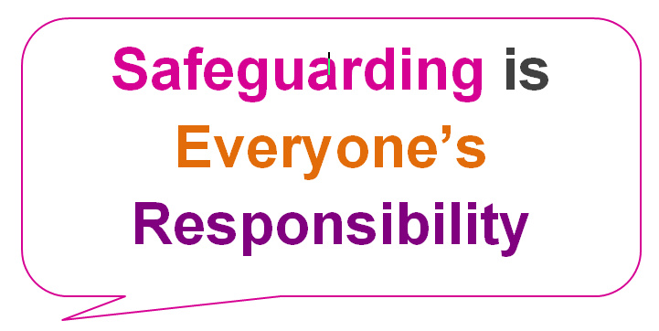
Who is responsible for safeguarding in school?
Amelia

Slide 5
Who is responsible for safeguarding in school?
Mr Cooil is ultimately responsible for safeguarding in school, but safeguarding is the responsibility of all adults- including staff, volunteers, governors and parents. And you can help to keep the school safe too!

Slide 6

Which adults are the three designated safeguarding leads in school?
Charlotte

Slide 7

Which adults are the two designated safeguarding leads in school?
Mr Cooil the designated safeguarding lead (DSL) in school and Miss Sambles and Mrs Grist are Deputy DSLs. This means that they help to make sure that everyone knows how to keep the school safe.

Slide 8

Who can you talk to if you have a worry about your safety or someone else’s?
Olly

Slide 9
Who can you talk to if you have a worry about your safety or someone elses?
You can talk to any adult in school if you have any worries or concerns. They are here to help you.

Slide 10

How do you know if an adult in school is supposed to be here?
Ethan

Slide 11
How do you know if an adult in school is supposed to be here?
All adults in school wear lanyards to show that they are meant to be here. We have different lanyards to show which adults are staff, governors, visitors, volunteers, contractors and student teachers.

Slide 12
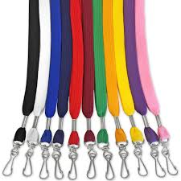
What should you do if you see an adult who is not wearing a lanyard?
Izzy

Slide 13
What should you do if you see an adult who is not wearing a lanyard?
If it is a member of staff who you know, you could remind them to wear their lanyard. If you don’t know them, you should tell the nearest adult who you do know straight away.

Slide 14
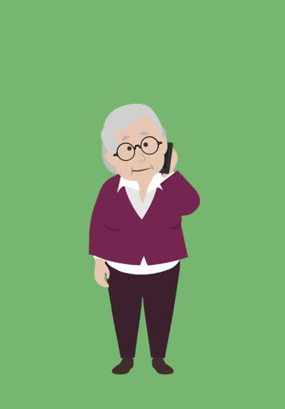

What should you do if you see an adult using a mobile phone in school?
Daisy

Slide 15
What should you do if you see an adult using a mobile phone in school?
You should tell a school adult who you know straight away.

Slide 16
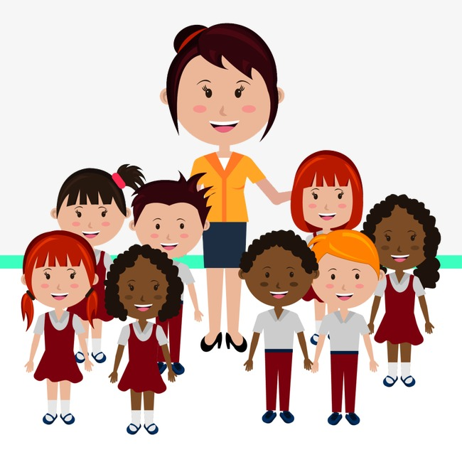
What do staff do to keep you safe?

Slide 17

What do staff do to keep you safe?
Help children who are hurt or have worries/upsets.
Keep everyone safe in emergencies (e.g. fire).
Problem solve when friends fall out.
Teach us how to be safe out of school.
Ask visitors in to talk to us about staying safe.
Set rules and routines which are fair.
Keep the classrooms safe.
Keep the school secure.

Slide 18
What can you do to help to keep the school safe?

Slide 19
What can you do to help to keep the school safe?
Be a good friend to others.
Look after each other.
Follow adult instructions and the Ide golden rules.
Have permission to use a computer and only go on websites that adults have said you can.
Keep the classroom safe and tidy.
Tell an adult if you are worried about yourselves, another child or a grown up.

Slide 20

What can parents do to help keep the school safe?

Slide 21
What can parents do to help keep the school safe?
Drive carefully on the road and teach us about road safety.
Help keep our school secure by keeping the front door closed.
Monitor what we do on our electronic devices at home.
Don’t share personal information about other peoples’ children on social media (unless you have the parent’s permission)

Slide 22
Well Done! You have completed the Botley safeguarding quiz!

Slide 23



Jacob

