Slide 1

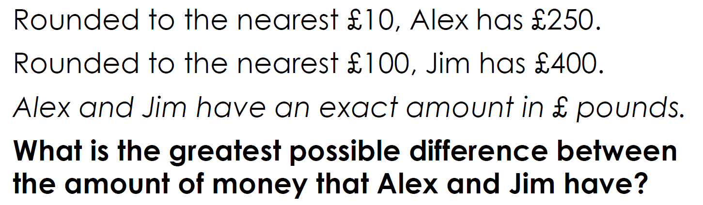

Maths at
Botley Primary School

Slide 2
Maths at Botley Primary School
Aims of this meeting:
Our Curriculum
How Maths is taught at Botley Primary School (and some strategies we use)
Written Methods and Our Calculation Policy
Assessments
How to Help Your Child With Maths

Slide 3
1. Our Curriculum
The national curriculum for mathematics aims to ensure that all pupils:
become fluent in the fundamentals of mathematics so that pupils develop conceptual understanding and the ability to recall and apply knowledge rapidly and accurately
reason mathematically by following a line of enquiry, conjecturing relationships and generalisations, and developing an argument, justification or proof using mathematical language
can solve problems by applying their mathematics to a variety of routine and non-routine problems with increasing sophistication, including breaking down problems into a series of simpler steps and persevering in seeking solutions

Slide 4
Our aims are to ensure that all pupils become proficient with:
Fluency
Reasoning
Problem Solving

Slide 5
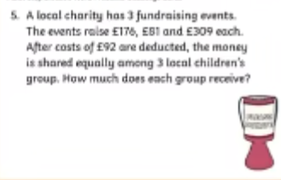
Fluency

Slide 6
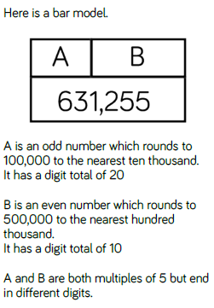
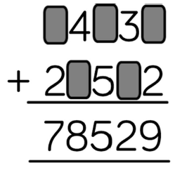
Deepening the learning
Problem Solving

Slide 7
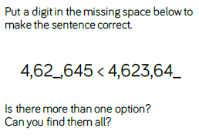
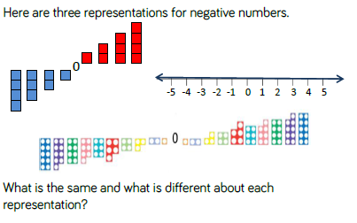
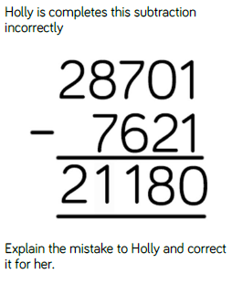
Deepening the learning
Reasoning

Slide 8
Skills needed to solve this problem:
Rounding
Difference
Interpreting information
Concept of ‘greatest’ and size
Money

Slide 9
The least Alex can have is £245.
The most Jim could have is £449.
The greatest possible difference is 449-245 = £204

Slide 10

A CPA Approach

Slide 11
2. How Maths is taught at Botley Primary School
Maths is taught each morning for 1 hour – mostly by their normal class teacher.
Maths is not ‘set’ – all children are taught in a mixed ability setting, with teachers using effective AfL to tailor learning to each child.

Slide 12
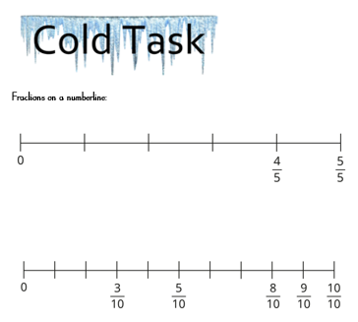
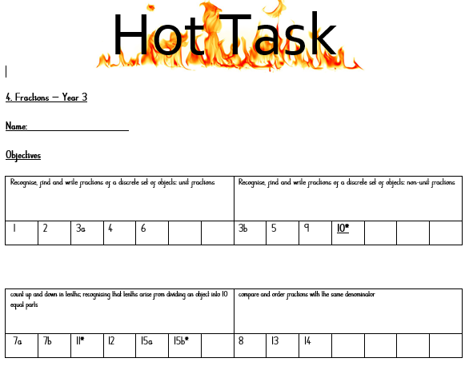
Providing a challenge for all learners

Slide 13
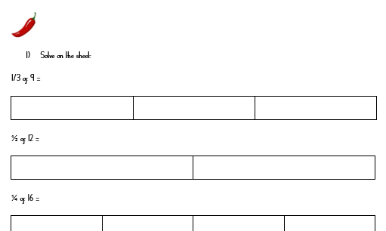
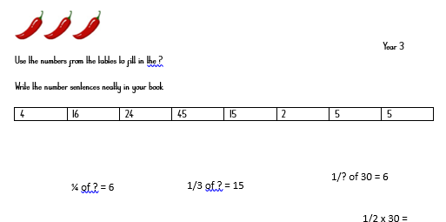
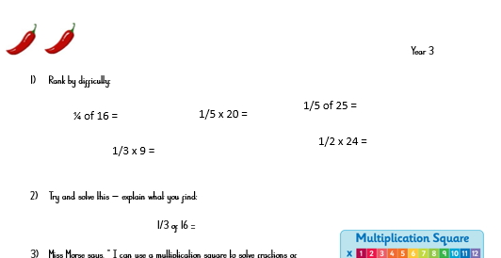
Providing a challenge for all learners

Slide 14
In a maths lesson, you will see:
Teachers modelling methods and skills,
Concrete and pictorial resources,
Overlearning and retrieval tasks,
Children working in groups, independently, with a teacher or a LSA,
Cutaway groups,
Self- and peer-marking,
Assessment.

Slide 15
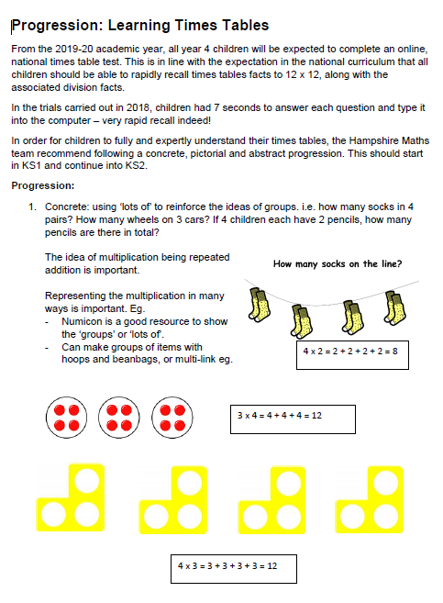
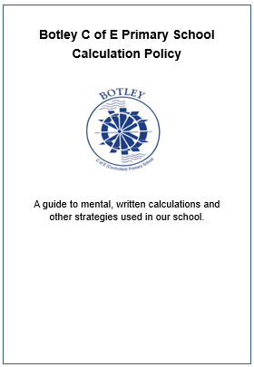
3. Written Methods and our Calculation Policy

Slide 16

Website Support

Slide 17
4. Assessments
At the end of year 6, Children will sit three papers in maths:
Paper 1: arithmetic, 30 minutes
Papers 2 and 3: reasoning, 40 minutes per paper
Paper 1 will consist of fixed response questions, where children have to give the correct answer to calculations, including long multiplication and division. Papers 2 and 3 will involve a number of question types, including:
  Multiple choice
  True or false
  Constrained questions, e.g. giving the answer to a calculation, drawing a shape or completing a table or chart
  Less constrained questions, where children will have to explain their approach for solving a problem
  These assessments are mirrored throughout the year groups so children are more than familiar with the process.

Slide 18
Sample KS1 maths arithmetic questions
3 x 5 =
12 + 2 + 2 =
22 + 20 =
10 x 4 =
79 – 6 =
10 + 60 + 20 =
¼ of 28 =
6 ÷ 2 =
35 + 5 + 5 =

Slide 19
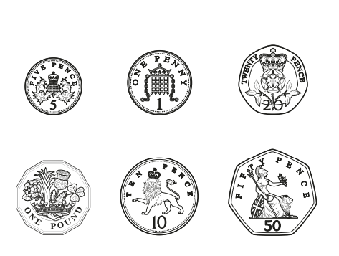
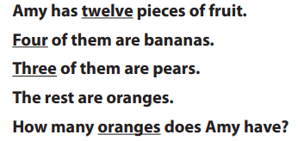
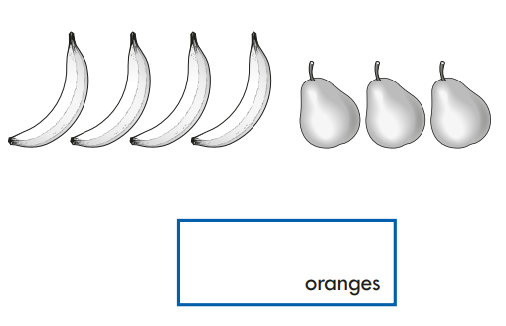
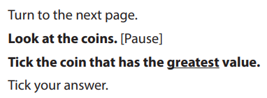
Sample KS1 maths reasoning questions

Slide 20
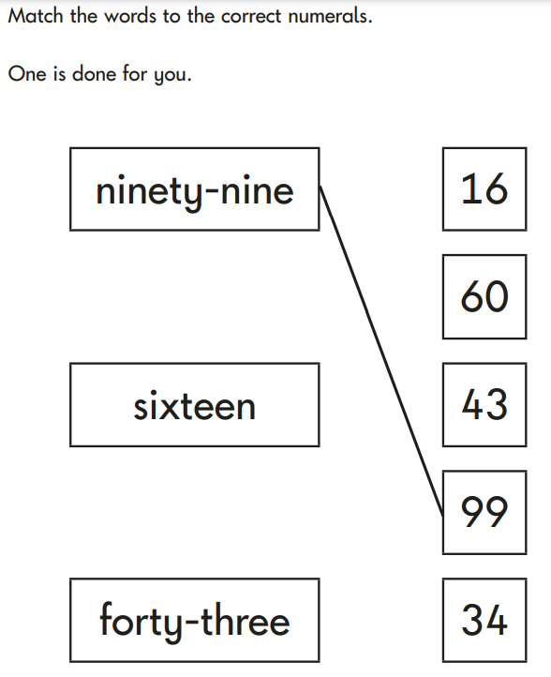
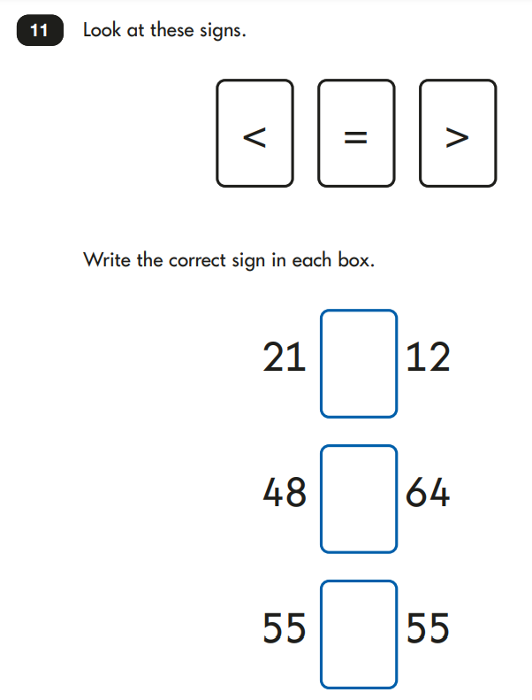
Sample KS1 maths reasoning questions

Slide 21
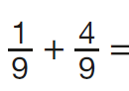
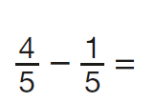
Sample KS2 maths arithmetic questions
6.1 + 0.3 =
5 × 4 × 7 =
4² =
1,440 ÷ 12 =
630 ÷ 1/9 =
1,034 + 586 =
86% of £324 =
2.5 + 0.05 =
24 × 3 =
100 × 100 =
48 ÷ 6 =
1.28 × 100 =

Slide 22
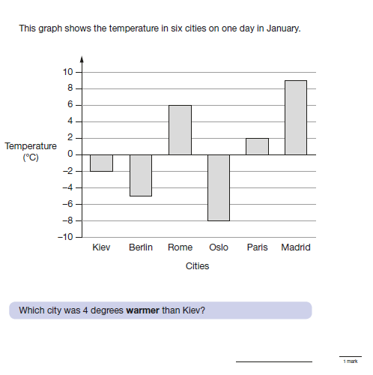
Sample KS2 maths reasoning questions

Slide 23
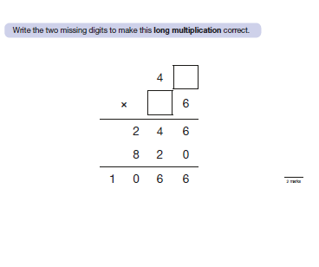
Sample KS2 maths reasoning questions

Slide 24
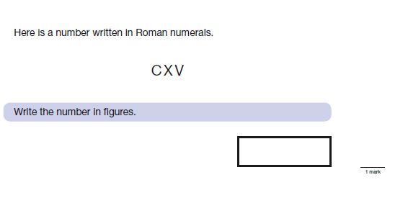
Sample KS2 maths reasoning questions

Slide 25
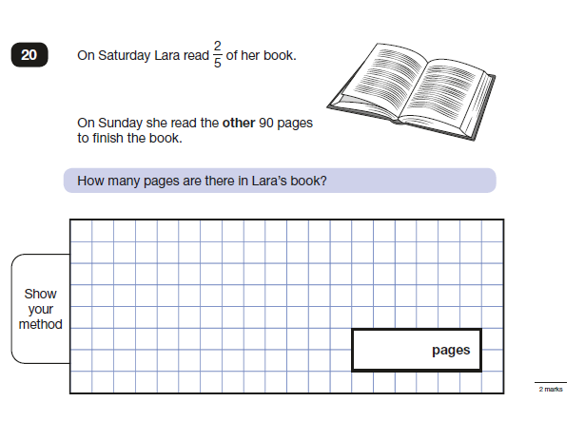
Sample KS2 maths reasoning questions

Slide 26
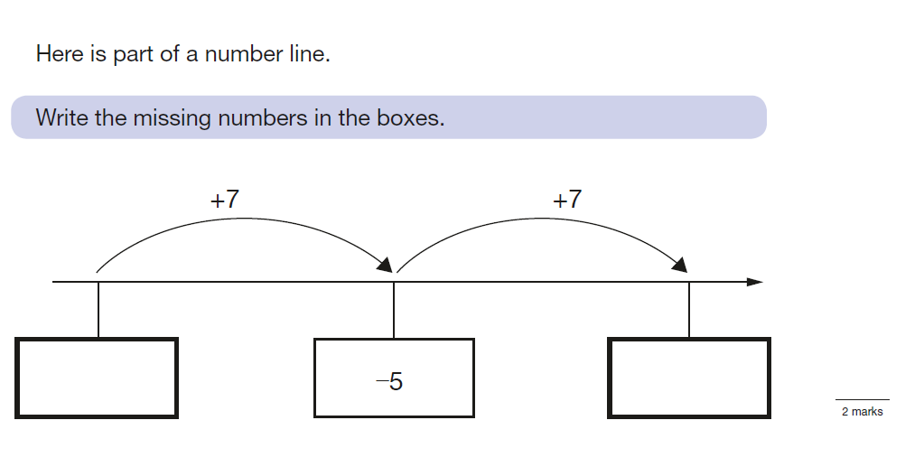
Sample KS2 maths reasoning questions

Slide 27
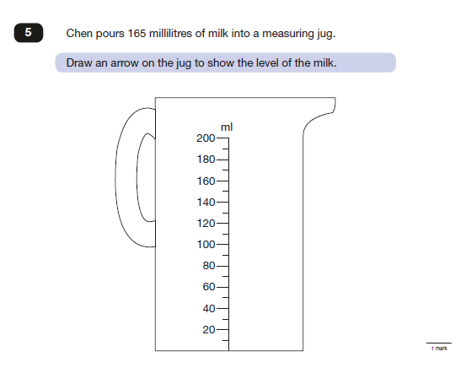
Sample KS2 maths reasoning questions

Slide 28
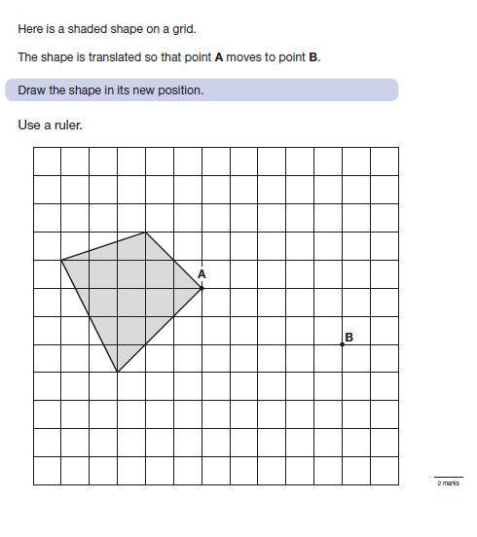
Sample KS2 maths reasoning questions

Slide 29
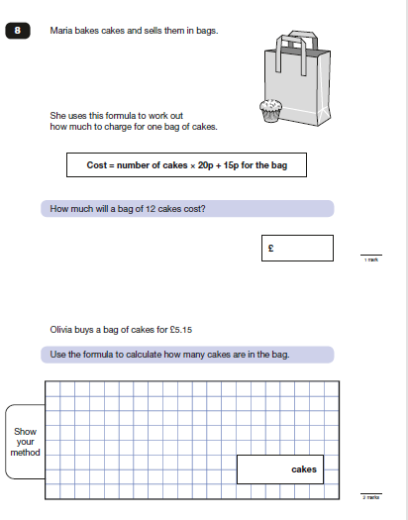
Sample KS2 maths reasoning questions

Slide 30
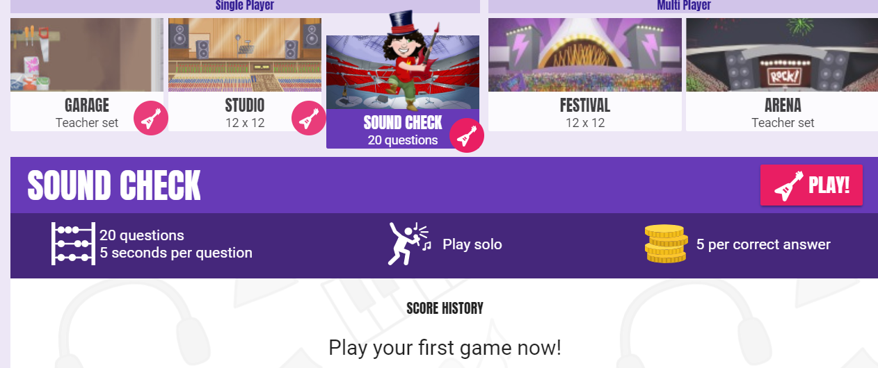
Year 4 Times Table ‘Check’
Children in year 4 will be required to take part in a times table check in the summer term – this is to check whether they can rapidly recall all of their times tables (to x12).
It will be an online test: each question will be displayed for 6 seconds on the screen and children will be required to type in the answer. It will then move on to the next question (children will not be able to return to a question if they miss it out).
TT Rockstars have introduced
‘Sound Check’ mode which will
replicate this set up.

Slide 31
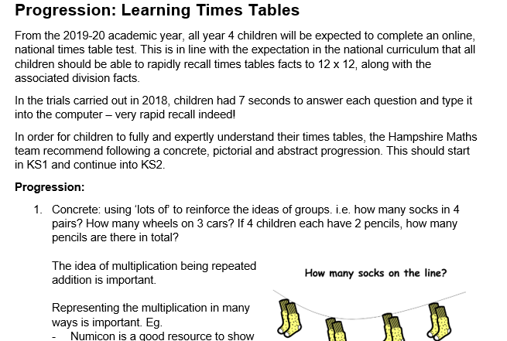
Progression in Times Tables Document

Slide 32
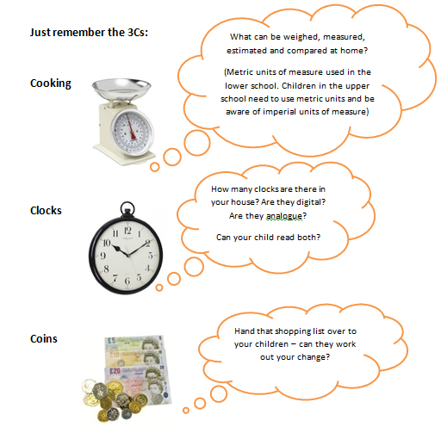
5. How to support your child with maths
Please continue to help your children with their homework – taking time to sit down with your children helps to demonstrate the importance of learning!

Slide 33
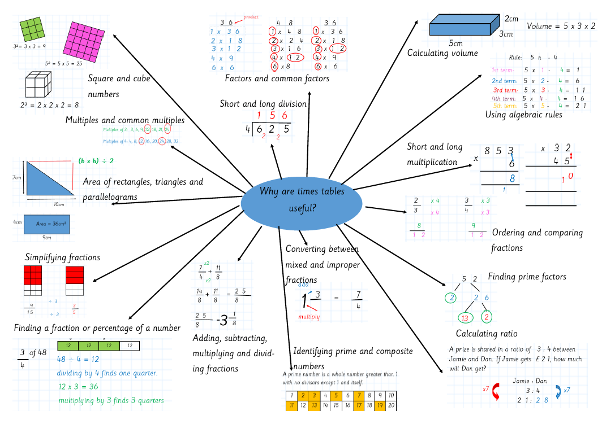
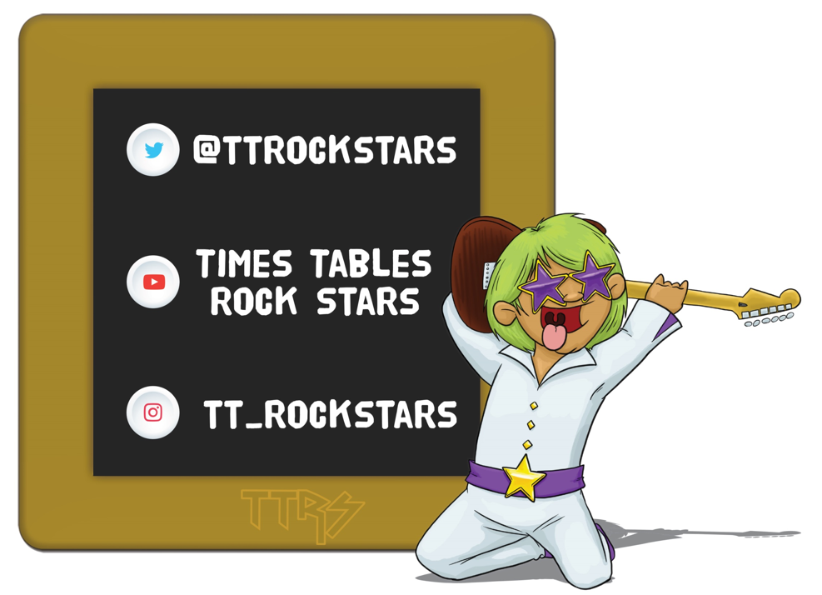
How to support your child with maths

Slide 34
Questions?
Please ask your class teacher in the first instance – they can always pass questions on to the Maths lead if required ☺

