Slide 1

Year R September 2026
Induction Meeting 1

Slide 2
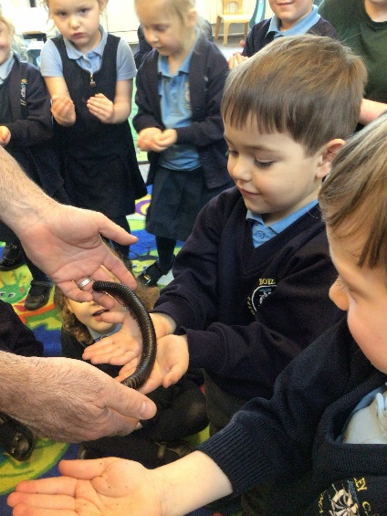
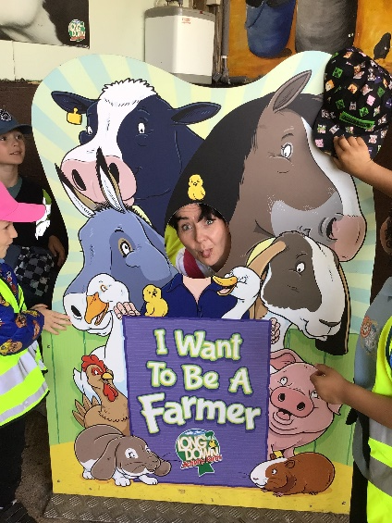
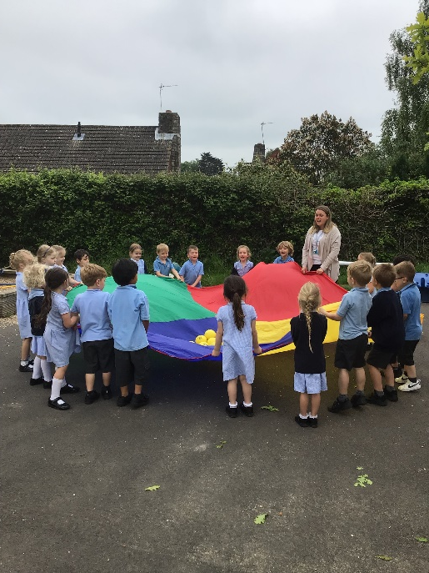
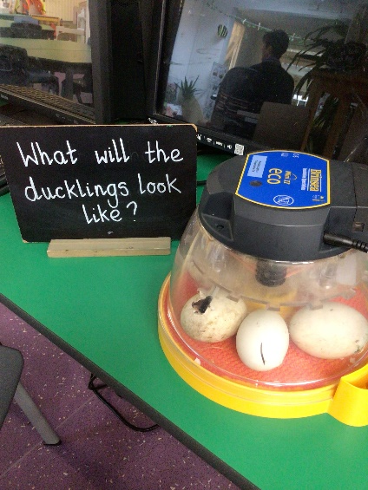
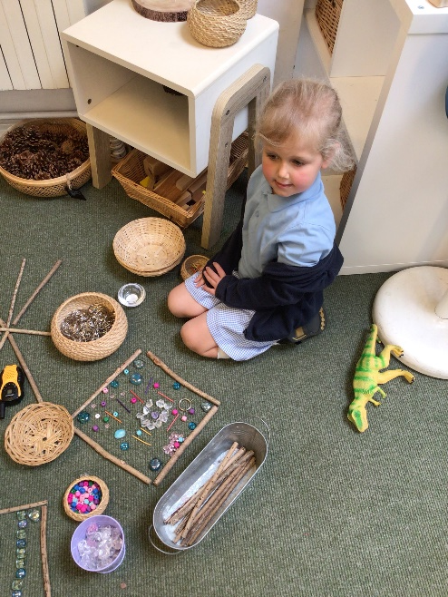
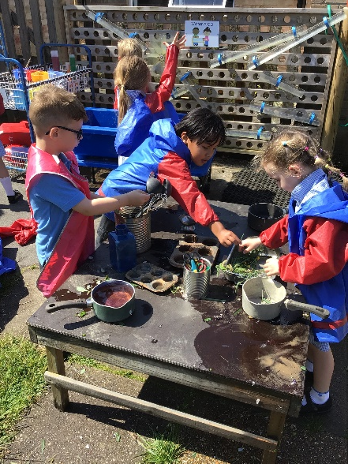
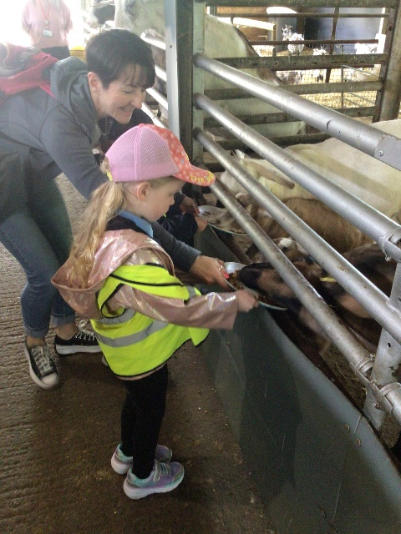
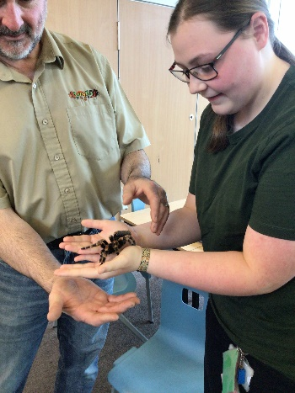
Welcome!
Notes:
Joe

Slide 3
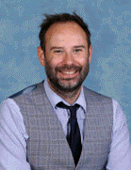
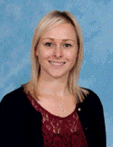
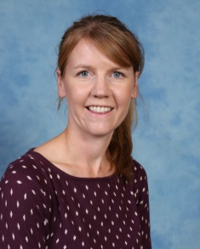
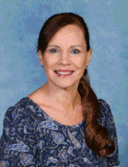
Senior Leadership Team
Headteacher:
Mr Joe Cooil
Deputy Headteacher:
Mrs Becci Shuttle
SENDCo:
Mrs Kate Roberts
Senior Administration Manager:
Mrs Hilary Ellery
Notes:
Joe

Slide 4
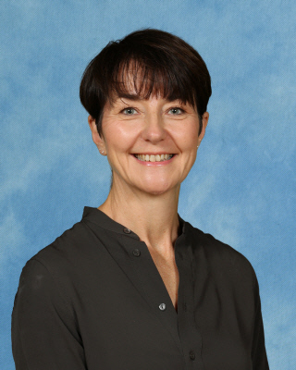
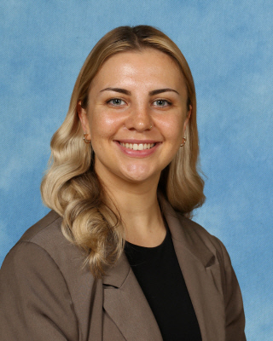
Adults
Teachers
Mrs Voirrey Gray (EYFS Lead)
Miss Lily Scott
LSA support
Mrs Barfoot
Miss Coull
Mrs Barton
Miss Allison
Notes:
Joe

Slide 5
Key Information
Intake of 60 children.
Two classes of 30.
Bumblebee and Dragonfly classes.
Register and have lessons in individual classrooms but operate across both as a single unit and share use of the large outdoor area.
Balance between adult led learning and child initiated learning through a continuous provision approach.
Notes:
Aimee

Slide 6
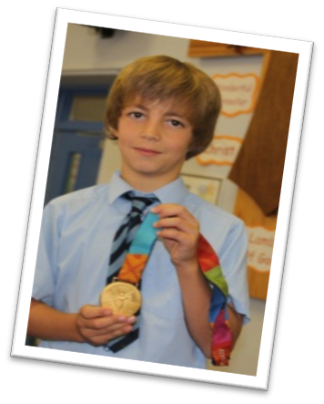
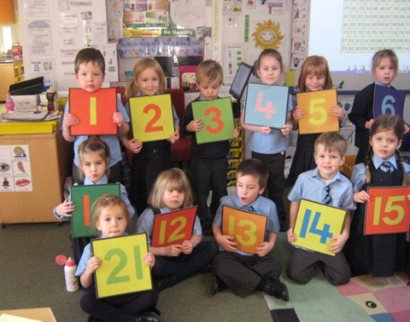
A Christian School
- A Church of England school
- Links with the Diocese
- Strong links with All Saints Church,
- Rector visits
- Church visits
- Whole School Celebrations
- Our Botley Heart Values of courage , respect and stewardship.
Notes:
Joe

Slide 7
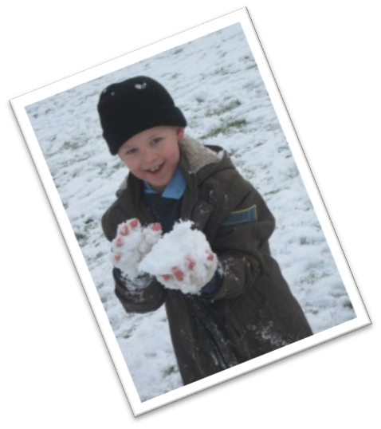
Behaviour
- Our behaviour has been judged outstanding
- Positive approach to behaviour
- Consistency with a clear policy
- Range of rewards and sanctions
- Close relationships with parents
- Whole school celebrations weekly
- Calm and purposeful atmosphere in which all children can learn
Notes:
Joe

Slide 8
Starting School
Wednesday 2nd September – home visit week
Tuesday 8th and Wednesday 9th September– 9.00am until 11:30am-more opportunity for home visits during afternoons
Thursday 10th and Friday 11th September-9.00am until 12.30-stay for lunch
w/c 14th September – All children full time
Notes:
Aimee

Slide 9
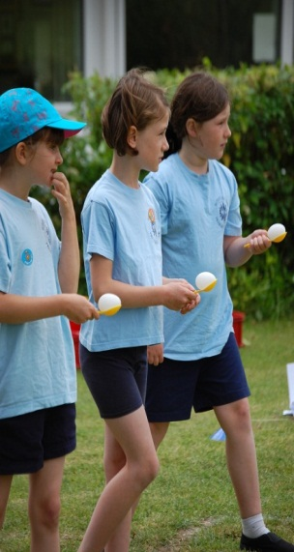
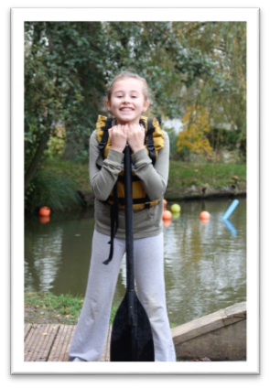
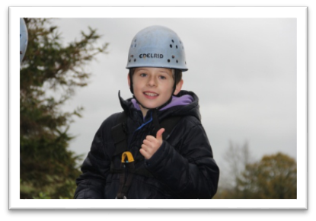
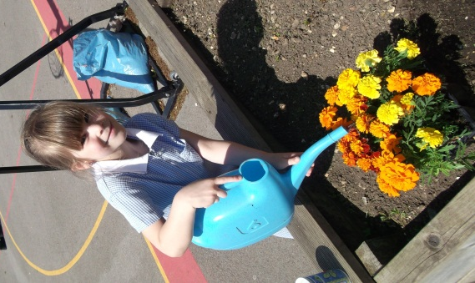
Preparing the Children for School
- Induction meetings
- Visits to school
- Home visits
- Contact Early Years providers
Notes:
Aimee

Slide 10
Food and Drink
Milk is provided daily free of charge to all 4-year olds.
There is at least one free healthy snack of fruit every day.
Children will need a named water (not metal). bottle each day which contains fresh water
A hot school lunch is provided free of charge each day through our provider Aspens.
This needs to be selected before 8:00am each day, but can be ordered up to a month in advance.
Special diet application deadline – 1st July
Notes:
Fran

Slide 11
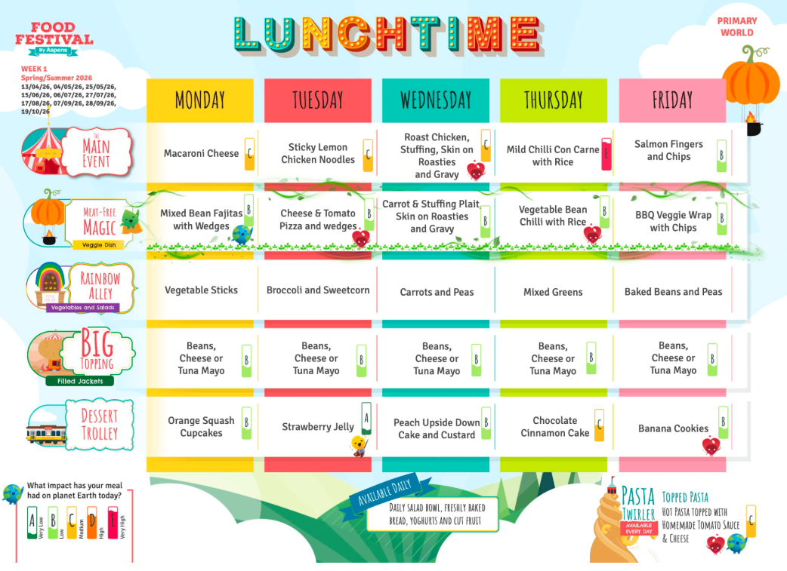
Example of Current Menu

Slide 12
School Uniform
The school has a summer and a winter uniform, however we discourage Year R children from having button up shirts.
The uniform list can be found on the school website.
School uniform with a logo can be purchased from our online uniform provider – SchoolKit (see website).
Other elements of uniform can be purchased from other providers (e.g. supermarkets).
Notes:
Fran

Slide 13
School Uniform
Please ensure all uniform is named (including PE kit) – it will get lost otherwise.
Writing names in pen is not a good way to name uniform in order to ensure it stays safe.
Also name all other items brought to school such as hats and coats.
Each child will need a school book bag. These can be ordered online.
Children will not need to bring rucksacks to school.
Notes:
Fran

Slide 14
PE
Children need a PE kit that they bring in and keep in school (see uniform list).
If it gets wet or needs washing in term time it will be sent home, otherwise it just gets washed during school holidays.
Your child will need a PE t-shirt (available from SchoolKit) in their house colour. Houses will be shared at the next meeting.
Children will not need trainers until after February half term.
Earrings removed on PE day before the child comes to school that day.
Notes:
Fran

Slide 15
Supporting Learning at Home
Your child will receive a reading record at the beginning of the year, this can be used to communicate with school and record reading experiences.
Seesaw should be used to evidence children’s learning at home as well as us sharing the children’s learning with you.
Home learning activities will be uploaded to SeeSaw each week.
Reading will be undertaken using the Success for All scheme that the school uses.
We encourage children to take part in home learning to support their learning at school.
We will be running parental workshops in the first half term.
Notes:
Fran

Slide 16
Parental Teacher Communication
Please use email to communicate if you cannot in person.
Open door policy but difficult to talk at length at pick up time.
If you would like to volunteer at any point please contact the office as we will need to undertake a DBS check.
Please ask us if you have any queries at any point.
Notes:
Aimee

Slide 17
School Visits
We will provide a number of opportunities for your children to visit the school before they start. It would be great if your children could come along. Please note these sessions are children only.
Session 1a: Tuesday 9th June (9.30 – 11.00am) - first half of cohort, surnames A – L
Session 1b: Wednesday 10th June (9.30 – 11.00am) - second half of cohort, surnames M - Z
Session 2: Thursday 25th June (9.30 – 11.00am) All children.
Session 3: Wednesday 8th July (9.30 – 11.00am) – All children in.
Notes:
Aimee

Slide 18

Readiness for School
On Wednesday 8th July whilst the children are at the Stay and Play (9.30-11am)
Held at the Church (across the road from school)
Will give support and advice on how to ensure your children are ready to begin school in September
Run by Hampshire Healthy Families along with our Family Support Worker, Mrs Thomson
Notes:
Aimee

Slide 19
Medical Needs and First Aiders
If your child has any specific medical needs or any allergies, please let the school know as soon as possible.
Medication can be administered onsite if this is required to support your child’s health.
Extensive paperwork to be completed!
A high number of trained first aiders on site.
First aids reported back via Arbor to parents and bumped head bands given.
Parents contacted as required.

Slide 20
How can I best support my child?
Read, read, read, read!
High levels of attendance.
Talk and engage.
Positivity about learning and school.
Physical activity.

Slide 21
Induction Meeting 2
In person at the school on Tuesday 30th June at 6:30pm – parents only
What the children will be learning.
Preparing to start school.
Classes.
Houses.
Home Visits.
Other people within our school community.
Walk the school (swimming pool, classrooms, gardens etc.)
Paper work to be taken away and returned to school ASAP.
Notes:
Aimee

Slide 22
Any Questions?
Notes:
Joe

