Slide 1

Safeguarding at Botley School
A Guide for Parents

Slide 2

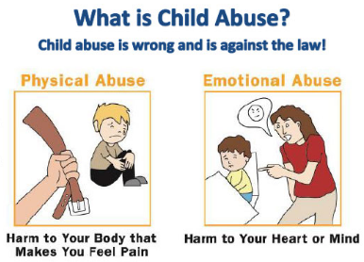
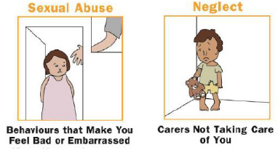
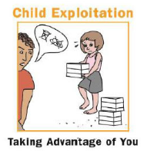

Slide 3


Who is the Designated Safeguarding Lead?
Mr Cooil is the Designated Safeguarding Lead and he has overall responsibility for safeguarding at Botley School. His contact email is j.cooil@Botley.hants.sch.uk
The Deputy Safeguarding Leads are Miss Sambles, Mrs Grist, Mrs Westlake and Mrs Shuttle. They have responsibility for safeguarding in Mr Cooil’s absence.
The Designated Safeguarding Lead and the Deputies have training every other year to make sure they are up to date.
Our safeguarding Governor is Mrs Abigail Kolstoe. She helps the Governors to monitor how the Designated Safeguarding Lead is promoting safeguarding in the school.

Slide 4

How are staff trained about safeguarding?
All staff have training every year on safeguarding, making sure they understand the signs of abuse and how to keep children safe, with ongoing training throughout the year.
Every member of staff reads an important document for schools called Keeping Children Safe in Education.
Mr Cooil regularly quizzes the staff to make sure that they have remembered and understood their training!
All staff regularly receive training on Prevent. Prevent is the duty that all schools have to prevent children from being radicalised.
Appropriate members of staff receive First Aid Training.
Appropriate staff receive Fire Safety Training and all staff take part in regular fire drills.

Slide 5

How do our children learn about safeguarding?
We have a strong PSHE curriculum where children have lessons about welfare and personal safety.
As part of PSHE, we teach Relationship and Sex Education in line with the Government’s guidance.
We teach e-safety as part of the Computing curriculum.
Our children take part in special events such as Road Safety Week and Safer Internet Day.
We talk about risks and how to manage them in subjects such as DT and Science, especially if the children are using special equipment.
We have regular worships where we talk about keeping safe.
We work with the NSPCC and each year have workshops with them as part of the Speak Out, Stay Safe program.
We read stories which encourage children to celebrate difference and diversity, so that they feel confident to speak out if they encounter prejudice or radicalisation.

Slide 6

What about Health and Safety?
Regular Fire Practices take place.
We have risk assessments in place for all key activities and these can be found in the school office.
Our Health and Safety Governor monitors all our policies and practice.
We teach the children how to keep themselves safe, for example teaching them how to use PE equipment safely before they use it.
Individual pupils who have additional needs have plans for extra support they need.

Slide 7

What about First Aid?
Trained staff administer First Aid.
Information about individual pupils with medical needs is shared with staff so that they can help them in the best way.
All First Aids are recorded thoroughly.
We have conversations with parents if their child has needed First Aid and if a child has bumped their head, we also put a sticker on them so parents can see.
All staff know the children very well and can spot changes which might suggest they are unwell
We have a very thorough First Aid Policy which we have put on our website.

Slide 8

How are children kept safe during off-site visits and with visitors to the school?
All visitors to the school, including volunteers, are required to complete a DBS check before starting.
All new staff and volunteers have a thorough induction, including aspects of safeguarding and health and safety.
We share school protocols for trips with all adults before going.
Before a trip or before a visitor, we complete thorough risk assessments and pre-visits.
Medical information is shared with all relevant adults before trips and medicines are taken on trips and carefully controlled.
Transport is arranged, risk assessed and managed carefully by staff.

Slide 9

How is attendance monitored?
We monitor attendance carefully, including incidents of late arrival at school.
We have regular conversations with parents where attendance and time keeping is becoming a concern.
Parents receive letters from the school if their child’s absence remains a concern.
Parents are offered support with attendance if this is appropriate, including support from our Pastoral Support Worker.
If necessary, parents can be signposted towards support from other outside agencies, such as Banardos or the Family Support Service.

Slide 10

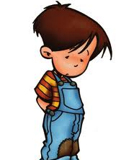
How do we promote an anti-bullying message to our children?
How do we aim to prevent bullying at Botley?
We discuss, reward and celebrate our school Heart Value of Respect.
Each class agrees on their own set of class rules.
We recognise national anti-bullying week each year.
We raise awareness through assemblies, work in PSHE lessons and circle time discussions.
In PSHE we use drama and role-play activities to help children be more assertive and teach them strategies to help them deal with bullying situations.
We teach the children about positive friendships
We have introduced playground improvements and initiatives, e.g. Playground Pals.
We have a ‘Worry Monster’ in each class where children can write down any concerns they have.
We use praise and rewards to reinforce respectful behaviour.
We facilitate multi agency work – working with social services, police etc.
We work with our lunchtime staff to ensure that they support children in making and sustaining positive friendships.
We record any incidents of bullying, making sure that we have the capacity to observe any patterns of concerning behaviour.
We put in clear sanctions for any unacceptable behaviour.
Bullying is not ……….
It is important to understand that bullying is not a period of falling out with friends, name calling, arguments or when the occasional trick or joke is played on someone. Children sometimes fall out and say things because they are upset. When occasional problems of this kind arise, although unkind, it is not classed as bullying. It is an important part of children’s development to learn how to deal with friendship breakdowns or an unwanted comment.
What is bullying?
Bullying is when an individual or group deliberately hurts another or makes them feel unhappy. Bullying behaviour will be repeated over a period of time and is difficult for the victim to defend against. Bullying may also be racist, sexist, or homophobic. People can be bullied for any reason; because of the way they look, because of their religion, their age or because of a learning or physical difference, for example.
We use the acronym STOP to define bullying:
Several
Times
On
Purpose

Slide 11
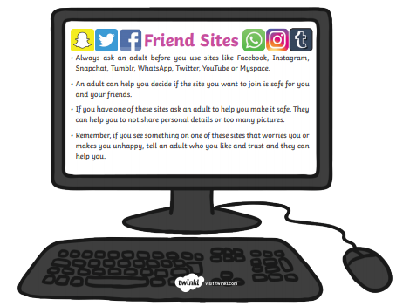
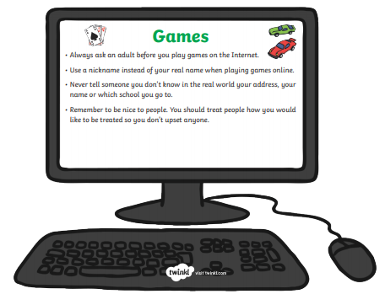
What do we teach children about online safety?
Even if you cannot see someone, things you write and send to others can still upset them.

Slide 12

What do we do in school if we have a safeguarding concern?
We know our children very well, so the first thing we do is look carefully for any changes in children’s behaviour, appearance, friendships or learning behaviours.
We write down exactly what we notice or what a child has said to us on C-POMs, which is our secure in-school system.
If appropriate, we talk to parents about our concerns.
We continue to monitor the child to see if there are any more concerns.
If we have a serious concern, we might ask Children’s Services or the police for more support.

Slide 13

What can you do if you have a concern?
If you feel that your or your child are in danger, you must call the police.
You can come and talk to Mr Cooil or one of the Deputy DSLs.
You can speak to our Pastoral Support Worker, Kerri Ward, who can signpost you to organisations who may be able to help.
There are other safeguarding agencies which can offer help and advice including:
The freephone, 24-hour National Domestic Abuse Helpline 0808 2000 247
Solent Mind Tel: 023 8202 7810
Young Minds free parents' helpine on 0808 802 5544
Banardos 0800 157 7015
Hampshire Specialist CAMHS: 0300 304 0050

Slide 14

Useful websites
NSPCC - www.nspcc.org.uk/keeping-children-safe/support-for-parents/pants-underwear-rule/
CAMHS - https://hampshirecamhs.nhs.uk/
Banardos – www.banardos.org.uk
Solent Mind – www.solentmind.org.uk
Young Minds – www.youngminds.org.uk
Domestic Abuse - www.nationaldahelpline.org.uk
ChildLine – www.childline.org.uk
Family Action – www.family-action.org.uk
Relate – www.relate.org.uk/family-support
E-safety - www.childnet.com
Change Grow Live Southampton - www.changegrowlive.org/drug-alcohol-service-southampton/info

