Slide 1
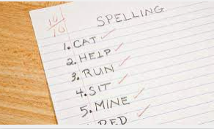

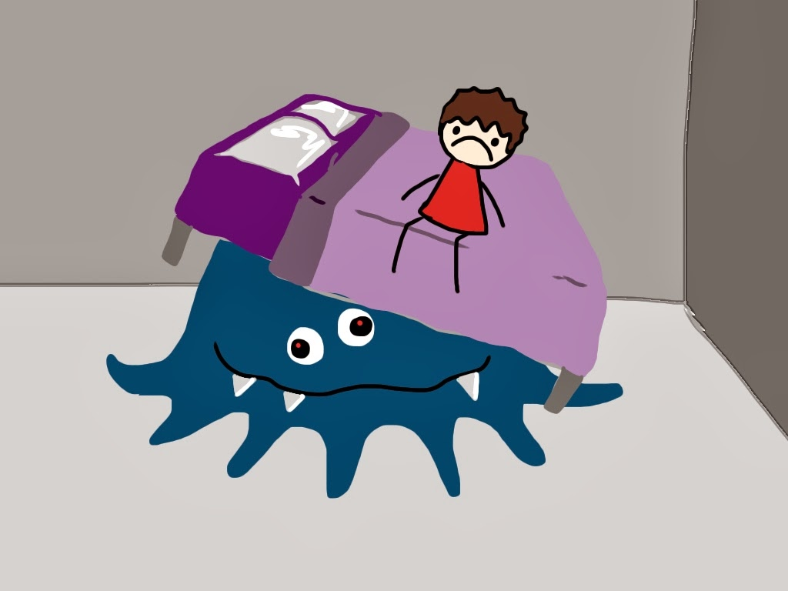
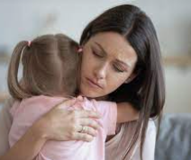

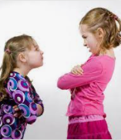
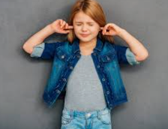

What do you worry about?

Slide 2

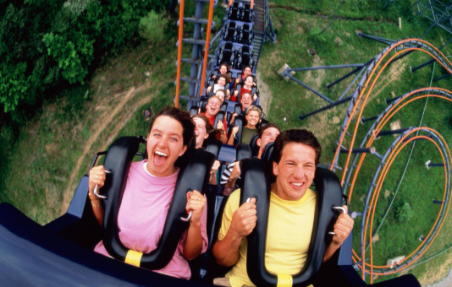
Why do we worry?
We need a little bit of worry. It helps us to act in the right way when things are dangerous.
Worry is not always a bad thing. We can worry about something which is also fun – think about rollercoasters!
If we never worried, we probably wouldn’t be doing anything new or exciting.
All feelings are okay – we must not worry about being worried.
If we worry about something and then manage it well, we feel great about ourselves!

Slide 3
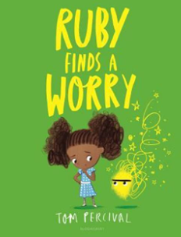
https://www.youtube.com/watch?v=lIS9Ang7cNg

Slide 4
How can we help you in school if you have a worry?
Talk to a grown up that you trust.
Tell a friend.
Message your teacher on Seesaw.
Use the worry monster in your classroom.
Use the wellbeing jar in your classroom.

Slide 5
Our Prayer
Dear God,
Thank you that you love every single one of us more than we can ever know. When we are feeling alone or when we think we’re not being noticed, help us remember that you are always watching over us.
Amen

