Slide 1
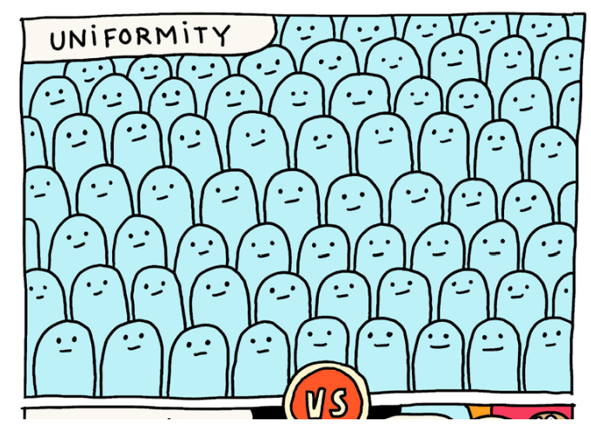
What do you think of this picture? What do you notice?

Slide 2
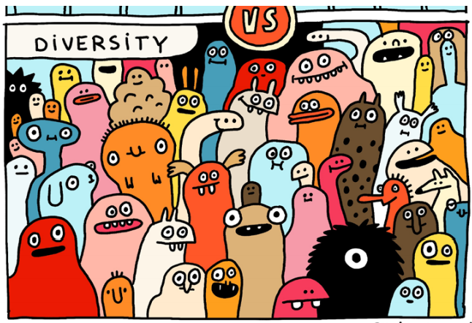
What do you think of this picture?
What do you notice?

Slide 3
Although you all wear a uniform, you are all different and that is what makes you special, and it’s what makes our school so amazing. We all have things that are the same and things that are different as well.
I love Maths!
Maths is the best lesson ever!
I love
cheese …….
Cheese is the best food ever…

Slide 4

So let’s be kind to each other and celebrate what makes us different and the same.

Slide 5
It’s okay to be different to the people around us.
We might look different, like different things, learn differently or think differently.
That’s okay – we all have a right to be our own person.
We just need to make sure that we do that respectfully and make sure we are still kind to others.

Slide 6
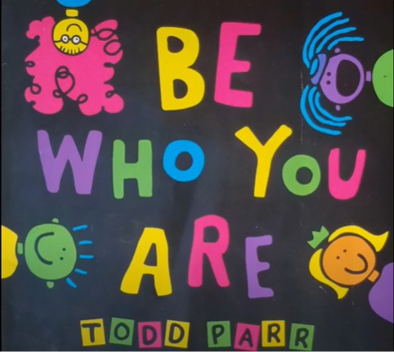

Slide 7
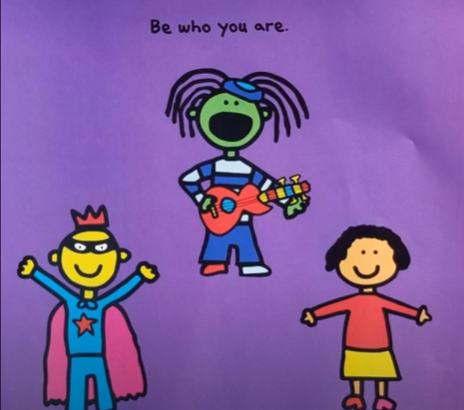

Slide 8
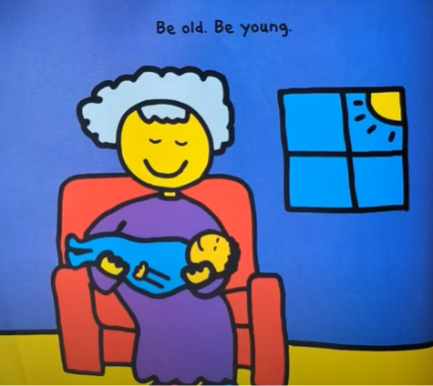

Slide 9
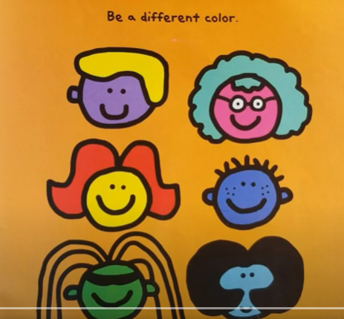

Slide 10
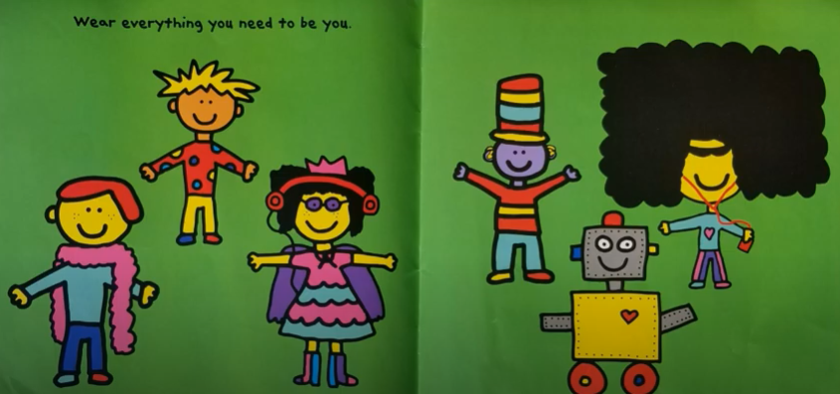

Slide 11
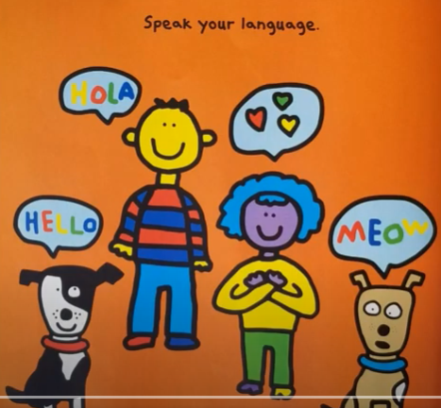

Slide 12
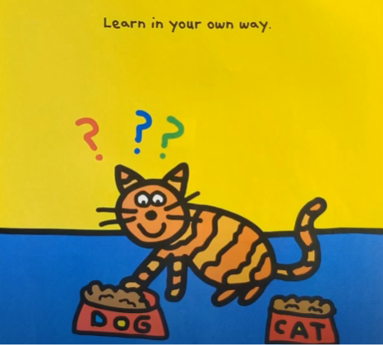

Slide 13
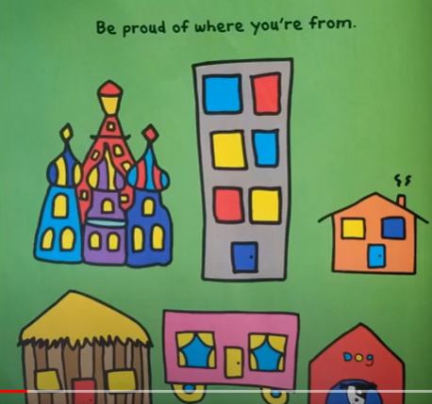

Slide 14
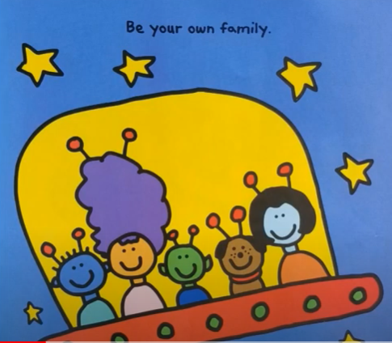

Slide 15
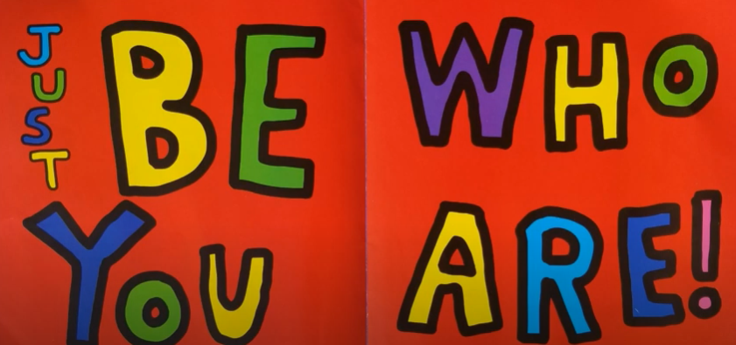

Slide 16
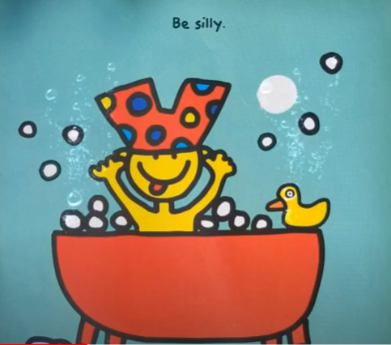

Slide 17
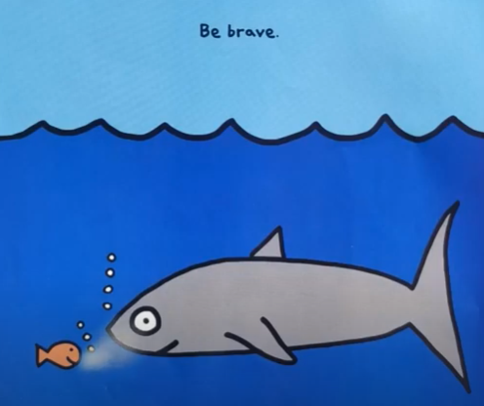

Slide 18
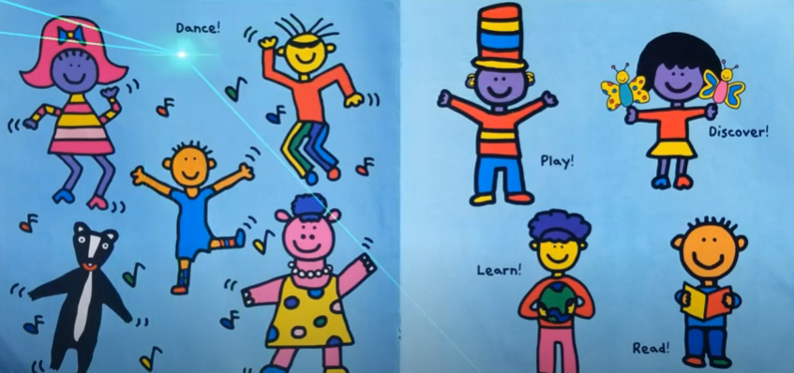

Slide 19
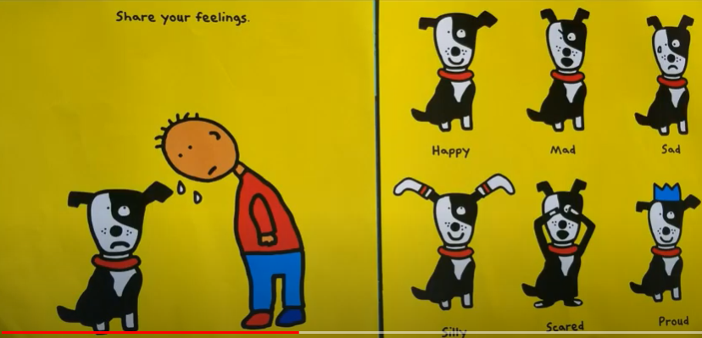

Slide 20
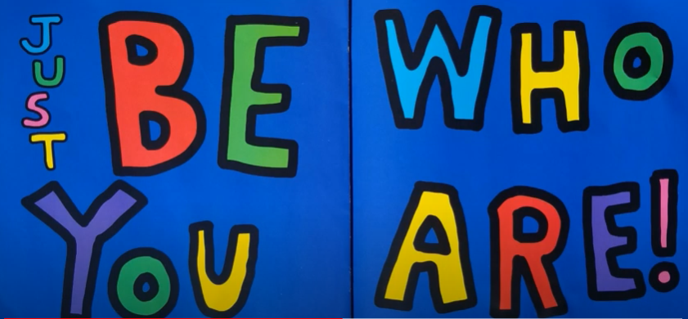

Slide 21
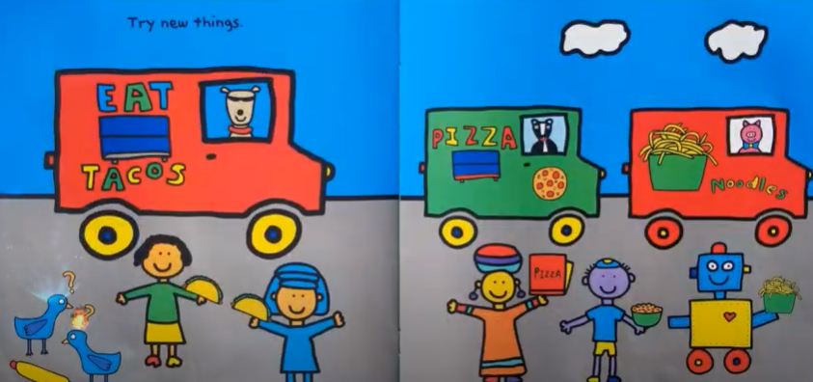

Slide 22
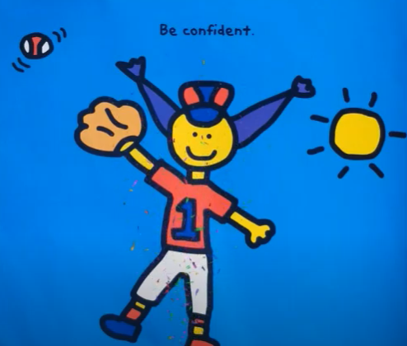

Slide 23
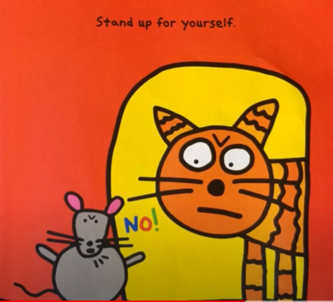

Slide 24
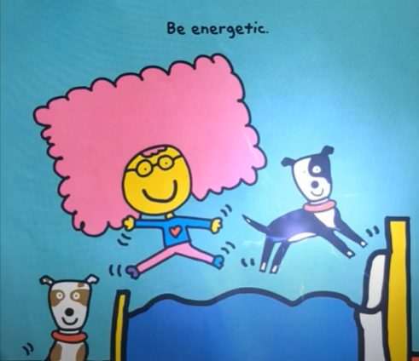

Slide 25
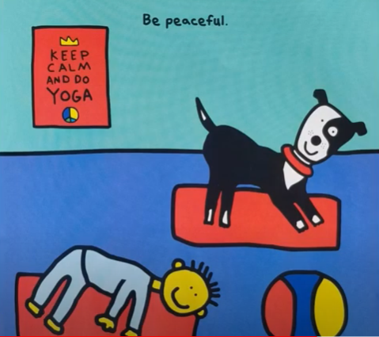

Slide 26
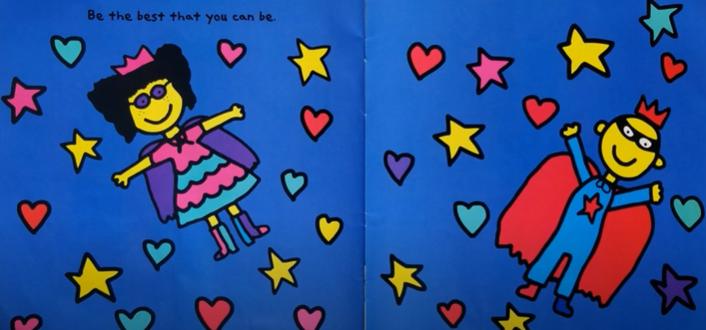

Slide 27
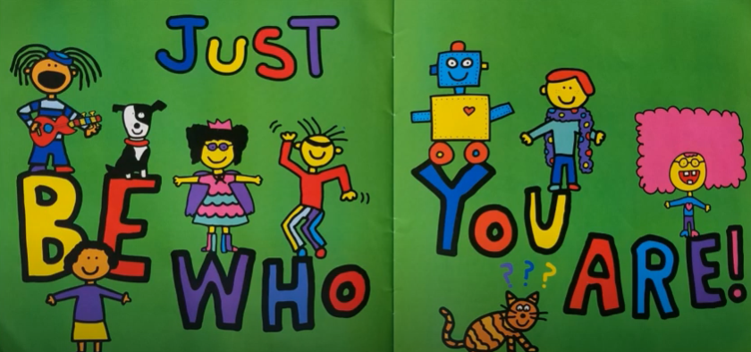

Slide 28
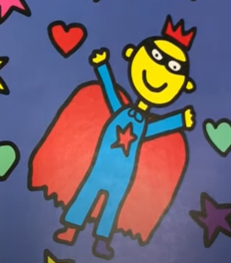
We want you all to be who you are – because you are amazing!
You have the right to be who you are, special and unique.
Remember – you need to do that in a respectful way.

Slide 29
Which way is better?
You ask a friend to play and they say ‘No, I’m going to play football instead, but thanks for asking.’
You ask a friend to play and they shout ‘no’ as they run over to the football pitch.
Which way is better?
You want a quiet playtime. Your friends all want to play basketball and tell you that you have to join in or you are not their friend.
You want a quiet playtime. Your friends all want to play basketball. They leave you but check in with you every now and then to make sure you are okay.
Which way is better?
You are working in a group with your friends. They all want to do a role play to show what you have learned but you don’t want to because you feel embarrassed. You make them all do a poster instead, because that’s what you want to do.
You are working in a group with your friends. They all want to do a role play to show what you have learned because you feel embarrassed. You ask if you can be a ‘director’ and advise them, but you ask not to do the acting because you don’t like doing that.

Slide 30
Dear God,
We celebrate the ways in which we are different.
Thank you that you have made each of us a one-off, and that you love us.
Help us to value and celebrate the uniqueness of others.
Help us to be comfortable with difference and to remember that deep down, we are all the same on the inside and are all created in your image.
Help us to be tolerant, understanding and accepting.
Amen.

